Slide 1
The international test and evaluation association
WELCOME!

Slide 2
Topics
Who is ITEA?
The ITEA Vision & Mission
Why join ITEA?
Organizational Values
Strategic Goals
Governance (Board/Committees/Chapters)
Membership
Professional Certification
Awards Program
Key Activities
Upcoming events

Slide 3
Who is ITEA?
Established in 1980 – proudly serving the T&E community of professionals over 30 years
Incorporated in the District of Columbia
Not-for-profit 501(c)3 educational association
Primary purpose to further education and science in the field of T&E
May not attempt to influence legislation as a substantial part of its activities and it may not participate in any campaign activity for or against political candidates participating in or contributing to political

Slide 4
The ITEA Vision & Mission
Our Vision
To be the premier global association for test and evaluation
professionals, organizations, and related communities.
ITEA's Vision defines what the Association desires to create and/or to become in the long-term. It provides a long-term focus for the Association, its programs and services, and its resource allocations. It is the image of the future we seek to create.
Our Mission
To advance test and evaluation globally by providing professional development resources, best practices, networking, and learning opportunities for the test and evaluation community.
ITEA's Mission defines the Association's scope, direction, and emphasis as the Vision is pursued. The Mission is a positioning statement for members, potential members, and related organizations in the short-term. It represents our purpose, reason for being, who we are and what we do.

Slide 5
2020 ITEA strategic Plan Strategic goals
Provide professional development opportunities that help T&E professionals acquire and demonstrate that they have the knowledge, skills, and abilities necessary to excel.
Broaden and diversify participation.
Clarify ITEA’s image and better communicate benefits of participation.
Strengthen ITEA Chapters and Volunteer leadership.
Improve the quality and relevance of educational courses.
Increase opportunities for information exchange and networking through association events, publications, social media, and other avenues.
Increase opportunities to recognize accomplishments of T&E professionals.
Improve the financial performance of the Association.

Slide 6
GET CONNECTED...with ITEA!
To LEARN
To SHARE
To ADVANCE

Slide 7
GET CONNECTED...with ITEA!
GET CONNECTED... to LEARN
Your KNOWLEDGE Connection for:
Personal Growth
Professional Development
Career Advancement

Slide 8
GET CONNECTED...with ITEA!
GET CONNECTED... to SHARE
Your NETWORKING Connection for:
Building Relationships
Acquiring Experience & Knowledge from Others
Exchanging Lessons Learned

Slide 9
GET CONNECTED...with ITEA!
GET CONNECTED... to ADVANCE
Your CAREER Connection for:
Promoting YOUR Profession
Demonstrating YOUR Commitment to Excellence
Investing in OUR Future Workforce

Slide 10
ITEA Values
Professionalism
Volunteerism
Service-Oriented Organization
Open Communications
Balanced Focus on Individual and Corporate Members

Slide 11
Governance
19 Chapters / 1,500 Active Members/90 Corporate Members

Slide 12
2016 ITEA board of directors
Board Officers (1 year terms)
President Vice President
Mr. William “Bill” Keegan Mr. Peter G. Crump
Secretary Treasurer
Wilson N. Felder, PhD Eileen Bjorkman, PhD
Elected Directors (3-year terms)
Mark Brown, PhD Mr. Peter Nikoloff
Mr. Bruce Einfalt Mr. Brian Moore
Mr. Ed Greer Mr. John Schab
Mr. Brian Moore
Executive Director (ex officio)
Mr. James Gaidry, CAE

Slide 13
Itea committee chairs
Awards
Ms. Stephanie Clewer
Chapter & Individual Membership
Mr. Jim Myers
Communications
Mr. Erwin Sabile
Corporate Development
Ms. Kathi Swagerty
Elections
Mr. Matt Reynolds
Events
Ms. Doug Messer
History
Mr. James Welshans
Professional Development
Mr. Pete Christensen
Publications
Steven “Flash” Gordon, Ph.D.
Rules and Bylaws
Mr. Bill Keegan
Senior Advisory Board
Mr. Gene Hudgins
Strategic Planning
Mr. Pete Crump
Technology
Mr. Henry Merhoff, CTEP
Ways and Means
Mr. John Schab

Slide 14
ITEA regional vice presidents
Northeast Region
Open
Mid-Atlantic Region
Ms. Jeanine McDonnell-Zubowski
Southeast Region
Mr. Miles Thompson
Southwest Region
Mr. Dave Webb
West Region
Mr. Terry McKearney
International Region
Mr. Peter Nikoloff

Slide 15
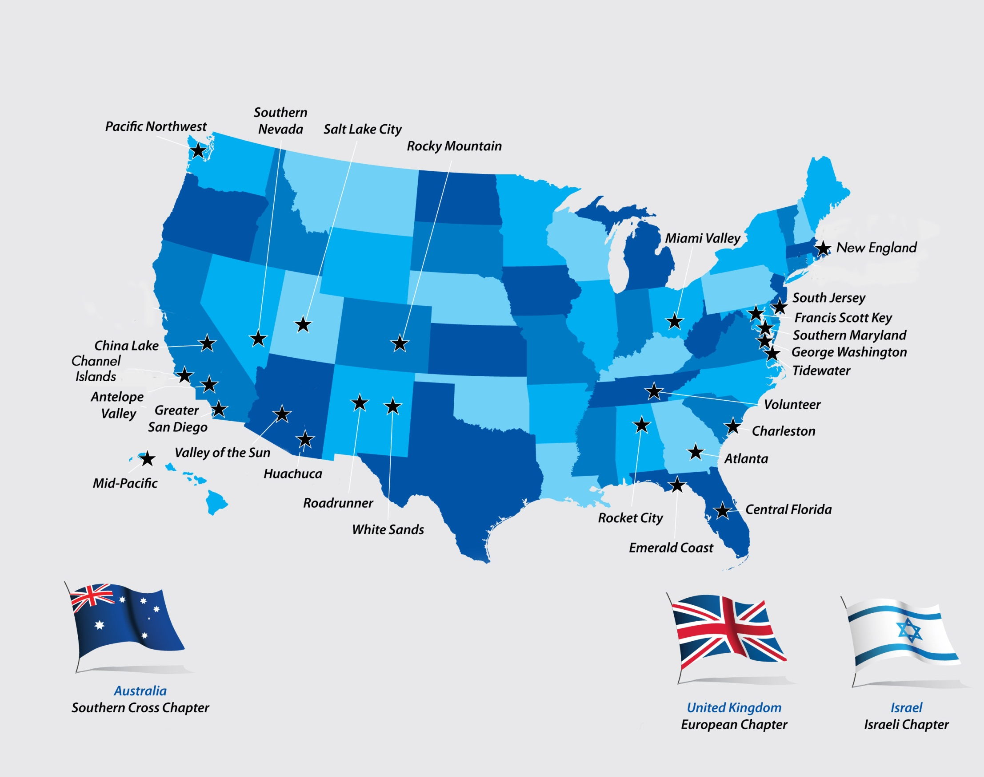
ITEA Chapters
Penn State
Northeast Region
West
Region
Mid-Atlantic
Region
Southwest Region
Southeast Region
International Region

Slide 16
ITEA Chapters
26 chapters located in continental US, Hawaii, Australia, Israel, and Europe
Basic unit of ITEA – typically centered around local commands
Carry out projects and programs supporting ITEA goals
Frequently identify areas of interest for the Association’s educational events and host or sponsor most ITEA educational events
Support ITEA’s mission to enhance educational opportunities for students and young professionals by administering the scholarship distributions
Provide entry-level leadership opportunities
Conduct regular meetings to meet the needs of their members
Participate in ITEA’s awards program
Nominate candidates for election to the ITEA Board of Directors

Slide 17
ITEA Members
Open to all individuals and organizations interested in promoting the objectives of Test and Evaluation.
1,000 individual members from:
Government
Industry
Academia
Non-profit organizations
80 Corporate members from:
T&E related service industry
OEMs
Contractors
Consultants
T&E peripheral work

Slide 18
Corporate Membership
Includes individual memberships
Eligible to send employees to ITEA events at reduced rates
May submit news articles for the “Corporate News” section of the ITEA Journal
Reduced rates for Journal advertising and exhibits at ITEA events
Receive a library subscription to The ITEA Journal of Test and Evaluation
Included annually in the Journal’s corporate membership directory; includes services and capabilities

Slide 19
Thank you to our corporate members!
Acquired Data Solutions, Inc.
Advanced Systems Development, Inc.
Advanced Test Equipment Rentals
AEgis Technologies Group, Inc.
Aermor LLC
Agency of Defense Development Technical Library
Air Academy Associates
AMERICAN SYSTEMS
Analytical Graphics, Inc.
Apogee Labs, Inc.
Applied Research Laboratory/PSU
Arcata Associates, Inc
AssetSmart
Astro Haven Enterprises
Australian Defence Force Tactical Data Link Authority
BAE Systems (Australia)
BEI Precision Systems & Space Company
Black Diamond Consulting Corporation
Brazilian Aeronautical Commission, D.C.

Slide 20
Thank you to our corporate members!
CALCULEX, Inc.
Capability Analysis & Measurement Org. LLC
Cervello Technologies, LLC
Command Post Technologies
Defense Acquisition University
Dell EMC Corporation
DEWESoft, LLC
Dynetics, Inc.
Engility Corporation
Engineering Research and Consulting, Inc.
EWA Government Systems, Inc.
Galleon Embedded Computing
Garud Technology Services, Inc.
GDP Space Systems
Geil Marketing Associates (GMA)
General Dynamics Mission Systems
Georgia Tech Research Institute
InDyne, Inc
Jacobs Technology, Inc.
Joint Research and Development, Incorporated
JT3 LLC
Kaman Precision Products

Slide 21
Thank you to our corporate members!
KBRWyle
Kistler Instrument Corp.
MacAulay-Brown, Inc.
Maritime Test and Evaluation Authority
MEI Technologies, Inc.
Modern Technology Solutions, Inc. (MTSI)
National Chung Shan Institute of Science and Technology - NCSIST
NetAcquire Corporation
New Zealand Defence Force
NOVA Systems
PAE
Photo-Sonics, Inc.
Quintron Systems Inc.
Rockwell Collins
Rolls-Royce plc
Rotating Precision Mechanisms, Inc.
RoundTable Defense, LLC
Schafer Corporation
Scientech Inc.
Scientific Research Corporation
Sealing Technologies Inc
Smartronix Inc.

Slide 22
Thank you to our corporate members!
SURVICE Engineering Company
SYMVIONICS Inc.
System Testing Excellence Program
Systems Application & Technologies (SA-Tech)
Systems Engineering & Management Company
Teletronics Technology Corp
Telspan Data
The Boeing Company
The MIL Corporation
THE SENTE GROUP, INC.
TRAX International
Trident Research
TRIDEUM Corporation
Westech International, Inc.
Wideband Systems, Inc.
WJ Hughes FAA Technical Center
Zodiac Data Systems

Slide 23
RELATED COMMUNITIES OF INTEREST
T&E
Infrastructure/
Architecture
Modeling &
Simulation
Systems
Engineering
Test and Training
(Facilities/Instrumentation)
Joint
Experimentation
(MC02)
Software
Information
Assurance
(new/legacy)
Transportation
Systems
Research and
Development
Aeronautics and
Space Systems

Slide 24
ITEA Key Activities
Scholarship Program
Workshops / Conferences
Over $2,000,000 in scholarships awarded
Chapter managed
ITEA administered
4-6 per year - Many hosted by Chapters
Annual International Symposium
Conferences with industry partners
The ITEA Journal of
Test and Evaluation
Short Courses
Available throughout year
Tailored to customer
Topical areas (e.g. IA, Spectrum, KPP, etc.)
Premier publication of the T&E industry
Published quarterly
Articles by members and other industry leaders

Slide 25
The Itea journal of test and evaluation
T&E articles of general interest to ITEA members and The ITEA Journal of Test and Evaluation readers are always welcome. Each Issue includes specialty features:
“Featured Capability” describes unique, innovative capabilities and demonstrates how they support T&E
“Historical Perspectives” recall how T&E was performed in the past, or a significant test or achievement, often based on personal participation in the “old days” of T&E
“TechNotes” discusses innovative technology that has potential payoff in T&E applications or could have an impact on how T&E is conducted in the future

Slide 26
The Itea journal of test and evaluation
Interested authors should submit contributions to the ITEA Publications Committee Chairman (journal@itea.org, attn.: Steve “Flash” Gordon, Ph.D.).
Detailed Manuscript Guidelines can be found at www.itea.org under the “ITEA Publications” tab.

Slide 27
Awards Program
ITEA Awards Provide Recognition of Achievement in T&E
Matthews Award
Board of Directors’ Award
President’s Award
Publications Award
Cross Award
Special Achievement Award
Junior Achiever Award
Chapter of the Year Awards
Energizer Volunteer Award
Nominations are always welcomed and encouraged!

Slide 28
professional development
Education Workshops
International Test and Evaluation Symposium
Education Courses
Education On-Demand Webinars
Certified Test and Evaluation Professional (CTEP) Credential

Slide 29
professional development
Education Workshops and International Symposium
Systems-of-Systems Workshop (January)
Cyber Security Workshop (March)
Test Instrumentation Workshop (May)
Test Technology Review (September)
Annual International Symposium (December)

Slide 30
professional development
Short Courses (3 – 5 days)
Android Forensics and Security Testing
Cybersecurity and Information Assurance
Fundamentals of T&E Processes
Scientific Test and Analysis Techniques (STAT), a.k.a. Operational DOE
What T&E’rs Need to Know about Program Management and Systems Engineering and Why
Education On-Demand Webinars
Tutorials (4 and 8-hour sessions presented the dsy prior to an ITEA Workshops and Symposium)

Slide 31
Certified test and evaluation professional (ctep) credential
ITEA begin offering in 2013 a professional certification credential that provides significant benefits to T&E professionals, organizations, and their customers.
Over 500 T&E subject-matter experts (SMEs) have been involved in the development of this credential.
These SMEs—T&E executives, managers, supervisors, individual contributors, and technicians—have come from a diverse cross-section of the T&E profession, representing industry, government, academia, laboratories, ranges, weapon systems, information technology, transportation, electronic communications, consumer electronics, and more.

Slide 32
Purpose of the ctep credential
Recognize individuals who demonstrate:
KNOWLEDGE, SKILLS, AND ABILITIES: They meet the minimum level of competency in the requisite KSAs that have been identified by T&E subject-matter experts (SMEs).
COMMITMENT to maintain currency in the field.
DEDICATION to advancing the profession.
Develop and promote common standards, principles, procedures, processes, and terms for the T&E profession.
Support professional development and education to enhance the KSAs of T&E professionals.

Slide 33
Ctep credential development
Job/Task Analysis (JTA)
Identifies the job tasks (work duties, responsibilities, and functions) that is performed across the broad spectrum of most T&E professionals most of the time and their relative importance, difficulty, and frequency.
Body of Knowledge (BOK)
Identifies the primary knowledge, skills, and abilities (KSAs) that would be required to competently perform the job tasks identified in the JTA.
Table of Specifications (aka “Exam Blueprint”)
Developed based on the BOK and reviewed periodically to assure an accurate reflection of KSAs required for continued proficiency in the T&E career field.
Certification Examination
A 200 question, 4-hour exam created from a Data Bank of questions that represents a valid, reliable, legally defensible, and fair measure of professional competence in the job performance areas of the “Exam Blueprint.”

Slide 34
Ctep candidate requirements
The CTEP requires a candidate to have:
A baccalaureate degree from an accredited college or university, preferably with a major in engineering or a related technical field, AND a minimum of three (3) years of relevant work experience, OR,
An associate degree from an accredited college or university, preferably in a technical field, AND a minimum of five (5) years of relevant work experience, OR,
A minimum of ten (10) years of relevant work experience.
NOTE: Eligibility to take the certification exam is independent of any course of study, curriculum, or test book.

Slide 35
Ctep credential requirements
The following documentation must be submitted along with the CTEP application to assist in the determination of a candidate’s eligibility to sit for the CTEP examination:
Two (2) qualified references that can attest to your work in the test and evaluation field.
An official college transcript is required for all applicants with less than 10 years of relevant T&E experience, and must be on file at the ITEA Executive Office before you can register for an examination.
A signed copy of the Test and Evaluation Professional Code of Ethics.

Slide 36
ITEA Headquarters
International Test and Evaluation Association
4400 Fair Lakes Court, Suite 104
Fairfax, VA 22033-3891
Phone: (703) 631-6220
Fax: (703) 631-6221
Email: itea@itea.org
Web: www.itea.org

Slide 37
Distinguish Yourself…
Submit an article for the ITEA Journal
Answer a “Call for Papers”
Make a Presentation
Volunteer for an ITEA Committee
Serve at your local Chapter
Submit an Awards Nomination

Slide 38
GET CONNECTED...with ITEA!
To LEARN - Your KNOWLEDGE Connection for:
Personal Growth
Professional Development
Career Advancement
To SHARE - Your NETWORKING Connection for:
Building Relationships
Acquiring Experience & Knowledge from Others
Exchanging Lessons Learned
To ADVANCE - Your CAREER Connection for:
Promoting YOUR Profession
Demonstrating YOUR Commitment to Excellence
Investing in OUR Future Workforce

