Slide 1
Digital Twins and Digital Threads in Defence through the lens of T&E
Christophe Harvey
Publication Number: QINETIQ/20/03071
16 September 2020

Slide 2
Introduction
The pace of innovation is an increasingly dominant factor in deterring aggression and winning battles, getting capability from the drawing board to the front line quickly and cost-effectively is now recognised as being fundamental to modern warfare. This urgency will only convert to success if the capability delivered is proven to be safe, reliable and effective.
As the majority of faults or errors are introduced into a system during its requirements and design stage, capturing and rectifying them early is key to reducing cost and time for defence programmes. This is complicated further by the increased depth of integration of sub-systems from multiple suppliers within modern military platforms. Modernising and digitally enabling T&E to be aligned with the increasing adoption of digital engineering and underpinning the evolution of the platform digital twin will be critical.
This presentation will describe how
the use of a federated (co-simulation) approach to system modelling and simulation can be used to provide an early life cycle T&E digital range that could be applied in the concept and design phase to accelerate collaborative development programmes
the data generated initiates the population of the evaluation digital thread which provides the through life single source of truth.

Slide 3
Why do we do T&E?
Single source of truth for T&E – the Evaluation Digital Thread
Exploitation of information/data for certification and assurance through life. Proved reference data and drives T&E activities
Notes:
Purpose of T&E is to generate robust evidence for T&E is done for performance, safety, off contract acceptance
There is testing to get the evidence, then evaluation to make a decision
Different elements and aspects to T&E through life from concept to in-service often considered as a set of discrete activities, often in isolation of each other – start with test beds, finish on DEP

Slide 4
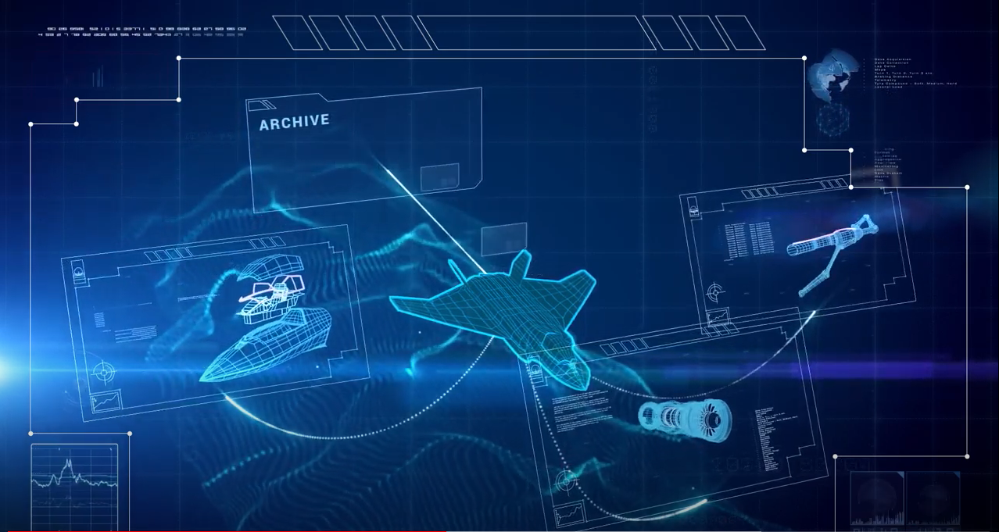
A Changing Landscape
Modern defence systems are becoming ever more deeply integrated suites of systems and sub-systems to deliver a capability
Developed collaboratively across supply base
Rapidly changing threat landscape
Reduction in the time period from concept to in-service
Subject to budgetary challenges
Model Based Systems Engineering and Model Based Engineering (MBSE/MBE) techniques developed in the non-defence world are being increasingly being adopted in the defence arena
Progressive evolution of system models towards the platform or capability digital twin will be an essential part of future programme planning

Slide 5
Removing stovepipes and enriching the Through-Life Evaluation Digital Thread
Evolving sub-system reference models
Evolving sub-system reference models
Evolving Platform and capability reference model/digital twin
Evolving Platform and capability reference model/digital twin
Progressively blended live/synthetic Test & Evaluation
Live Test and Evaluation
Evolving evaluation evidence (evaluation digital thread)
Evolving evaluation evidence (evaluation digital thread)
Earlier through-life decisions
Through Life decisions
Notes:
As sub-system and system reference models evolve, typically in isolation of the rest of the system components. Interactions are more transactional at defined points
Evidence capture starts to blend later in the platform life rather than remain in their own individual “tracks” as is the current state
Move to a future where those same models evolve in parallel where they are continually tested and checked against the other system models in a more flexible, “agile” manner that will enable…

Slide 6
Defence Digital Experimentation Platform (DDEP)
A federated (or co-simulation) environment that enables live digital interconnection and interaction between software and hardware engineering assets distributed across the supply base
Aids the de-risking of design, development and acceptance for platforms and equipment at a reduced cost and accelerated pace
Enables rapid experimentation using (sub)system models developed across the OEM partner base to explore concepts and trade-offs early in the life-cycle to inform design decisions prior to manufacture
Protects OEM and supplier intellectual property (IP)
Minimises the need for co-location during testing
Evidence generated forms part of a digital thread to be used throughout the system lifecycle to inform and aid accelerated certification and acceptance
Notes:
Something about discussion with UK defence organisations to inform, or does this follow from slide 5 so build the hook in there?
Make comment that initially thinking software models but in future should be transparent to user whether it is hardware of software representation

Slide 7
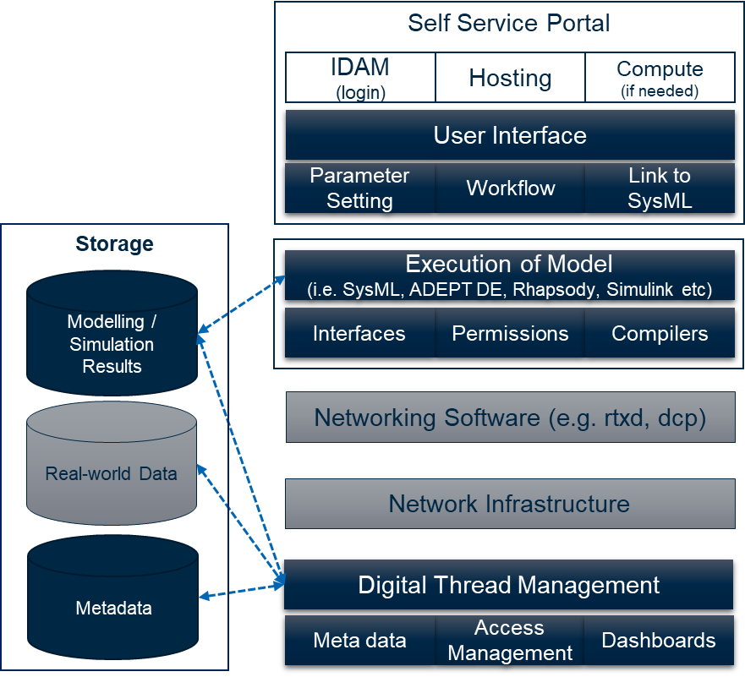
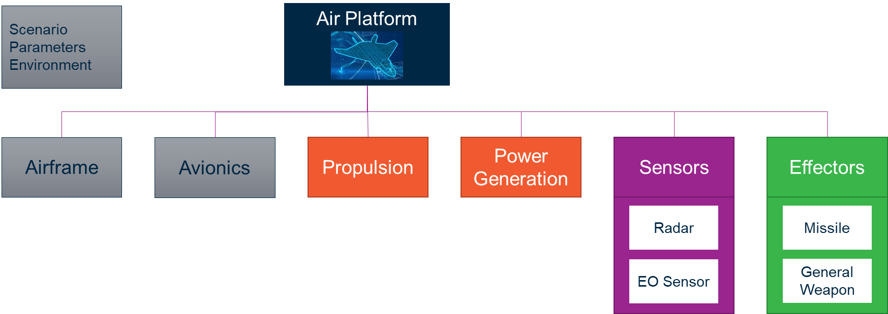
What does DDEP comprise?
Self-service Portal containing
User Interface
IDAM/Access control functionality
Links to high level system architecture (logical model)
Links to system and sub-system physical-based models
Distributed/Networked model execution software
Configuration management
Digital thread and data management
Network connecting the supply chain & partners
Developed a concept demonstrator to explore technical challenges
Phase 1:
Prove we can distribute and execute a simple system model over geographically dispersed compute capability
Integration of models without exposing IP
Phase 2:
Increase system complexity with a more representative system model, supporting artefacts etc.
Implement parameter setting, improved user workflow
Notes:
Embellishment of the points and brief discussion of the components in the diagram
Highlight that the different phases brought about new questions i.e. freely connect models (like in Simulink) vs. something more ordered and structured, supporting data aretfacts, where they might exist
Reinforce distributed nature & IP protection
Make link to SysML-like high-level architecture that acts as a simulation controller
As demonstrator become more complex, shows other artefacts, processes etc. that need to be considered

Slide 8
DDEP in action
Notes:
Basic narration over the main parts

Slide 9
What have we learnt?
By creating a demonstrator we are able to
Explore the collaborative design/engineering challenge across a range of different functions, organisations and programmes
Understand how collaborative design/engineering fits with current organisational governance and assurance processes
Technology challenges to deliver DDEP are “solvable” but complicated
Integration of a set of components to deliver the service
Data & model classification
Networks and secure connectivity between organisations
Culture-based issues and how it fits in with existing practice are much more challenging
Interaction with SysEng/MBSE/MBE tools and methodologies used across organisations working collaboratively
Management and access to IP in collaborative design programmes
Governance and assurance processes across organisations
What does it give you?
Federated digital twin of a platform that can be used for evaluating and making decisions against
Instantiation of digital thread & distributed/federated digital twin
Framework within which models can be updated independently with the higher-level system model integrity maintained
Notes:
Highlights what we need to think about and where to focus effort
Refined our language and helped show what was out there already
Technology elements are complex but solvable

Slide 10
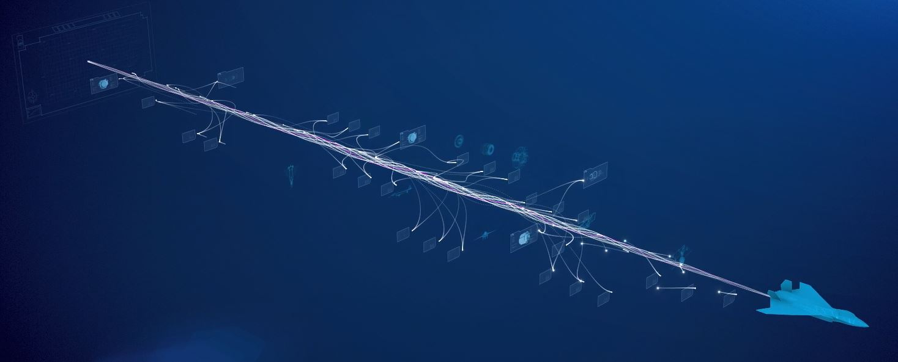
Evaluation Digital Thread
Instantiation of the Evaluation Digital thread early in a programme lifecycle starts to build the evidence chain for platform Certification and Through-life upgrades
An Evaluation Digital thread gives:
Holistic view of data/evidence relating to programme
Change balance of where evaluation evidence is generated between modelling and live
Reduce need for physical test
Reduction in programme duration
Richer collaboration between the customer, supplier and assurer having access to a single source of truth
All stakeholders bought in to the process
Progressively build and field capability
Notes:
Benefits
Holistic view of data/evidence relating to programme
Change balance of where evaluation evidence is generated between modelling and live
Reduce need for physical test – focus on what needs to be done, areas where confidence is low or no evidence available
Reduction in programme duration – not repeating things already done, re-use of existing data
Richer collaboration between the customer, supplier and assurer having access to a single source of truth
All stakeholders bought in to the process
Progressively build and field capability
S

Slide 11
Enabling the Change
Model/live T&E gap analysis
Progressive development & validation of models
Progressive alignment of live T&E capabilities
Cultural change – collaboration, management of IP
Commercial Practices
Skills development – model based certification
Toolset and standards
Progressive implementation of digital architecture to enable federated environment

