Slide 1
ITEA Presentation: Microservice Architecture Benefits to Test Systems
Robert E. Carpenter, PE, PMP
Lead Engineer
Training, Testing & Efficiency (T2E) Solutions
General Dynamics Mission Systems
Email: robert.e.carpenter@gd-ms.com

Slide 2
Agenda
The topic of todays discussion centers on delivery of software that operates the testing system. The Integrated Live-Virtual-Constructive Testing Environment (ILTE) will be the basis for discussion.
Topic Points:
Problem Space
History
Current Reality
Remote Access for Software Maintenance (LTE relationship)
Product Line Engineering (PLE), DevOps, DevSecOps
Microservice Architecture
©2020 General Dynamics. All rights reserved.

Slide 3
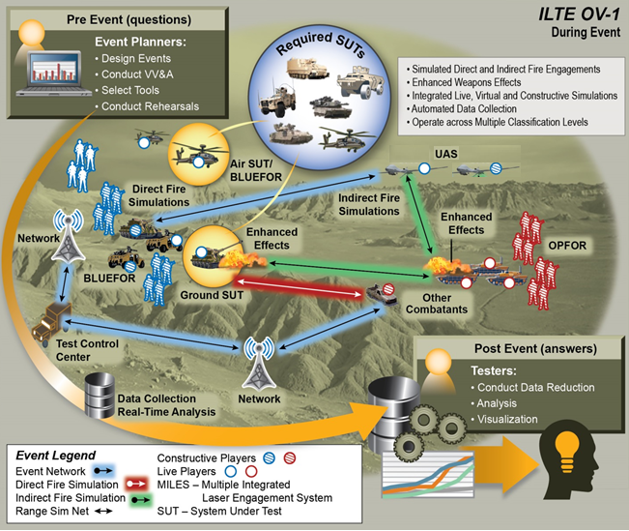
Problem Space: Test System Software
What drives the challenges for test system software distribution?
2
6
Test systems are constantly needed – cannot afford significant downtime.
Multiple complex LVC computer systems
Increasing Data needs
More
Faster
Interconnected
Evolving technology
Operational Testing in particular can be:
Remote
Distributed
crummy terrain
A challenge
1
7
8
3
4
5
Public Domain
File:DoD Electronic Commerce Concept of Operations (OV-1).jpg
©2020 General Dynamics. All rights reserved.

Slide 4
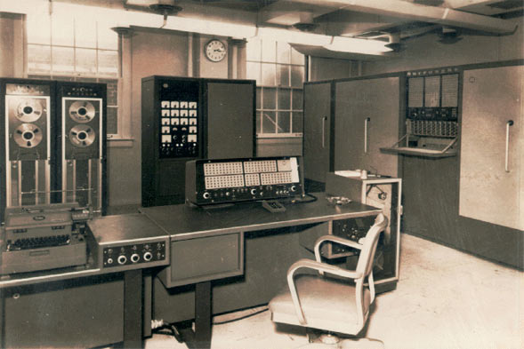
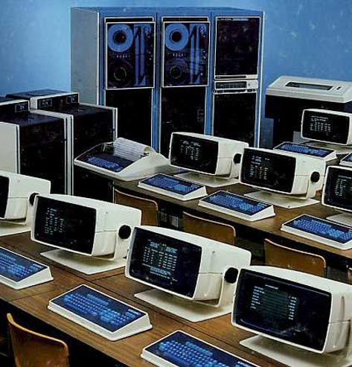
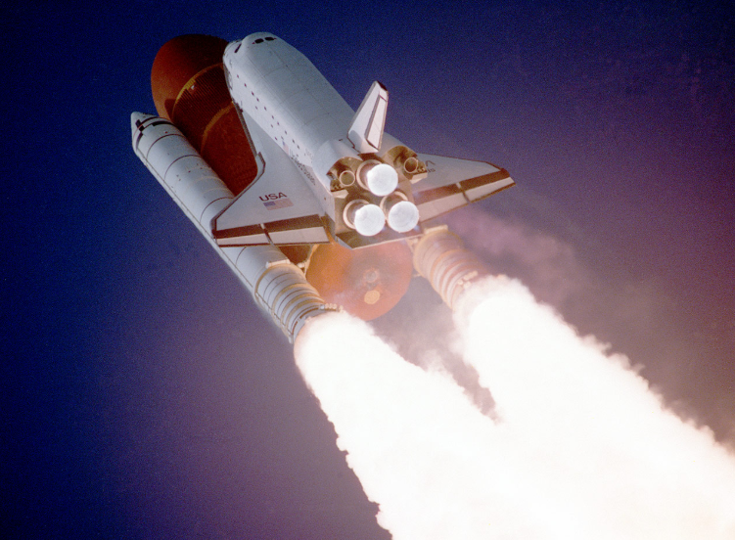
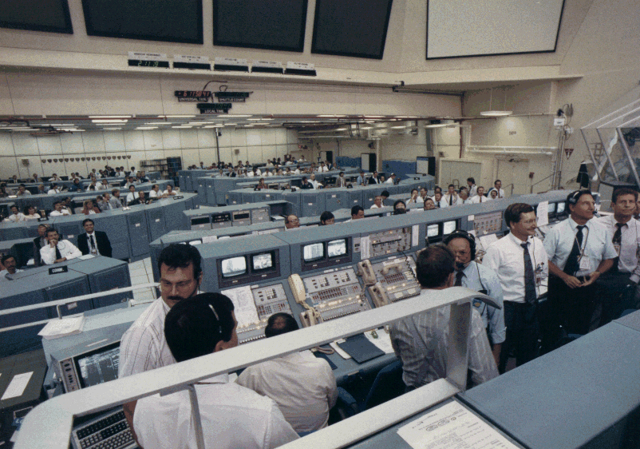
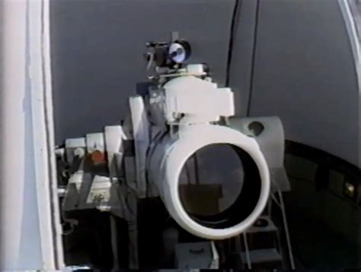
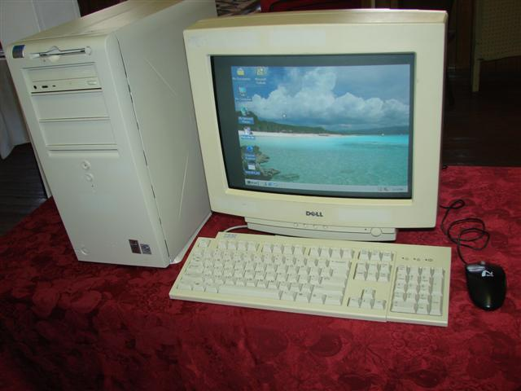
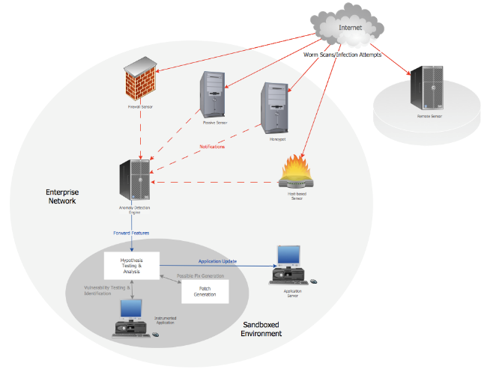
History: Test equipment / computer system legacy
How did we get here?
MODCOMP – in a STAR network
Once per second updates
Stand-alone test equipment
1960’s Burroughs
Data General eclipse with Dash terminals
1960’-70’s
1980’s – 90’s
Interconnected, complex computer networks
Distributed instrumentation (LTE comms)
Virtual Machines (VM)
Computers inside computers
“Cloud Ready”
Cybersecurity! VPNs, cryptography, CDS….!
Microservices….wait...what?
2000’s Dell
Mostly standalone more connected
2000’s-2010’s
©2020 General Dynamics. All rights reserved.

Slide 5
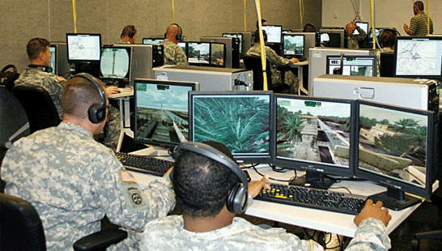
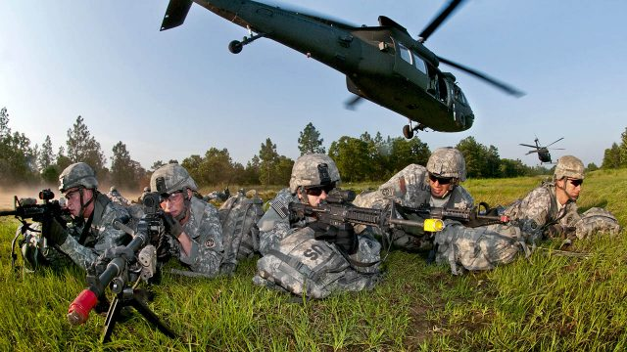
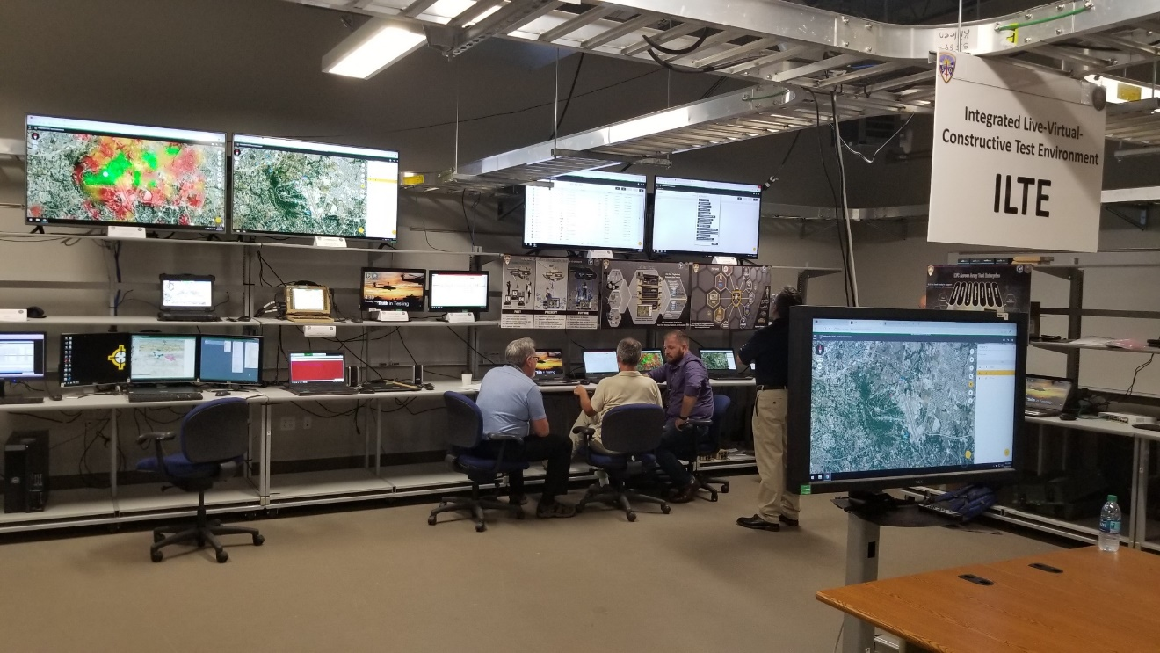
Current Reality
Multiple complex interconnected LVC computer systems
Interconnected LVC networks
Distributed instrumentation (LTE comms)
Virtual Machines (VM)
Computers inside computers
“Cloud Ready”
Cybersecurity - VPNs, cryptography, CDS…
Microservices
Photo: GDMS
Photo: GDMS
Photo: GDMS
©2020 General Dynamics. All rights reserved.

Slide 6
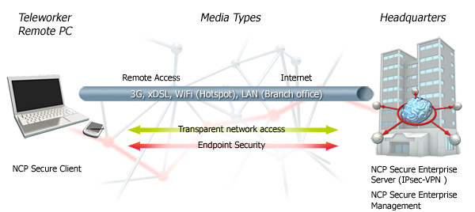
Remote Access – for Software Maintenance
Use Remote Access capability to “dial-in” to fielded system for updates and service
Enables you to manage the system security and performance updates remotely, from Post Deployment System Support (PDSS) contractor
Our current (COVID) reality:
Travel is a challenge – Remote access can reduce the need to send big teams out for software delivery and maintenance
Security Implications
Use VPN
Manage the risk
This all exists, in the Government owned, LT2 product line, and is used for training equipment.
https://www.remoteaccessworks.com/images/solutions/IPsec_VPN.jpg
©2020 General Dynamics. All rights reserved.

Slide 7
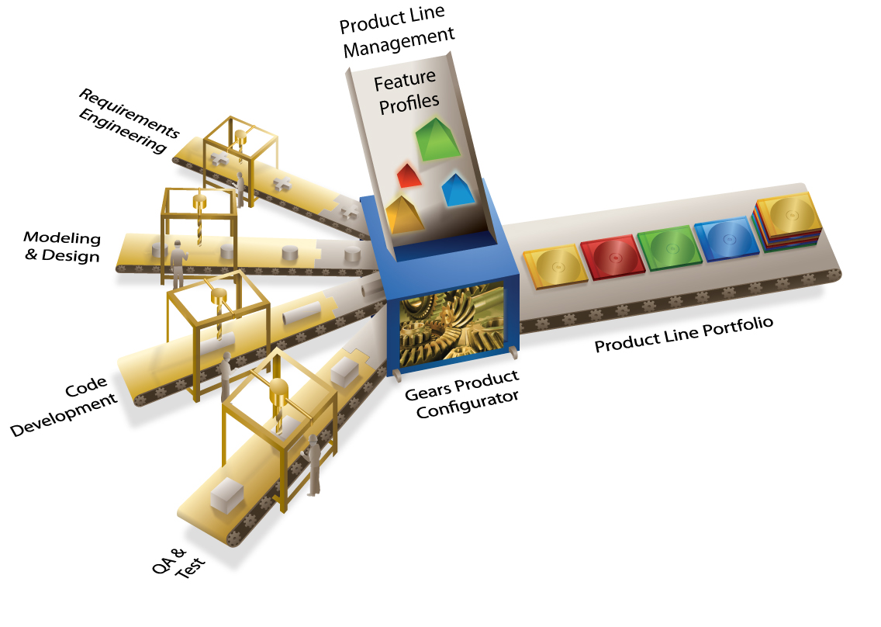
Product Line Engineering (PLE), DevOps, DevSecOps
Developed for Training – Now being used for Testing (ILTE)
PLE can help engineering firms to:
Increase a product line’s scale and scope
Make more efficient use of highly paid specialists
Get new products to market faster
Increase product quality by reducing mistakes
Source: http://www.productlineengineering.com/overview/what-is-ple.html
DevOps
A set of practices that combines software development (Dev) and IT operations (Ops).
Shortens systems development life cycle and provide continuous delivery with high software quality.
Benefits include:
Reduced labor costs
Increased quality
Repeatable deployments by applying automated toolchains.
DevSecOps
Augments DevOps to allow for security practices to be integrated into the DevOps approach.
©2020 General Dynamics. All rights reserved.

Slide 8
Consolidated Product Line Management – Next (CPM Next)
PM ITTS and PM TRADE jointly exploit the overlap in Testing and Training capabilities through deliberate application of Product Line Management and Engineering processes and tools based on a joint training and test/evaluation architecture
©2020 General Dynamics. All rights reserved.

Slide 9
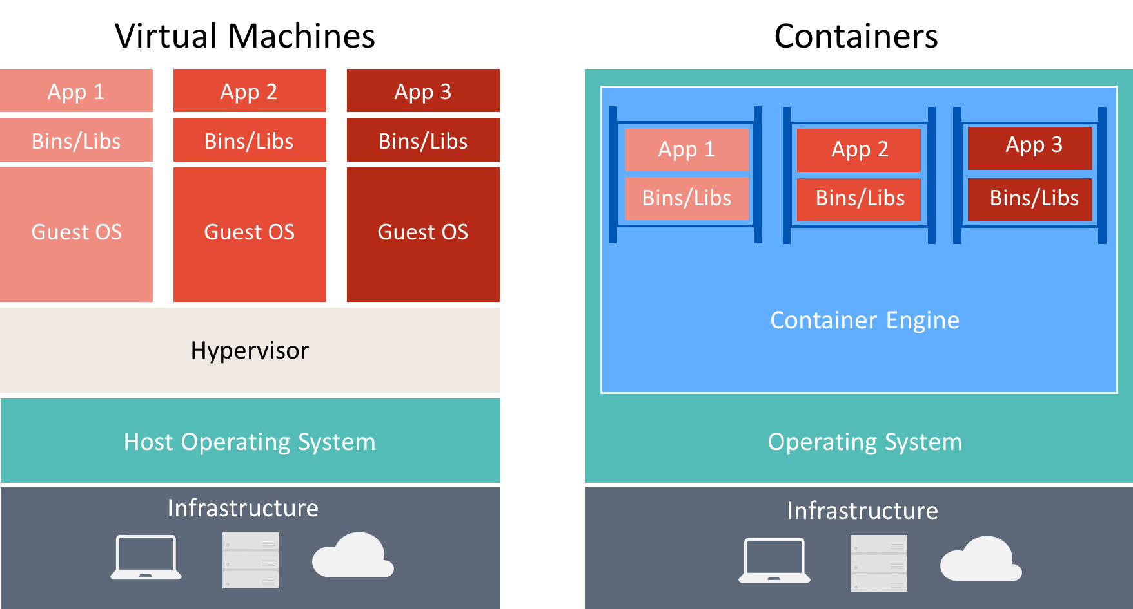
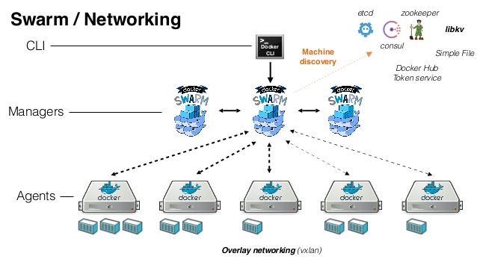
Microservice Architecture - “Cloud Ready” (though it may be YOUR cloud)
Industrial Start of the Art architectures enable the DoD to leverage modern industry efficiencies and capabilities
Architecture Benefits
Automated Failover capability (autoscaling)
Horizontal Scalability
Deployment process, offering zero-downtime-updates, and smaller, more frequent, low-risk releases
Source: https://docs.microsoft.com/en-us/xamarin/xamarin-forms/enterprise-application-patterns/containerized-microservices-images/containersvsvirtualmachines.png
Docker is a set of platform as a service (PaaS) products. that deliver software in packages called containers.
Containers
Are isolated from one another
Bundle their own software, libraries and configuration files
Communicate with each other through well-defined channels.
Run by a single operating system kernel and therefore use fewer resources than virtual machines.
Source: https://technologyadvice.com/blog/information-technology/kubernetes-vs-docker/
©2020 General Dynamics. All rights reserved.
Source: https://en.wikipedia.org/wiki/Docker_%28software%29

Slide 10
Pentagon is looking at Software Development – such that
According to “Breaking Defense.com” articles
bug and security fixes in minutes instead of weeks or months;
continuous feedback from the warfighters that need and use the software, instead of a rigid separation between developer and end-user;
automated testing and security, instead of laborious and fallible manual checking of countless lines of code;
a Continuous Authorization to Operate (ATO) process for rapid deployment and scalability, instead of having to develop a final product and then wait for a lengthy security review before actually using it;
holistic and “baked-in” cybersecurity instead of constantly scrambling to patch problems after the fact;
use of “microservices,” discrete, modular capabilities that can be quickly added to existing software, instead of having to reinvent the wheel and develop such functions anew for each project; and
the ability to deploy the same software on any environment, including DoD-approved cloud services.
https://breakingdefense.com/2019/06/fail-fast-not-twice-dods-push-for-agile-software-development/

Slide 11
Conclusion
Recap
Test systems:
Constantly needed – cannot afford significant downtime.
Comprise multiple complex interconnected LVC computer systems
Increasing Data needs
Microservice architectures:
Reduce down-time
Horizontal scalability
Automated failover capability
Remote access / maintenance
Security patches
Updates and improvements
Reduced travel.
A strong DevOps and DevSecOps, along with Product Line Engineering (PLE) make this possible.
Thank you!
©2020 General Dynamics. All rights reserved.

