Slide 1
T&E Workforce Panel
Laura Freeman
Director, Intelligent Systems Lab
Research Associate Professor, Statistics

Slide 2
Hume Center Mission
The mission of the Ted and Karyn Hume Center for National Security and Technology is to cultivate the next generation of national security leaders by developing and executing research and experiential learning opportunities to engage students.

Slide 3
Hume Center Snapshot
Research Laboratories
Major Program Initiatives
National Centers
Electronic Systems
Assured and Secure Communications
Advanced C4ISR and Counter-C4ISR
Quantum and Heterogeneous Computing
Space 2.0
Satellite Supply Chain
Mission Autonomy, Disaggregation
Platform and Payload Resilience
Aerospace and Ocean Systems
Resilient, Autonomous Missions
Remote Sensing
Space Situational Awareness
Cybersecurity
Transportation, Energy Security
IoT and 5G Security
AI/ML and Security
Centers of Excellence
Intelligent Systems
Machine Learning
Data Science
Cyber Operations
Artificial Intelligence
AI Assurance and Security
Deep Learning for Sensor Processing
Data Fusion and Sensemaking
85 | Faculty and Staff | 625+ | Students Engaged Annually | $16M | Annual Program Revenue | $130M | Venture Investment in Spin-Offs

Slide 4
Large Team Based Projects How do we adjust for online?

Slide 5
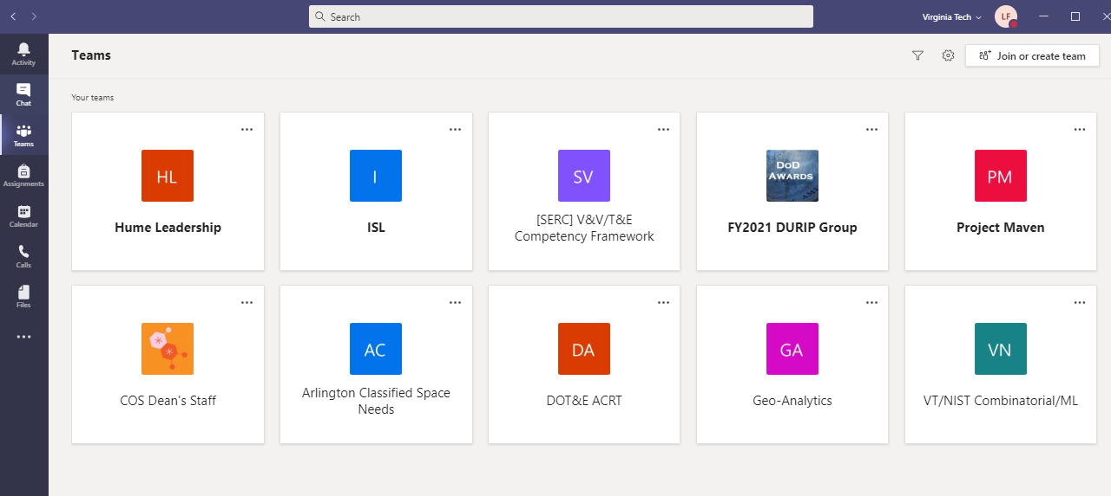
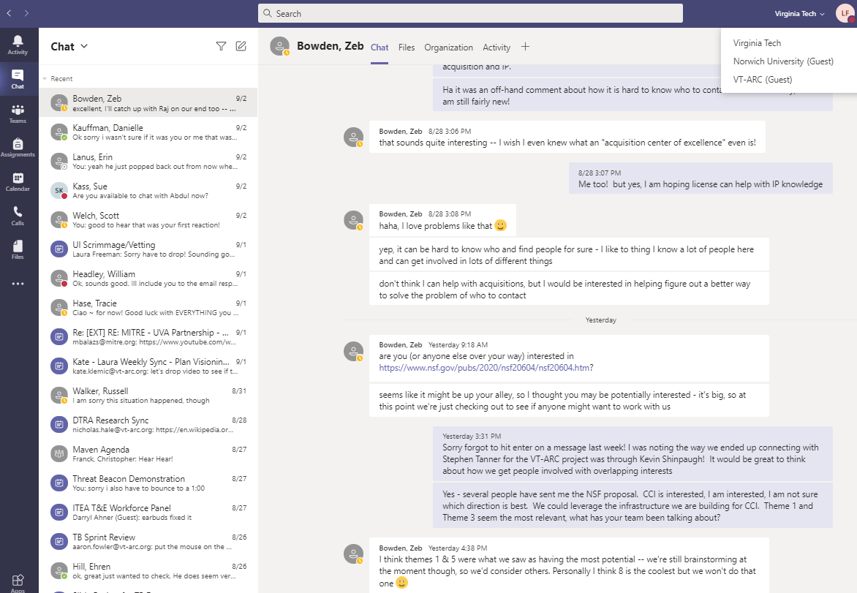
Moving Remote – Embracing our Tools

Slide 6
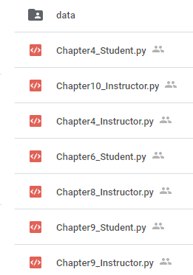
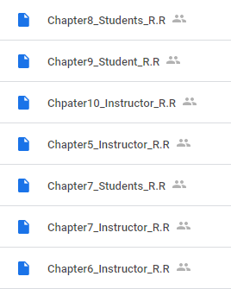
Moving Remote – Rethinking Education and Training
February 2020 – working with various agencies to develop in person trainings for professionals to attend for certifications in:
Systems Engineering and Simulation
Machine Learning
Natural Language Processing
Mission Engineering
Re-vectored into developing comprehensive materials suitable for remote instruction
Course notes, data, clear commented code!

Slide 7
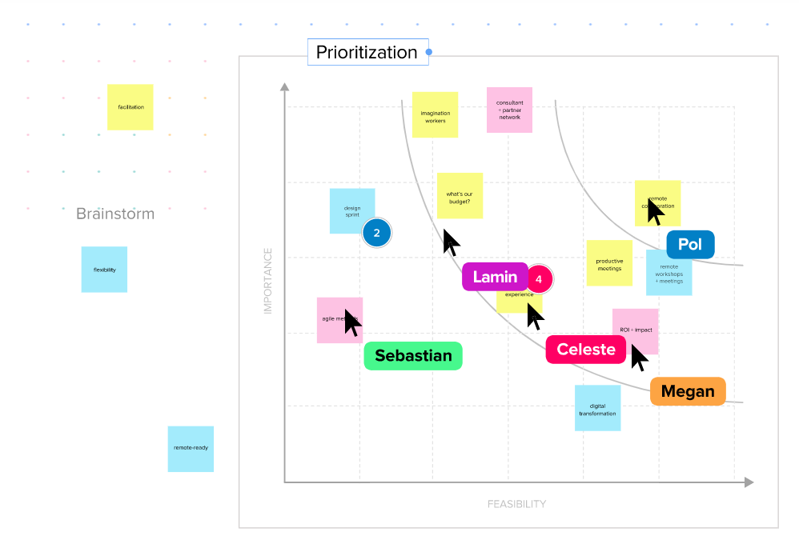
Challenges
Zoom/Teams/Blue Jeans/WebEx Wear out
Cross-Institution Collaborations
Accounts/Connectivity
Brainstorming and breakouts still struggle
MIRO/MURAL
New Program Starts

