Slide 1
Function Level ROP Gadget Survival Using Software Diversification
David Reyes
PhD. Candidate
University of Texas at El Paso

Slide 2
Overview
Background
Return Oriented Programming
Software Diversification
Problem Statement
Contribution
Preliminary Results
Conclusion
Future Work

Slide 3
Background
Software programs upon distribution are all identical at the assembly level
Creates a compromise once compromise everywhere scenario
Attacker’s code needs to work on one copy of the program to use their exploit across all systems running the program
Modern mitigations have made code injection exploitation techniques harder

Slide 4
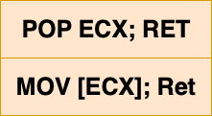
Return Oriented Programming
Return Oriented Programming attempts to bypass modern mitigations
Use code snippets already present in the program called ROP gadgets:
Execute instructions without injecting code
Bypass permissions
Can be used across systems

Slide 5
Return Oriented Programming-2

Slide 6
Software Diversification
Introduced as a potential way to mitigate ROP based exploits
Can be introduced in various phases in the software development lifecycle
How it works:
Create variants of vulnerable programs
Variants are semantically-equivalent
Variants are syntactically different
Instead of compromise once compromise everywhere exploits must become unique

Slide 7
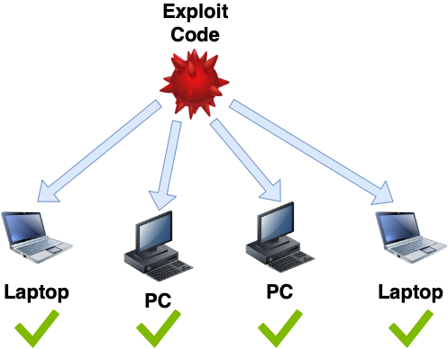
Software Diversification-2

Slide 8
Software Diversification-3
Advantages:
Diversification adds uncertainty
Information gathered from one variant might not carry over to other variants
Disadvantages:
Diversification may lead to performance penalties
Perfect control Flow recovery is not always possible

Slide 9
Problem Statement
Diversification has shown general success
Study of how diversification affects an attacker's effort is in its infancy
Few studies look at how diversity interferes with exploit re-use attacks
No widely accepted method has been presented to evaluate diversification techniques

Slide 10
Contribution
Design and develop models and method to measure the impact diversification approaches have on binaries
Greater understanding on how diversification approaches affect attack resistance
Greater understanding of the tradeoffs between different diversification approaches

Slide 11
Experimental Set-Up
Five Linux Core Util binaries
Diversified using Amoeba
Diversification engine developed by Penn State
Offers 9 different diversification algorithms
Data set was available from previous work
Binaries were diversified with nine different algorithms
Diversification passes ranged from 20-50

Slide 12
Preliminary Results
Analyzed the relationship between number of functions and number of ROP gadgets in non-diversified binaries
Rationale more functions in a binary more room for diversification
Linear relationship between functions and ROP gadgets for non-Diversified binaries

Slide 13
Preliminary Results-2

Slide 14
Preliminary Results-4
Analyzed the relationship between number of functions and number of ROP gadgets in diversified binaries
Relationship remains somewhat linear
Diversified variants seem to cluster with their non-diversified counterparts

Slide 15
Preliminary Results-3

Slide 16
Future Work
Further analysis when diversifying using other diversification engines
Comparing surviving ROP gadgets between variants for overlaps
Develop statistical methods to quantify the impact diversification has on ROP gadget removal

Slide 17
Conclusion
First step in understanding diversification's affect on binaries
Study of how diversification affects an attacker's effort is in its infancy
Greater understanding on how diversification approaches affect attack resistance

Slide 18
Q&A

