Slide 1
Cybersecurity of Development Environments
412th Test Wing
War-Winning Capabilities … On Time, On Cost
May 2020
Megan Fisher
412TENG/JT4
DISTRIBUTION STATEMENT A - Approved for public release; distribution is unlimited. 412TW-PA-21209
I n t e g r i t y - S e r v i c e - E x c e l l e n c e

Slide 2
412TENG CTTs
Airborne Instrumentation
TSPI
Development Environments
Data Centers
More to follow!

Slide 3
Development Environments
Critical to advancing technology
Must be agile to accomplish their mission
Traditional security does not always work

Slide 4
Why a Cyber Table Top?
Buy-in
Inexpensive
Flexible
Road Map

Slide 5
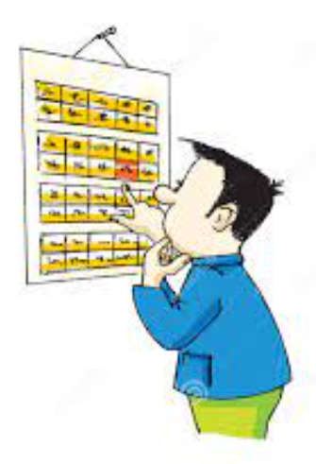
CTT-LITE
Low Impact To Execute
Reduced Scope
Planning: 3 months
Execution: 2 days

Slide 6
Scope
Goal: understand the risk development environments pose to mission systems
Out of Scope:
Working remotely
Connections to cloud environments

Slide 7
System
Fabricated development environment:
Set of computers and equipment (hardware and software) that generates knowledge and products used to operate and maintain mission systems (instructions, software source code, drawings, designs, hardware, procedures, configuration files etc…)

Slide 8
Cyber Mission
Cyber Team:
412TENG Cybersecurity Engineering Support Team (CSEST)
47th CTS
Intel
Attacks (40) were divided into 3 missions:
Gain logical access
Disrupt the development environment (16)
Corrupt, destroy, modify or exfiltrate product (12)
Notes:
.

Slide 9
Risk Matrix
30 total attacks
13 with high likelihood and impact

Slide 10
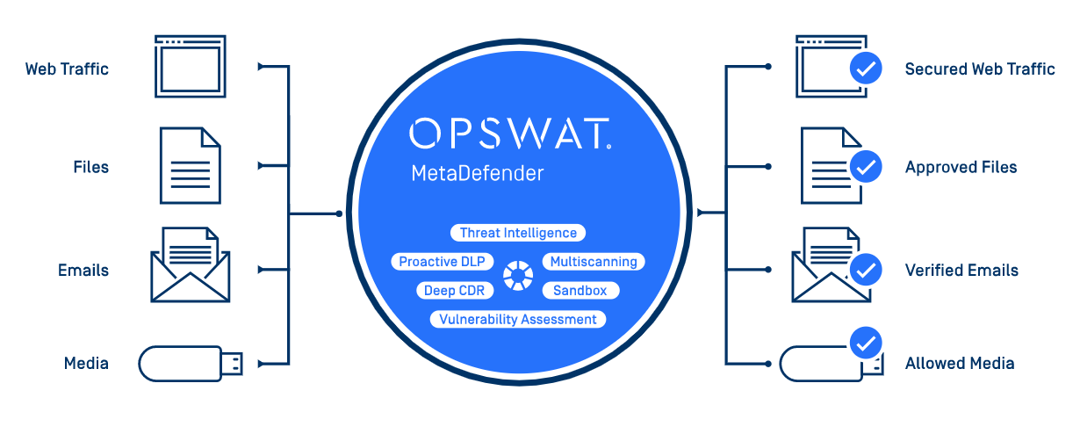
Findings
Boundary Protections
Physical security
Kiosk
Back-ups
KIOSK

