Slide 1
Dr. Raymond D. O’Toole, Jr.
Acting Director,
Operational Test & Evaluation

Slide 2
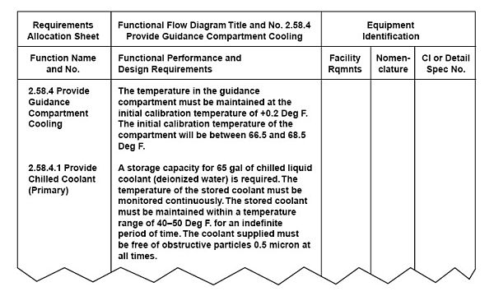
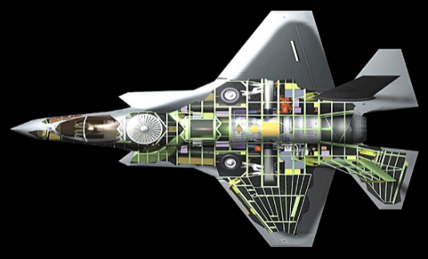
DOT&E Activities and Mission
Advise on Testable, Mission-Relevant Requirements
Approve Test & Evaluation Master Plan Submitted by Program Office
Collaborate with DT&E to gain early insight into performance
Inform Production/Fielding Decision
Evaluate system performance in a report to congress & DoD leadership
Approve operational and live fire test plans submitted by Service OTAs
Authoritative source for DoD weapon systems’ operational capabilities

Slide 3
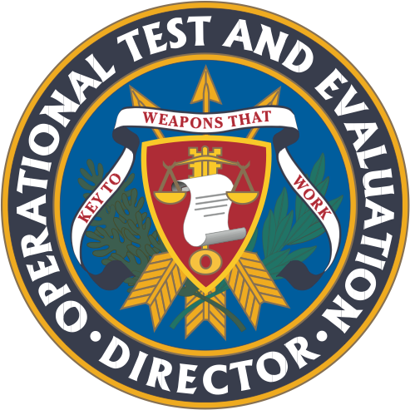
DOT&E S&T Strategic Plan
2021 - 2026
Purpose
Address key priorities within the context of science and technology to coordinate and align DOT&E’s efforts
………
Vision
Improved operational effectiveness, suitability and survivability of software intensive and cyber physical systems
Rigorous, operationally realistic T&E that characterizes system performance in multi-domain environments against modern threats
Efficient, integrated T&E programs that effectively leverage developmental, operational, and live fire testing across the system lifecycle while preserving independent evaluations by stakeholder organizations
Digital processes contribute to improved acquisition outcomes realized at a pace of operational relevance
Scientific and technical knowledge to achieve their mission
Software and Cyber T&E
Increase understanding of and confidence in the operational effectiveness, suitability and survivability of software intensive and cyber physical systems
We will…
Next-Gen T&E Capabilities
Make use of scientific and technological advancements to reduce O/LFT&E cost, time, and operational risk and ensure O/LFT&E is operationally realistic
We will…
Integrated T&E Lifecycle
Improve approaches to integrate testing and data collection across the full system lifecycle
We will…
Focus on Mission Effects and Consequences: Improve enumeration of mission effects and operational consequences of potential cybersecurity compromises
Emulate Cyber Threats: Improve emulation of cyber threat
Improve Rigor: Improve engineering rigor in (the art of) cybersecurity testing
Mature Software/Cyber Anomalous Detection (SCAD) Processes: Mature processes to continuously test and monitor software systems in operations to contribute to a body of evidence, usable to manage system configuration to counter vulnerabilities at tactically relevant speeds
Understand Cyber Survivability, Effectiveness, and Suitability: Improve DOT&E ability to identify and articulate enterprise trends in the operational effectiveness, suitability and survivability of software intensive and cyber physical systems
Plan for Advancing, Evolving, and Emerging Technology: Prepare the operational T&E community for advancing, evolving, and emerging technologies
Ensure Realistic Environments: Ensure operational T&E takes place under conditions that represent a realistic operational environment, including blue and red forces
Advance Test and Evaluation Methods: Develop, adopt, and promote methods for rigorous and efficient test design and evaluation
Adopt Remote T&E: Adopt methods for conducting OT&E via telepresence where applicable and appropriate
Shift Left: Incorporate operationally-relevant T&E activities earlier in the acquisition process in order to identify problems earlier, improve production readiness, and shorten the acquisition timeline.
Integrate Test Design Methods: Ensure that programs adopt integrated T&E approaches where individual test events build upon each other and support the data requirements for multiple stakeholders simultaneously.
Establish the strategic foundation needed to advance the utility of digital engineering in LF and OT&E, enabling streamlined, automated, model-centric LF and OT&E processes
We will…
Rapidly Provision Representative Digital Environments: Institutionalize the adequate assessment of the full spectrum of survivability (comms kill, mobility kill, firepower kill, catastrophic kill) early in LFTE through rapid provisioning of an adequately representative digital environment (emulated threat, digital twin, mission effects models [from cyber, EW, CBRNE, etc.]) and mission-based scenarios
Develop a Digital TEMP: Develop a Digital Engineering TEMP, reducing development time of TEMP and increasing utility of TEMP through fully integrated digital engineering processes
Digital Transformation and Automation
Transform Software Intensive and Cyber Physical System Testing: Use digital technology to transform testing of software intensive and cyber physical systems in development from linear, serial processes to iterative, incremental processes that build a body of evidence over time usable for operational assessments and evaluations
Workforce Expertise and Partnerships
Deepen and expand in-house scientific and technical expertise and access to technical talent to ensure a workforce that is capable of leveraging S&T advancements to conduct operational and live fire T&E
We will…
Enable SME Partnerships: Build partnerships with and create reachback mechanisms to access subject matter experts within key universities, research organizations, and industry to fill knowledge gaps for identified technical areas
Cultivate Federal and Coalition Partnerships: Cultivate and maintain partnerships with key federal and international partners to share lessons learned, ensure operational assessments fulfill requirements and meet guidance, and leverage mutual areas of interest in T&E investments
Grow Workforce Expertise: Deliver needed in-house expertise and create a pipeline of incoming workforce with the knowledge, skills, and abilities in advanced science and technology areas to meet the demands of the future T&E mission

