Slide 1

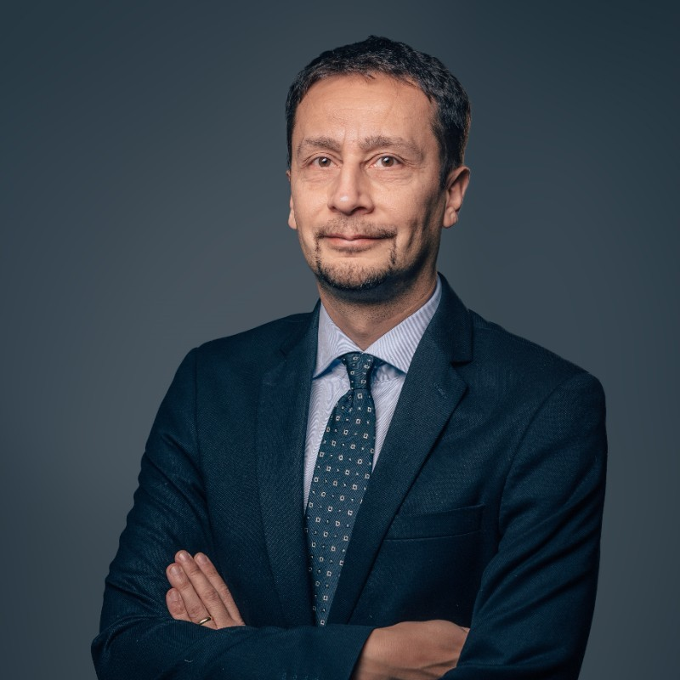
A Software Connected Approach for Facing the Challenges Associated to new EMSO and Digital Transformation in T&E
International Test & Evaluation Symposium
Mo., 13. Sept. 2021 – Fr., 17. Sept. 2021
Raffaele Fiengo
Massimo Sciotti
Principal BDM,
NI ADG BU
Technical Director Elettronica GmbH

Slide 2
Outline
A Software Connected Approach for Facing the Challenges Associated to new EMSO and Digital Transformation in T&E
EMSO and the EM Environment
System under test
Test & Evaluation Activities
Unified Framework for T&E
Technology Enablers
Success Case

Slide 3
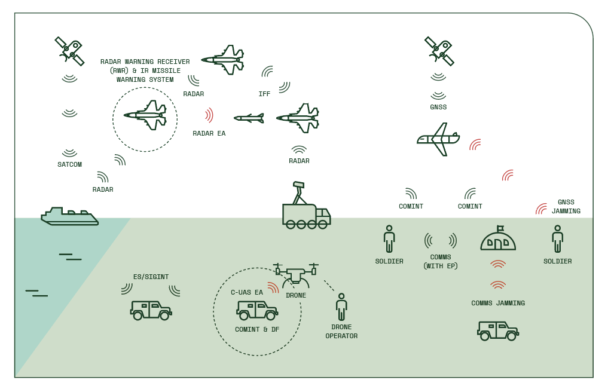
Electromagnetic Spectrum Operations
An on-going evolutionary process
(…) future warfare in 21st century will see the electromagnetic spectrum as a contested and congested resource for which silent battles will be conducted. A novel discipline, named Electromagnetic Spectrum Operations (EMSO), is growing, aiming (to) identify, organize and disseminate concepts of operations, User requirements, doctrine, resources, materiel and technologies which will enable Electromagnetic Spectrum Dominance in peace time, crisis and conflict.
https://www.emsopedia.org (accessed 15.8.2021)

Slide 4
EM Operational Environment (EMOE)
Complexity…Entropy….Multitude of options
US DoD describes EMOE Complexity as
Contested – Enemy activities detect, disrupt, exploit, degrade, deny, deceive, or destroy friendly EMS capabilities for the purpose of military advantage.
Congested – Military and civilian EMS-dependent systems continue to crowd the spectrum and increase the amount of unintentional interference.
Constrained – Domestic and international regulations cause the amount of spectrum available for military access to decrease.

Slide 5
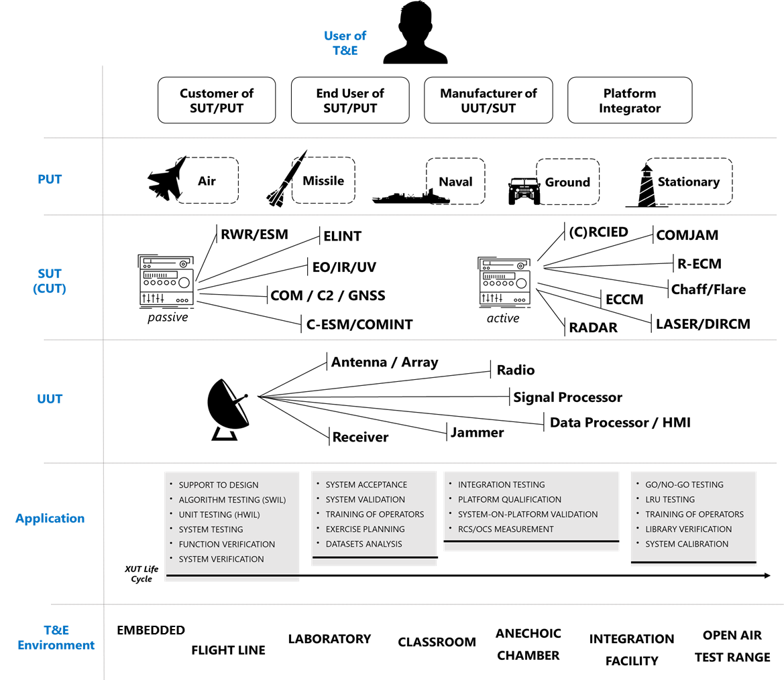
System under test
Wide spectrum of Needs
The System under test is an
……….EMS-dependent system
that can be characterized in terms of
User / Use Case
Platform
Nature
Test Goal
Testing Environment

Slide 6
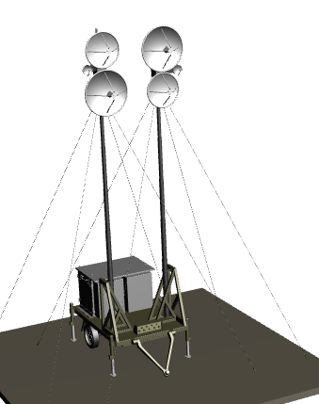

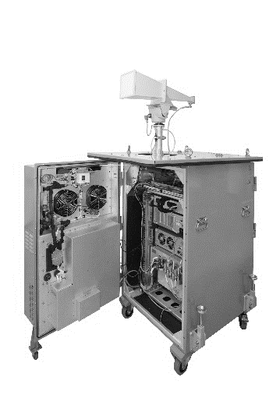

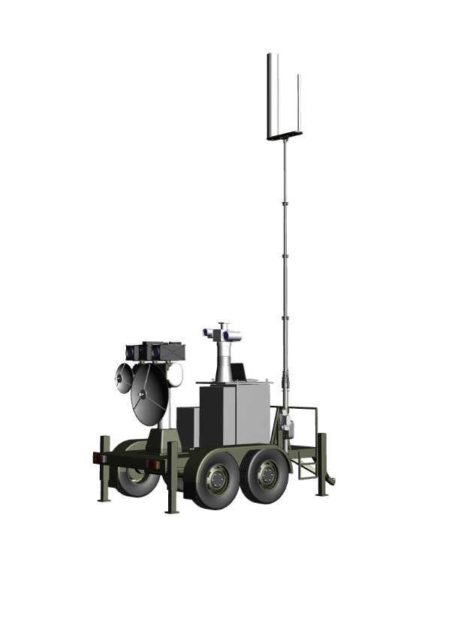

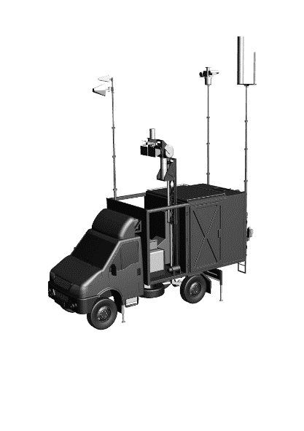
Test & Evaluation Activities
Along the System Life Cycle
Team A
Team D
Team E
Team B
Team C
20+ years

Slide 7
Unified Framework for T&E
Our proposal and experience
The aim is to keep pace with the complexity of interactions of system parts by unifying the framework in which the system is developed and operated and allowing different “views” of the system according to each life stage and User.
The diverse enablers for digital transformation in T&E can be grouped into three pillars: (i) Digital Engineering, (ii) Operational Intelligence, and (iii) Product life cycle analytics.
Through extended use of unified models and common modelling data during the SLC: exploitation of principles and tools offered by Model Based System Engineering (MBSE), Model Based Development and Model Based Testing (MBT), as well as Digital Twin.

Slide 8
Unified Framework for T&E
Our proposal and experience
Single (layered) architecture
Common Models
Pick & Replace

Slide 9
Technology Enablers
HW platform
MODULARITY as it needs to add/remove functions and capability according to the current “viewpoint” on the System,
SCALABILITY in terms of number of channels, computational resources, frequency bands,
FLEXIBILITY in terms of functions to be hosted and possibility for being re-programmed (software-defined) and connected to other systems and/or tools for data sharing and control.
Frequency band: from HF to above 40 GHz
Instantaneous bandwidth of more than one GHz
Tens of phase-coherent channels
Dynamic range to cope with low (Radar Cross Section) RCS and very high RCS targets at near and far range
Frequency and amplitude agility and settling time of a few hundreds of ns
Amplitude resolution/accuracy better than 0.1 dB
Phase control better than few degrees
Time resolution and accuracy less than 1 ns
Minimum I/O delay short enough to allow simulating near range targets.
Computational power enough for the synthetic targets, the RCS 3D modelling, Clutter modelling, Extended Targets with multiple scatterers)
Management of thousands of waveforms (I/Q samples) and real time control of waveform
Output noise floor (interpulse) low enough not to be seen by the receiver under test
……………….

Slide 10






PXI Technology - Areas NI Has Traditionally Invested
Multi-core Embedded Controllers and Data Interfaces
Windows, Linux, and Real-Time environments
64-bit, multi-core processing for complex computation and application development
Multi-chassis capability via MXIe extensions
Multi-Channel Synchronization and Coherency
Sub-100 psec time synchronization via NI TClk
Stable and Adjustable phase coherency (LO sharing)
  Multiple channels and/or across transmit and receive
Wideband equalization and match for phase and amplitude
Flexible
and
Software Defined
RF Channels
Embedded Controller
CPU
Embedded Controller
High Speed Data Storage
(RAID)
FPGA Coprocessor
RF Channels
High Speed Digital Data & Ctrl
CPU
RF Channels
0
1
1
0
1
0
0
High Speed Digital Data & Ctrl
FPGA Coprocessor
0
1
1
0
1
0
0
Open FPGA for Customized Firmware
Deploy custom, deterministic algorithms or measurements to instrumentation and coprocessors
Reprogrammable targets for multi-function needs
LabVIEW FPGA design environment including the ability to import existing VHDL IP
Xilinx Vivado Export and Project support
High Speed Data Transfer and Trigger Routing
Gen 3 PCIe Backend
Up to 24 GB/s Bi-directional Transfer Rates
Transfer targets including instrumentation, embedded controller, and/or RAID storage
Peer-2-Peer direct data transfer between instruments for low latency applications
Synchronous and Asynchronous Triggering
Mixed Domain Virtual Instrumentation
RF, Digital, DC - can be synchronized together to create mixed I/O closed or open loop instrumentation
Direct or indirect data transfer between instruments
Notes:
Designed for connectivity

Slide 11
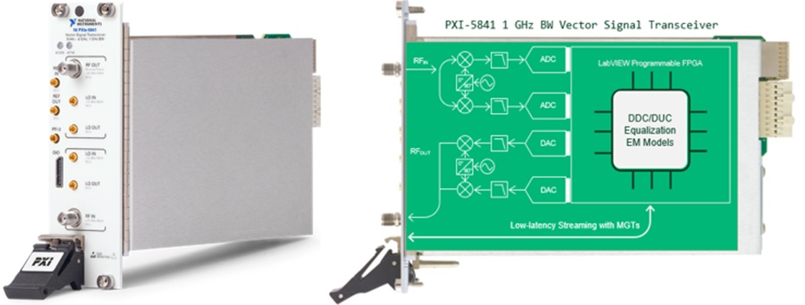
PXI Technology – Modular Instrumentation
PXIe Gen3 x8
Up to 12 Gbps
4 TX and 4 RX
Software-Defined Instrument
Notes:
Designed for connectivity

Slide 12
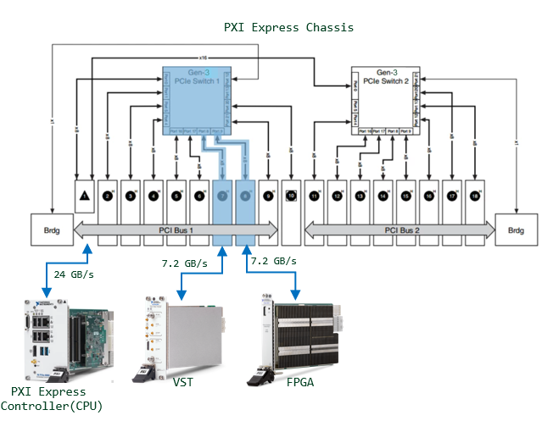
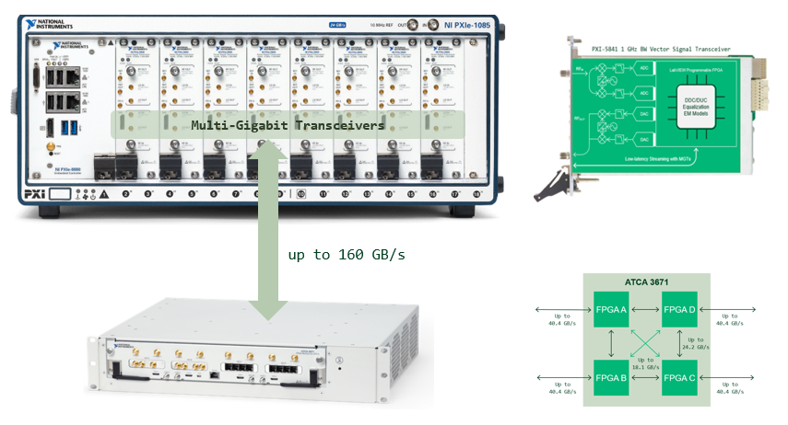
PXI Technology – Data Transfer
PXI backplane - Peer-to-Peer
1 GHz of IBW ≥ 4GB/s per 1 RF/microwave channel

Slide 13
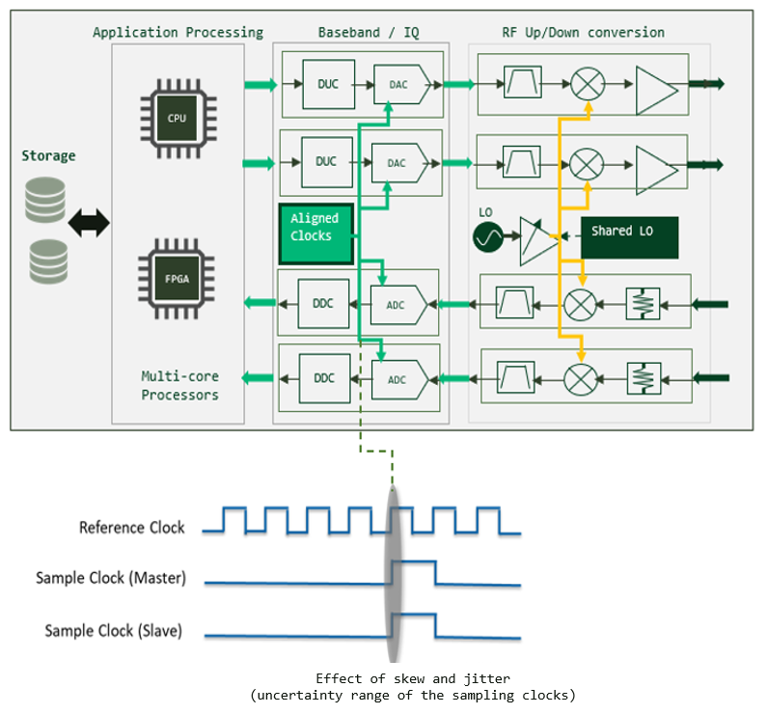
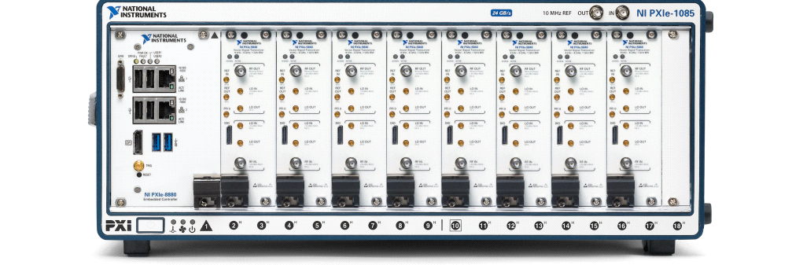
PXI Technology - System Calibration
Multichannel Phase Alignment - NI TCLK
Phase coherency
ADCs/DACs synchronization and triggering
RX/TX chains equalization

Slide 14
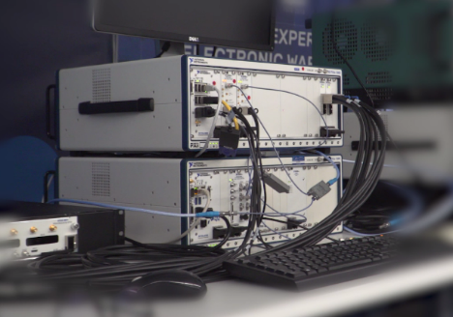
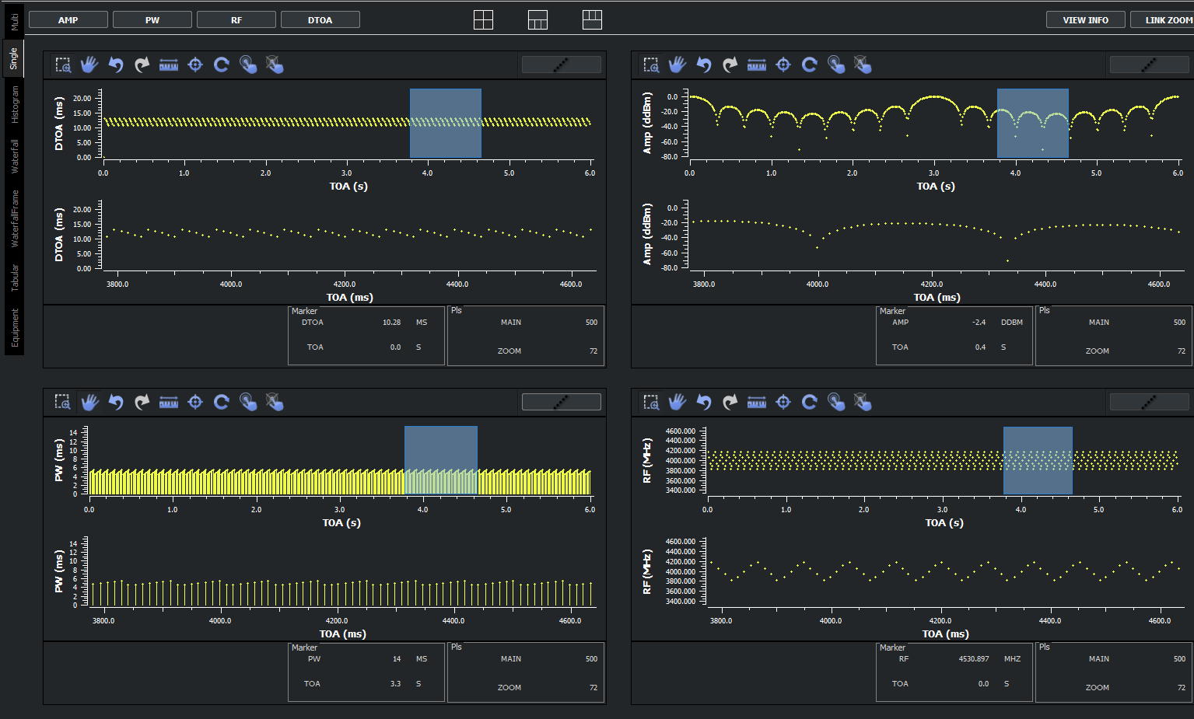
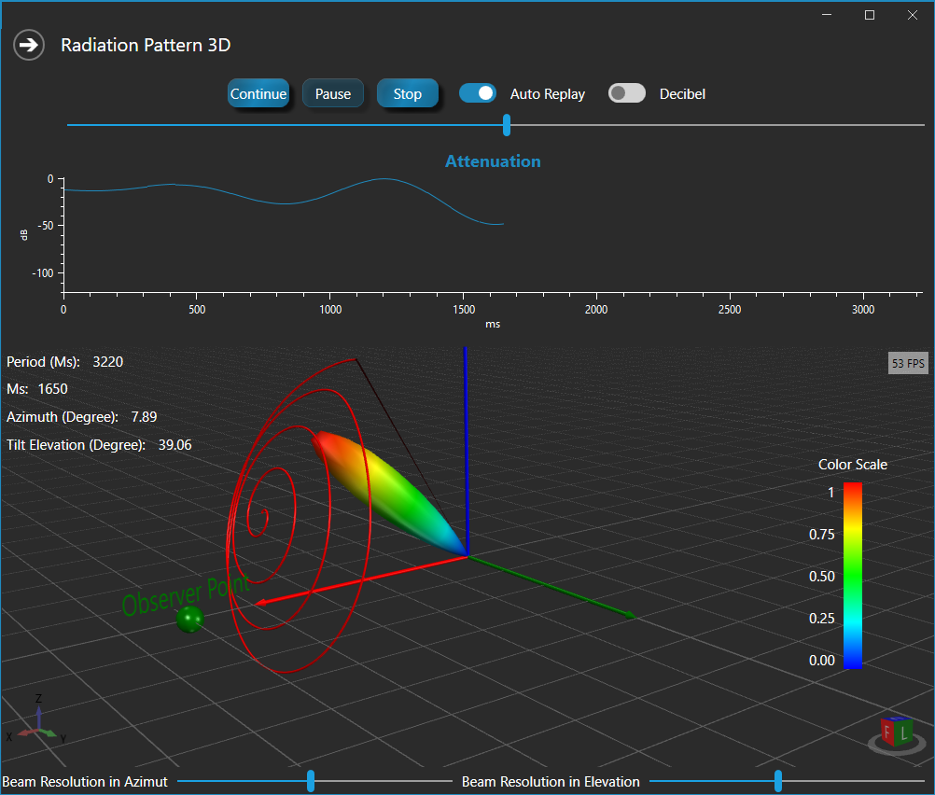
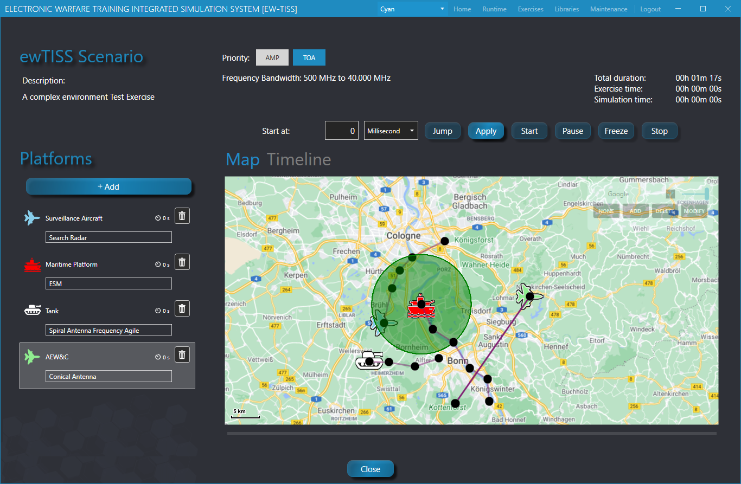
Success Case
Test & Evaluation of Reactive Jammer on board an Air Platform
Implementation of DRFM model behavior through use of NI VST which allows capturing wideband signals (up to 1GHz bandwidth) with high fidelity over multiple coherent channels
SW-implementation of jammer techniques that mimic the techniques used by the unit under test.

Slide 15
Success Case
Test & Evaluation of Reactive Jammer on board an Air Platform
Modelling of EMS scenarios for testing the jammer, including radar signals and echoes from moving platforms
Configuration of RF routing matrices for “closed loop” testing
Replacement of DRFM model with the unit under test
……………..

Slide 16
Conclusions
A Software Connected Approach for Facing the Challenges Associated to new EMSO and Digital Transformation in T&E
Tackling key technical and operational challenges, associated to the modern EMSO and Digital Transformation in T&E
Proposed a unified modelling approach throughout the EMS-dependent system life cycle
Challenges coming from multichannel phase aligned analyser and generator, high data throughput for managing large IBW, real-time signal processing and control, removing the silos in data sharing, discovering design problems in the early stage of the system life cycle, reducing the program risk and cost
Key enablers have been presented

