Slide 1
Immersive Environments for Visual Analytics
Selena Hamilton/James Hughes
Intern/Intern
CISD/CISD
Notes:
Hi I am Selena and I’m collaborating with my partner James on immersive environments in visual analytics

Slide 2
SELENA HAMILTON
Harford Community College
Sophomore
Computer Science
Previous Research Experience: RISE and FRC
GEMS III CS Principles and Applications 2019
Hobbies: Hiking, Reading, Programming, Longboarding
Mentor: Virginia To
Notes:
SELENA

Slide 3
JAMES HUGHES
Attending UMD College Park
Sophomore
Mechanical Engineering
Hobbies: Making Cosplay Props, Programming,
and Video Games
Mentor: Virginia To
Notes:
JAMES

Slide 4
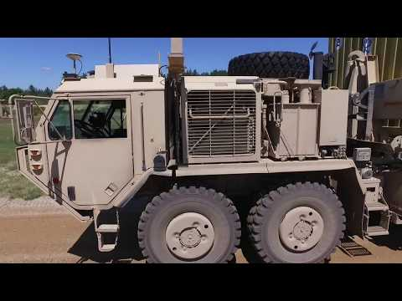
ABOUT EXPEDIENT LEADER FOLLOWER
Notes:
SELENA
Emphasize the fact that the follower cars need to compare both the data from the leader car and gps data as well as information from its surroundings to ensure it’s on the correct path and won’t cause accidents

Slide 5
ANALYSIS OF TEST DATA
Problem:
Test data for the Expedient Leader Follower program collected includes instrumentation, position, location, time, network comms, ROS, manually written Test Incident Reports (TIR), etc.,
Lack of capability for analytics at the large-scale – currently, custom queries are used instead
Notes:
JAMES
Lots of test data, need standardized analysis method

Slide 6
VISUAL ANALYTICS PLATFORM OVERVIEW
3D Visualization
Fully Scalable
Interactive Visualizations
Visualization
Scalable,
In-Browser
SCALABLE PLATFORM
Cache, Permissions
Accelerated Access
Query & Analytics
ML/Statistics
Data Management
Distributed FS
Transport
Parallel
Notes:
JAMES
You saw Miraya’s presentation on visual analytics workbench that analysts can use to interface directly with their data running on large-scale data systems. Our portion of the dashboard is a visual representation of the data being processed.

Slide 7
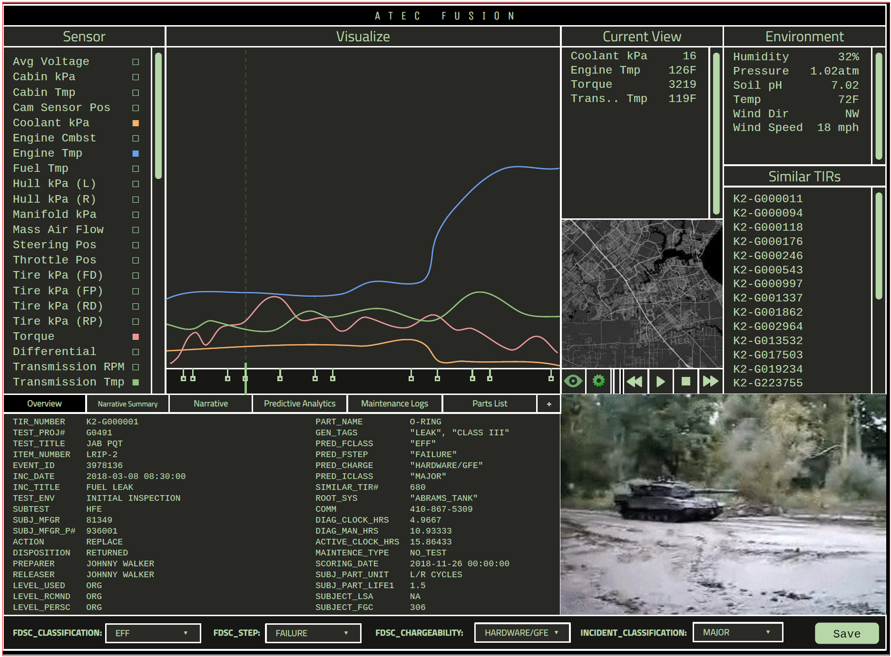
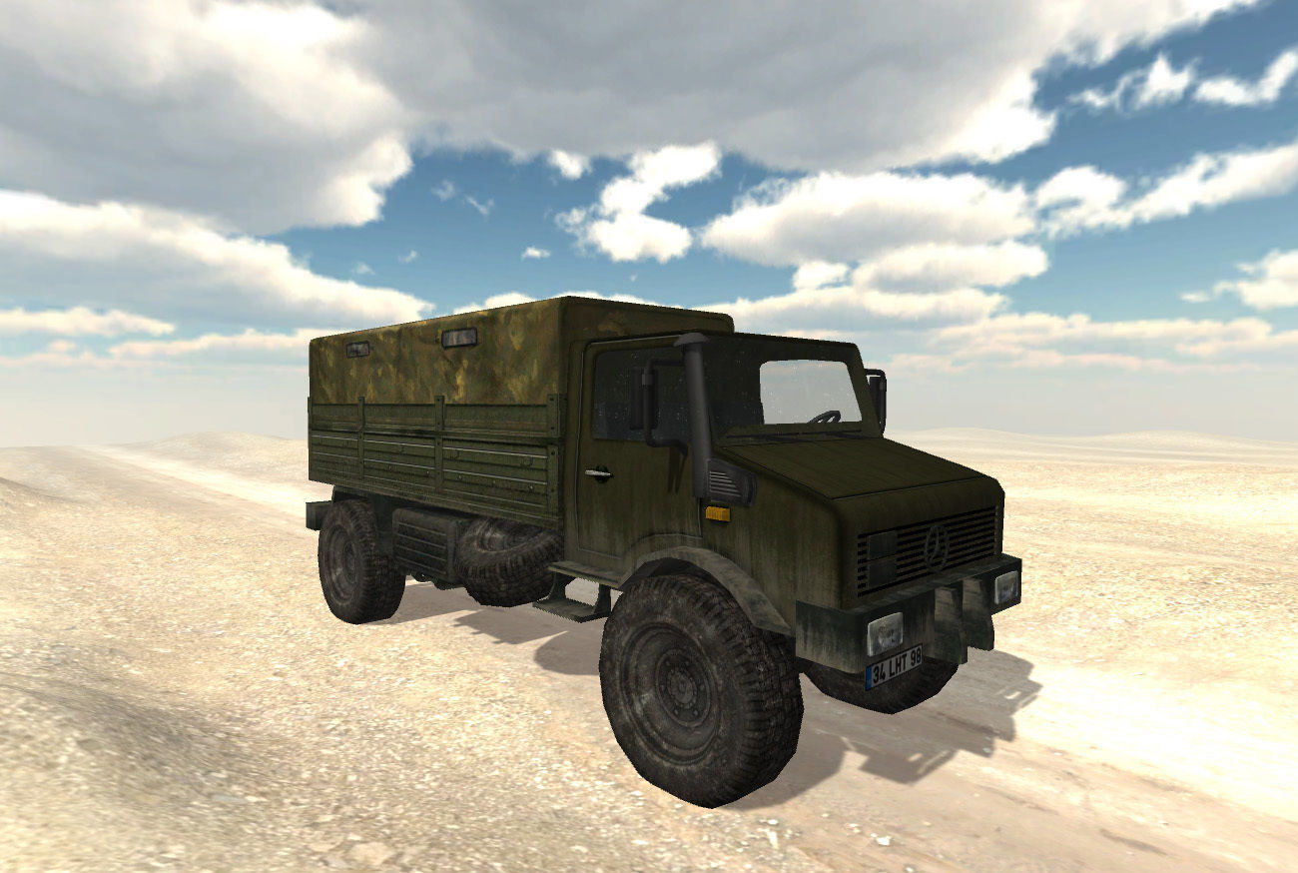
DASHBOARD INSPIRATION
Notes:
JAMES
Here is an artistic rendering of what the framework would look like.
Bottom right hand corner is where simulation would go.

Slide 8
ExLF SIMULATION
Custom Truck Model
Terrain Map and Test Track
Notes:
JAMES
Discuss custom models and production process, discuss issues with textures on provided terrain map due to updates outdating texture mapping
Terrain map gps data from apg, the texture mapping methods are outdated which caused it to look grainy.

Slide 9
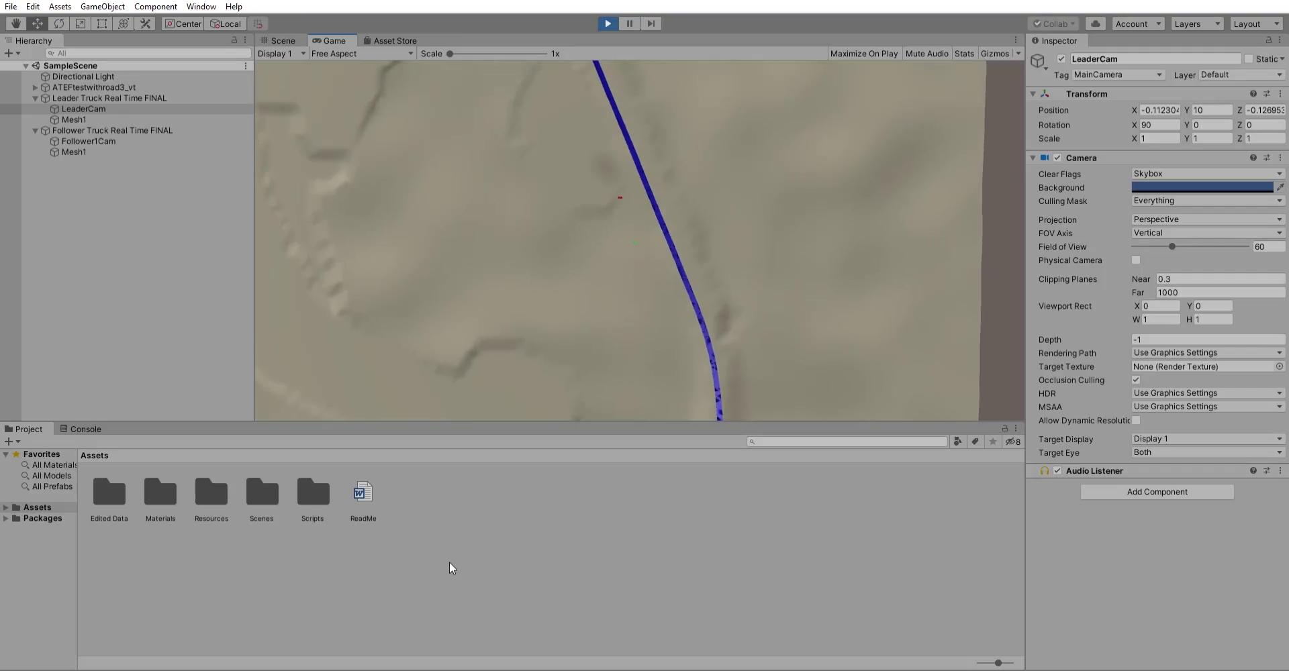
ExLF SIM VIDEO
Notes:
SELENA
Camera distance from the track
Truck not staying on track, but maintaining proper shape.
Track not warped in preparation, GPS data potentially not accurate enough to portray proper driving path
Two trucks on the track(The second one is green)
Trucks don’t change direction on track, just move along it for now

Slide 10
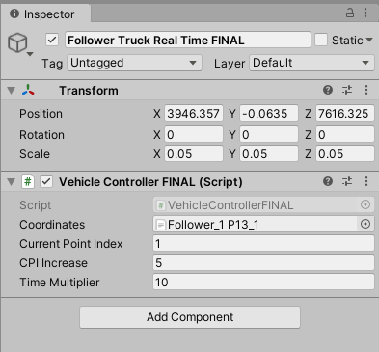
ExLF SIMULATION
Customizable Settings
Settings are truck specific
Each truck contains a different ‘instance’
of the script
Each data set can be individually
assigned
Notes:
JAMES
This allows individual coordinates to be set, as each truck has a different coordinate set.
Unity relies on prefabrications, which copies of are populated throughout the scene.
This also allows individual start times, which will be explained in the following slides.

Slide 11
ExLF SIMULATION
Customizable Settings
Current Point Index (CPI) determines the
data start point
Not ever truck’s data set starts at zero,
some idle while recording
This causes issues with truck movements
Notes:
JAMES
The script will progress the truck towards the next data point after it has no distance between it and the target point.
Since there is no travel time between points where the truck was recording but idling, there needs to be a built in delay before the truck begins moving.

Slide 12
ExLF SIMULATION
Customizable Settings
CPI Increase is the data jump size
CPI Increase determines how many
Data points are skipped when ‘animating’
Some rigs can’t handle this much data
processing, this lowers the bar
Notes:
JAMES
Data is very precise, and a multitude of extraneous points are present in the data.
Making the CPI Increase larger skips data points, which saves processing power, without sacrificing detail.

Slide 13
ExLF SIMULATION
Customizable Settings
Time Multiplier speeds up the simulation
This feature does not increase Unity’s
clock speed
We found when testing that because of
the amount of data present, the
trucks moved through it slowly
Notes:
JAMES
This also helps with raw data processing, lower CPI Increase gives more detail,
Because the truck’s take extra processing time every instance they reach a new data point, there is a lot of time where the trucks appear to not be moving.
For rigs with the processing power to have lower CPI’s, increasing the Time Multiplier (speed of the truck), will make the simulation run at a more realistic pace.
This also improves data analysis times, as the chosen track is quite large, and the trucks take considerable time to drive it.

Slide 14
ExLF SIMULATION METHODS
Assets were either given to the research team;
Test data, Track Layout, Terrain Map
Or generated using SketchUp (Truck)
Fake test data was generated using Excel
Notes:
JAMES
Assets created and set up, Method for trucks to move was experimented with and resourced, and the method was tested with fake test data
The truck movement code was sourced from the Internet

Slide 15
ExLF SIMULATION METHODS
Base code was sourced from GitHub, edited and elaborated on for our purposes
Code used CSV files, but was a bit clunky at first
Logic checks to see if object is at target location or not
If not, object slowly translates towards coordinates
Notes:
JAMES
Assets created and set up,
Method for trucks to move was experimented with and resourced, and the method was tested with fake test data
The truck movement code was sourced from GitHub

Slide 16
ExLF SIMULATION METHODS
GPS data was very cluttered
Unity struggled to load even a preview
Over 800,000 data points!
Data required significant cleaning and removal of columns
Notes:
JAMES
Assets created and set up, Method for trucks to move was experimented with and resourced, and the method was tested with fake test data
The truck movement code was sourced from the Internet
GPS data too big for Unity, processing and cleaning needed
Initial confusion over data regarding time stamps and separation of tests
Final sorting based on utc_run_id’s yields small files

Slide 17
ExLF SIMULATION RESULTS
At this time the trucks can be run with real data (albeit modified data)
Multiple trucks can be run simultaneously
Optimizations available for more or less computational power
Notes:
JAMES
Spacing for trucks is correct
More or less powerful computers can run the simulation

Slide 18
FUTURE WORK
What’s next on visual analytics?
Integrate visualization capability into Mariya’s dashboard
Some processes could be automated
Camera options are limited
Notes:
SELENA
User needs to perform calculations for initial start time, could have a toggle
(The sensors for the truck were turned on at separate times and as a result the trucks may not start moving at correct times)
Only one camera option, being able to toggle cameras with a swivel would be optimal (Name different angles)

Slide 19
ACKNOWLEDGEMENTS
High Performance Computing Modernization Program (HPCMP) and the HPC Internship Program (HIP)
The Army Research Laboratory DoD Supercomputing Resource Center (DSRC) for hosting our internship
Vince Perry
Nicholas Kendall
Virginia To
Notes:
SELENA
For their sponsorship
For helping us declutter our data and debug code
For helping design and 3D print need materials for our controller
For being a great mentor and guiding us through this internship

