Slide 1
Members Only Area Guide Book
International Test & Evaluation Association
An illustrated guide to getting the most out of
our interactive and self-service website
Notes:
At some point in a world long long ago the dream of AMS was that it could help you realize this imagined world….. But it isn’t working

Slide 2
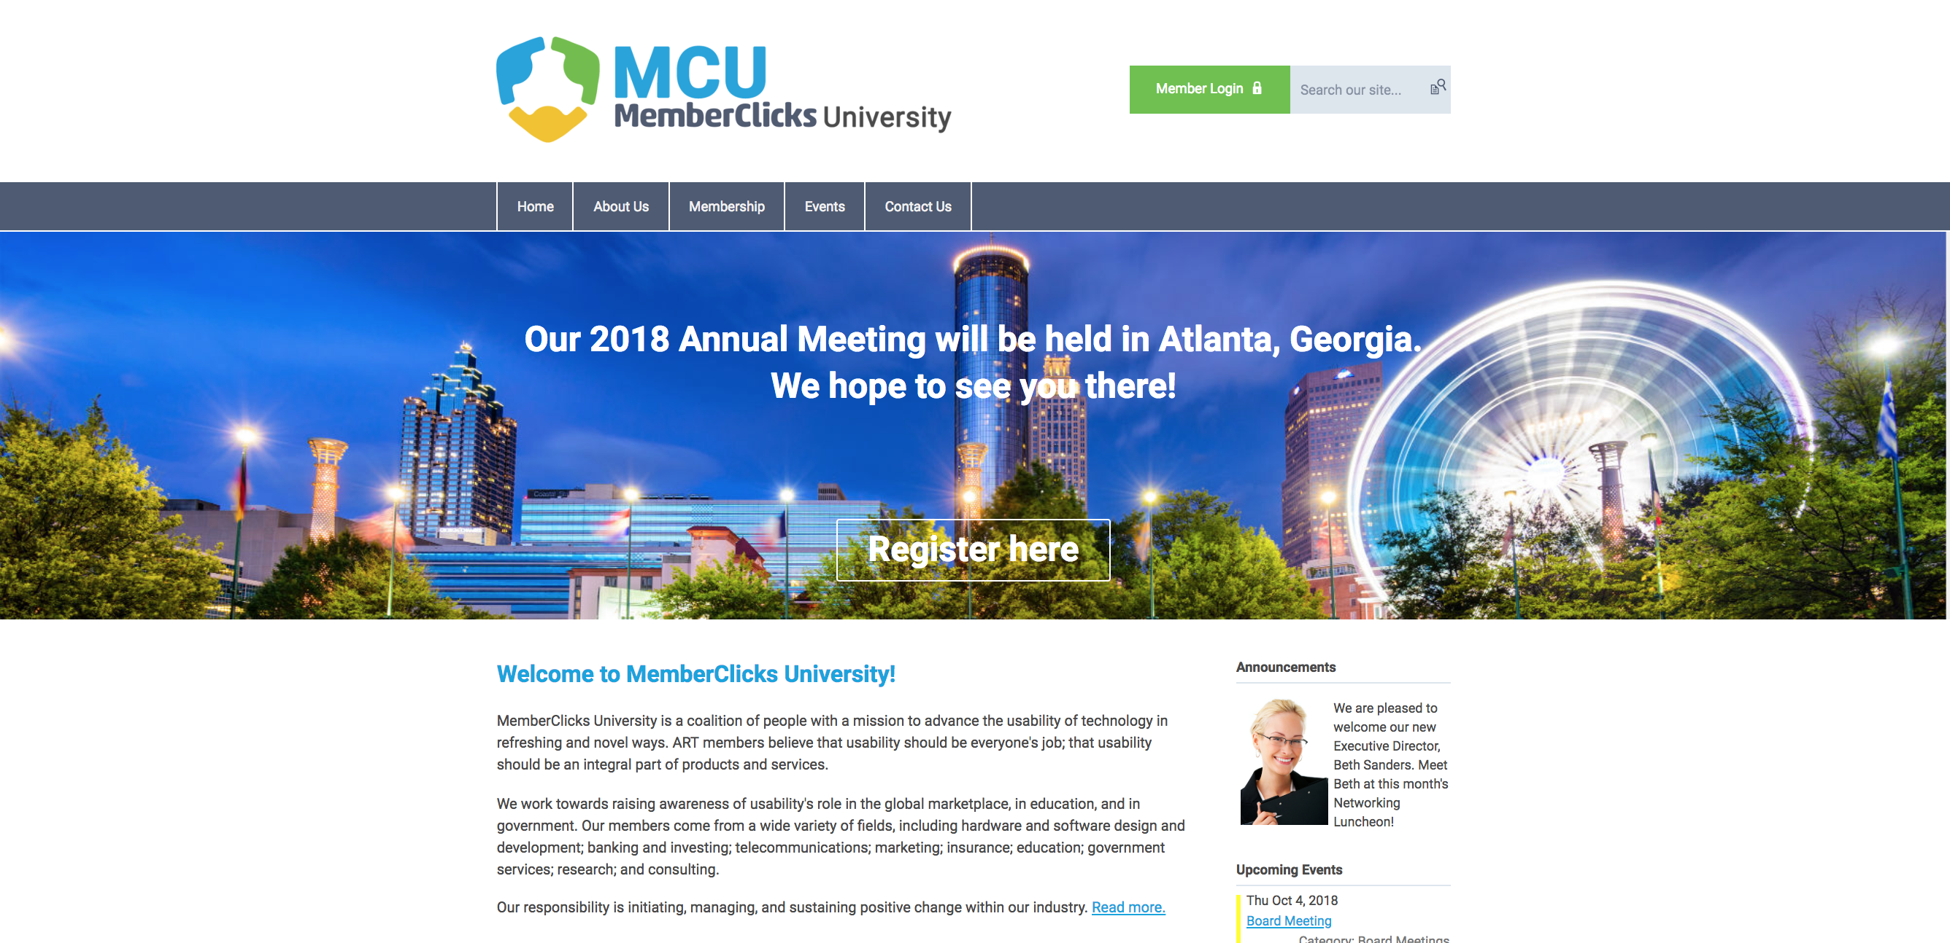
Membership Has its Privileges
Our membership portal is powered by MemberClicks, the association industry’s most powerful Association Management Software systems.
Our site offers many self-service and exclusive benefits that only members can take advantage of.
To ensure only Members receive these benefits, these areas of our site require a valid log in.
The pages in this guide will teach you how to log in and update your information, as well as take advantage of as many benefits as possible.
The more you update and personalize your membership, the more value you will receive from us.

Slide 3
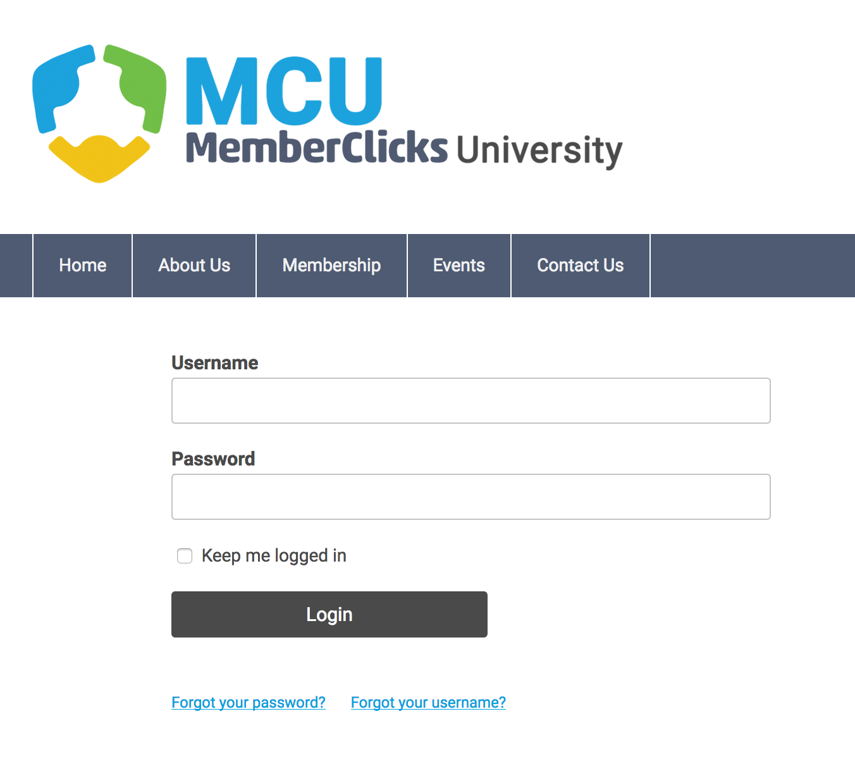
Take Control of Your Membership
Once you have a Username and Password, you can use it to access any Members-only or restricted items, like event discounts, ITEA Journal of T&E, recorded webinars, conference proceedings, member directory and the social community features.
If you have forgotten your password, no worries! Click ‘forgot your password’ and enter the email address associated with your profile. You will then be emailed a link to reset your password.
(HINT: Your email address is your username. The first time you login you WILL have to click reset password) Note: To receive the link via email, the email address you enter must be the email address in your membership profile.

Slide 4
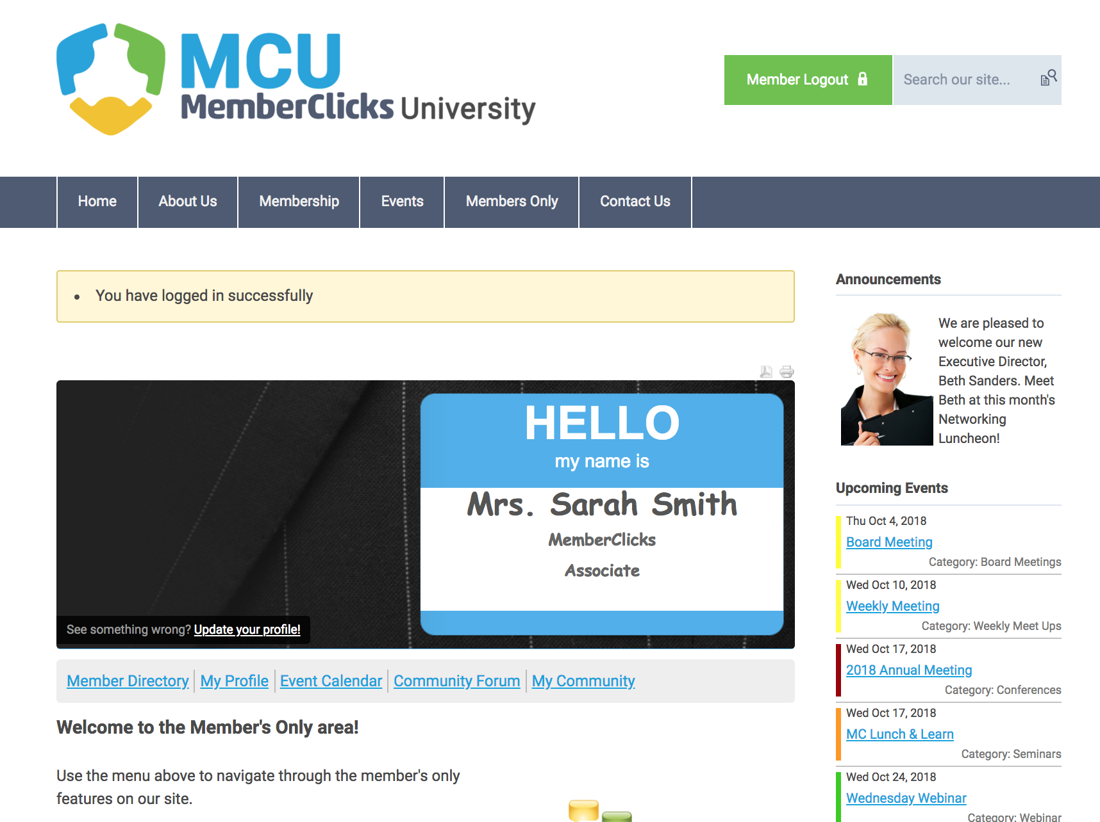
What Can I Do Here?
View your profile
View/ Pay Invoices
Access the Member Directory*
View the Event Calendar
Access to Social Community Features *
View any members only content on this website
Interact and connect with other members*
* Coming soon

Slide 5
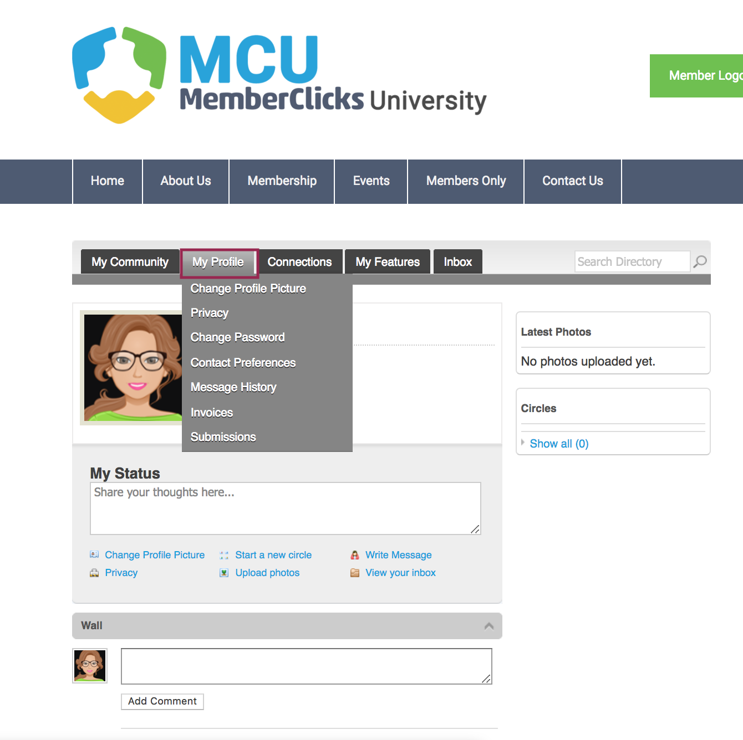
If you hover over the words ‘My Profile’, you can make additional changes to your profile.
In this area you can:
Change your profile picture that shows on the Member Directory
Edit your privacy settings
Change your password
Manage how we contact you
View past emails we have sent to you (message history)
View a list of all your invoices
View all forms that you have submitted

Slide 6
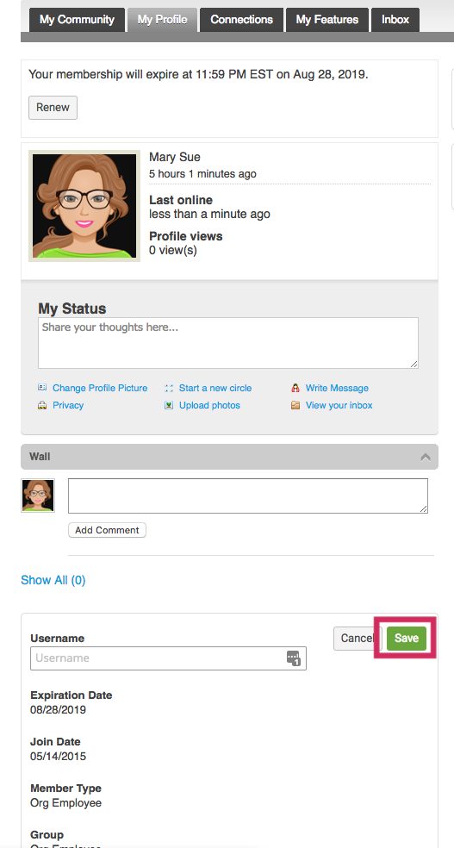
My Profile
These fields show you what information we have now. Please fill in any blanks so that we can know you as well as possible.
Information here can be used on your Directory listings or for communications we send out.
Make sure to click Save at the end of the process.

Slide 7
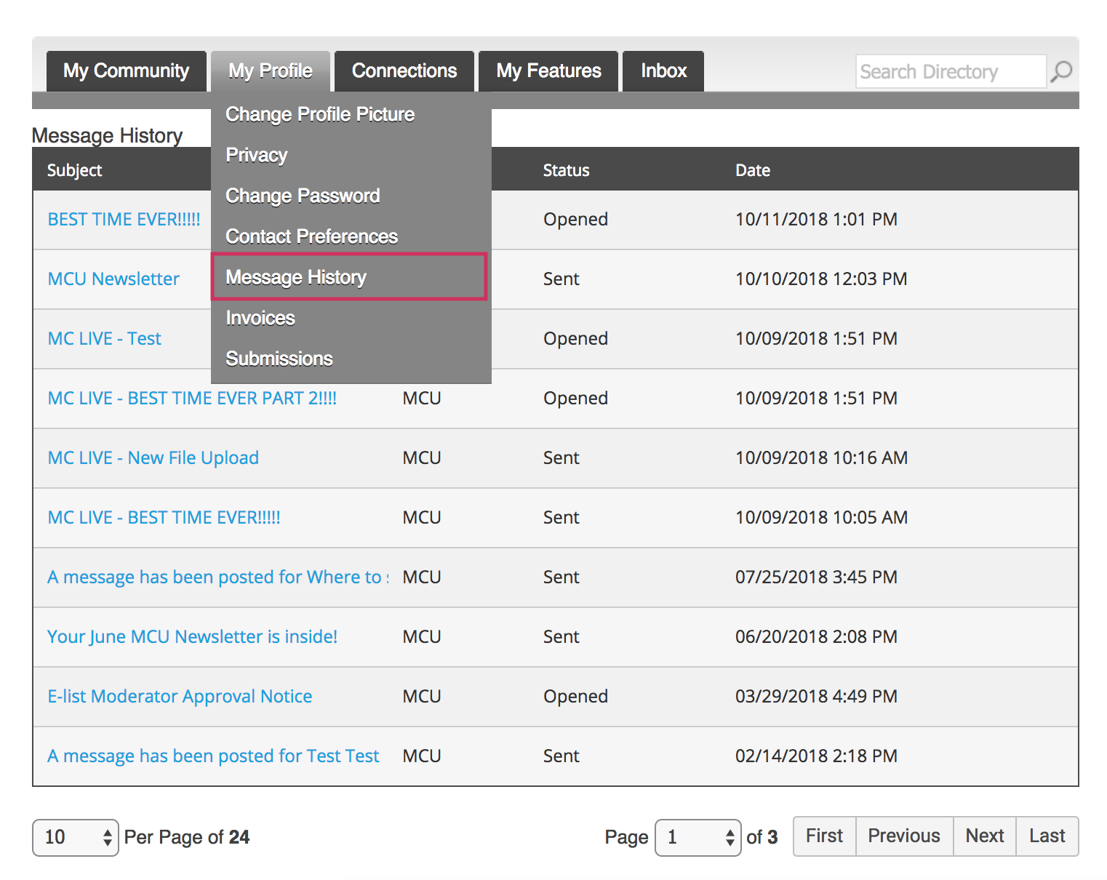
Message History
The Message History area will show you all of the emails the organization has sent to your personal inbox. If you ever delete an email, there is a full record kept in this area of your profile. Simply click on the subject line to open the body of the email.
Having a hard time receiving emails? Whitelist our email address. Click here to see how.

Slide 8
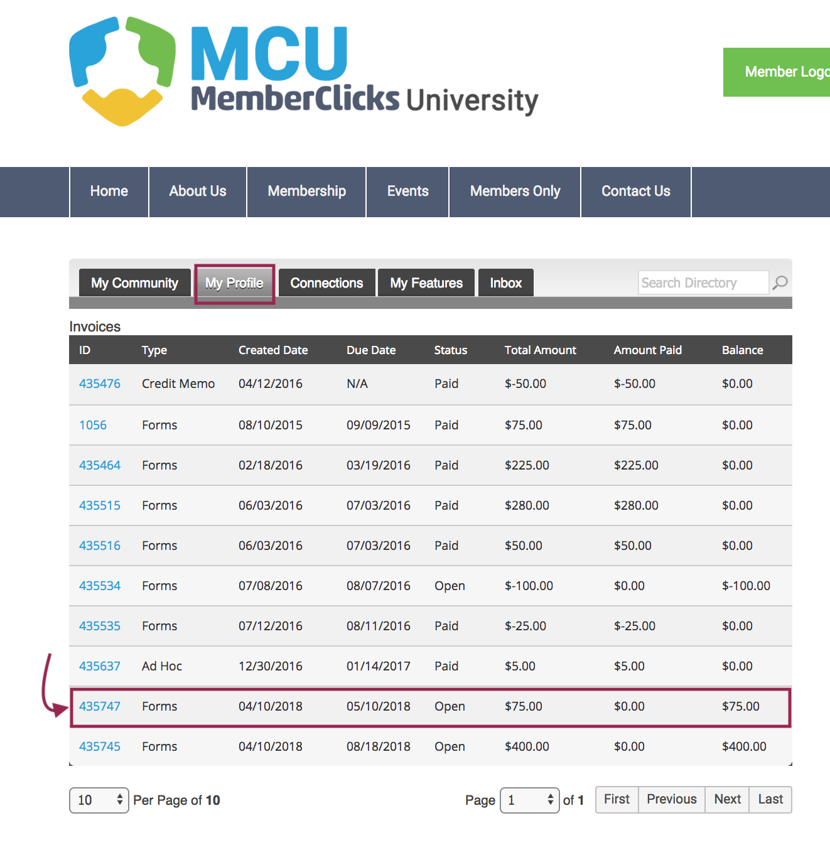
View your Invoices
Under ‘My Profile’ you have the ability to display your invoices.
This area will show you past paid invoices and open invoices that you are able to pay.
To open any of these invoices, simply click on the Invoice ID to view the invoice.

Slide 9
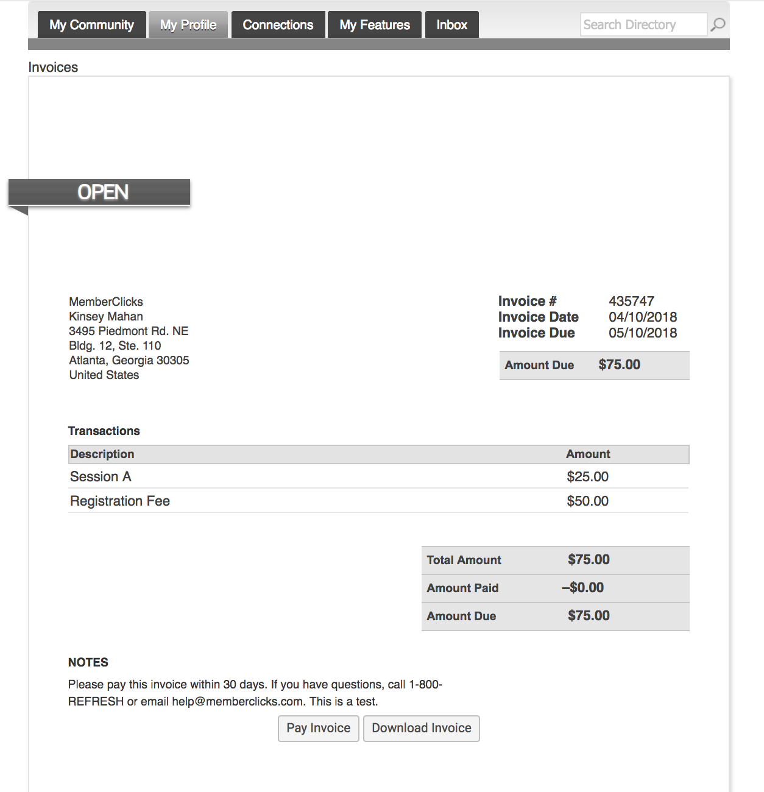
Pay Your Invoices
Once you have clicked on the Invoice ID, you have the option to pay an open invoice or download an invoice.
Paying an Invoice: Paying an invoice couldn’t be easier. Simply click on the button at the bottom ‘Pay Now’. Our payment area will come up for you to enter your card and billing information.

Slide 10
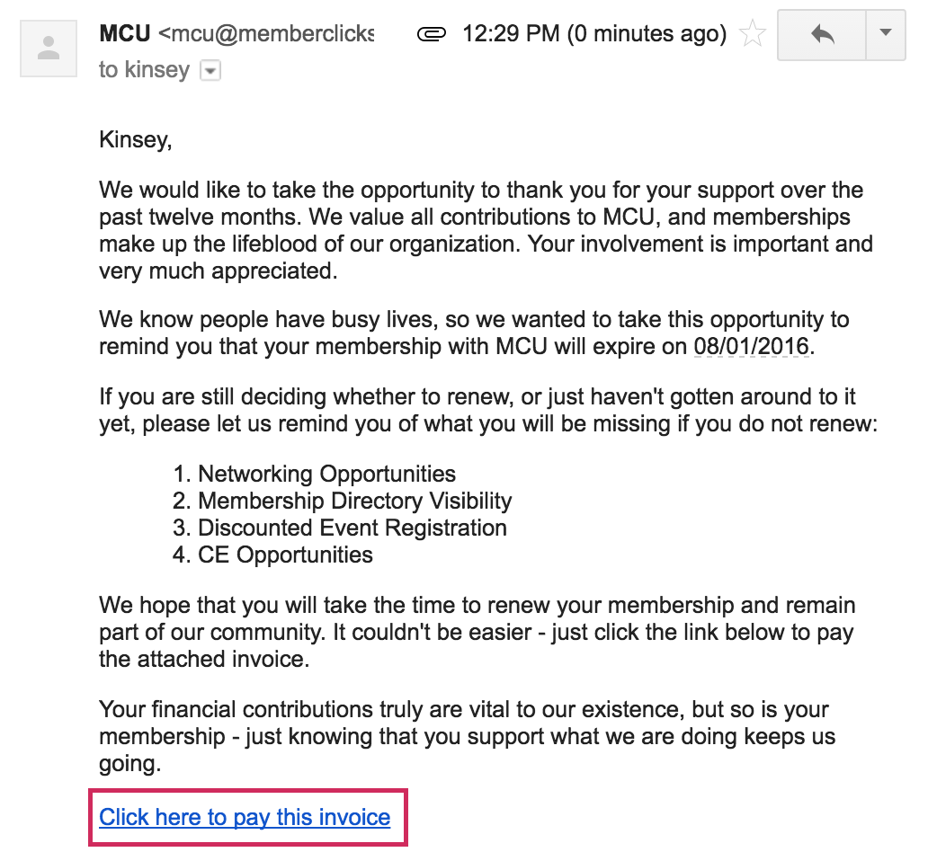
How to Renew Your Membership
Here's an example of a renewal email that will be sent directly to your personal email inbox.
A member can renew their own membership in one of three ways:
By paying the auto-generated Renewal invoice tied to your renewal notification
By logging in and submitting a Renewal Form
By logging in and using the ‘Renew’ option from the My Profile page

Slide 11
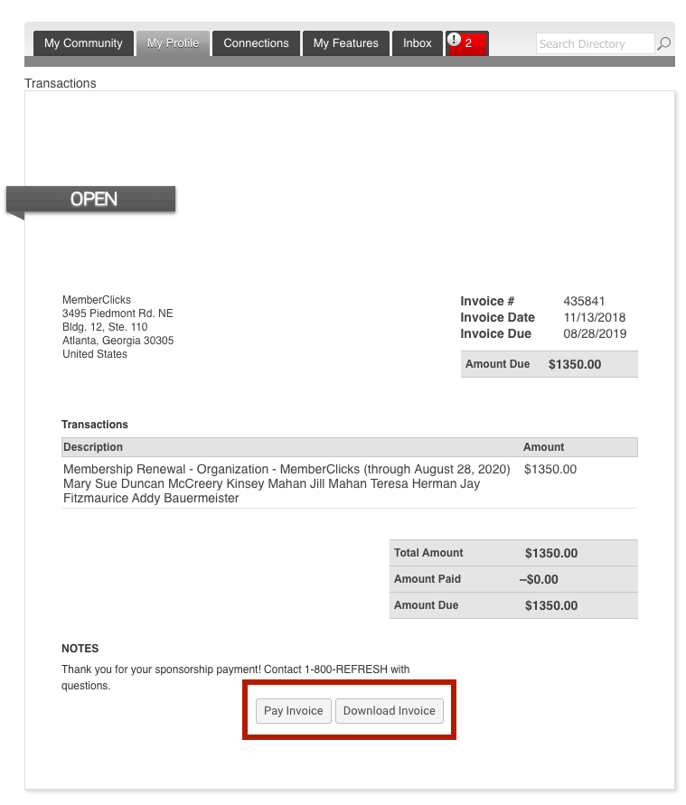
Pay Your Renewal Invoice
Once you have clicked submit, you will be taken to your renewal invoice to pay.
Paying an Invoice: Paying an invoice couldn’t be easier. Simply click on the button at the bottom ‘Pay Now’. Our payment area will come up for you to enter your card and billing information.

Slide 12
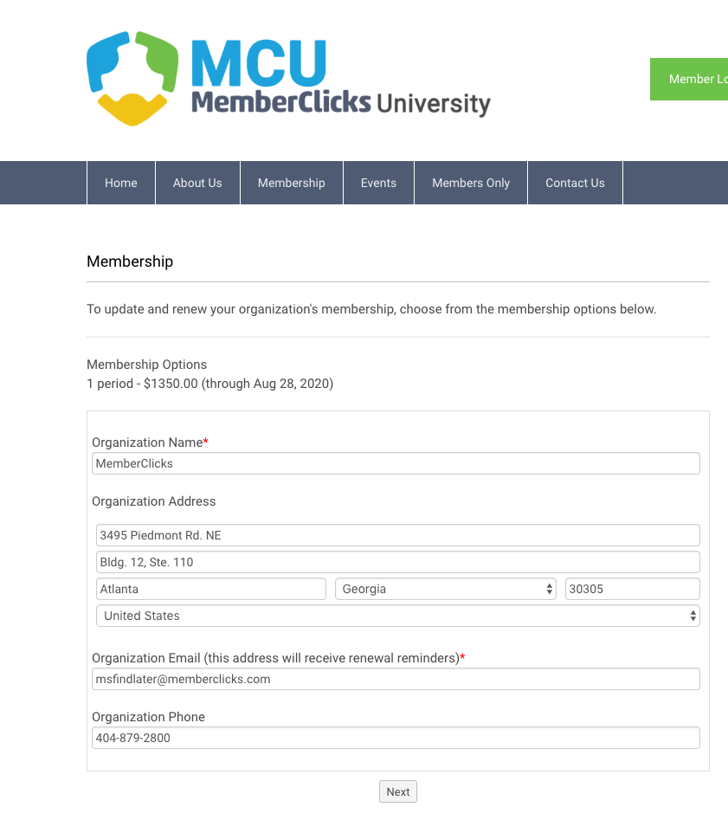
Renewal Form
Please take our renewal form to renew your membership for the next year.
By taking the renewal form, it allows you the opportunity to update your information, and add any linked profiles as needed.
Once you have completed our renewal form, a renewal invoice will be generated and emailed to you.
Note: In order to renew, you must have received a renewal email notification.

Slide 13
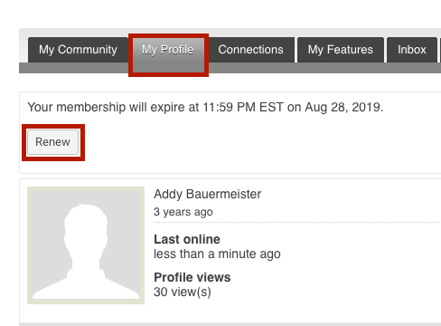
Renew From Your Profile
Log in
Click ‘Renew’
Navigate to ‘My profile’

Slide 14
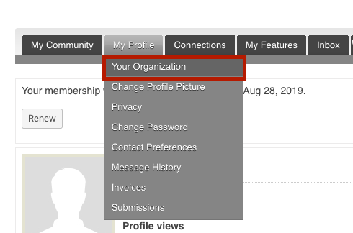
Organization Structure
Key Contacts changes to Organizational Profiles
If you are the Key Contact (aka: admin) to an Organization, you are able to make changes to the organization profile through your individual profile. To update your Organization's’ profile, hover your mouse over ‘My Profile’ and click on ‘Your Organization’.

Slide 15
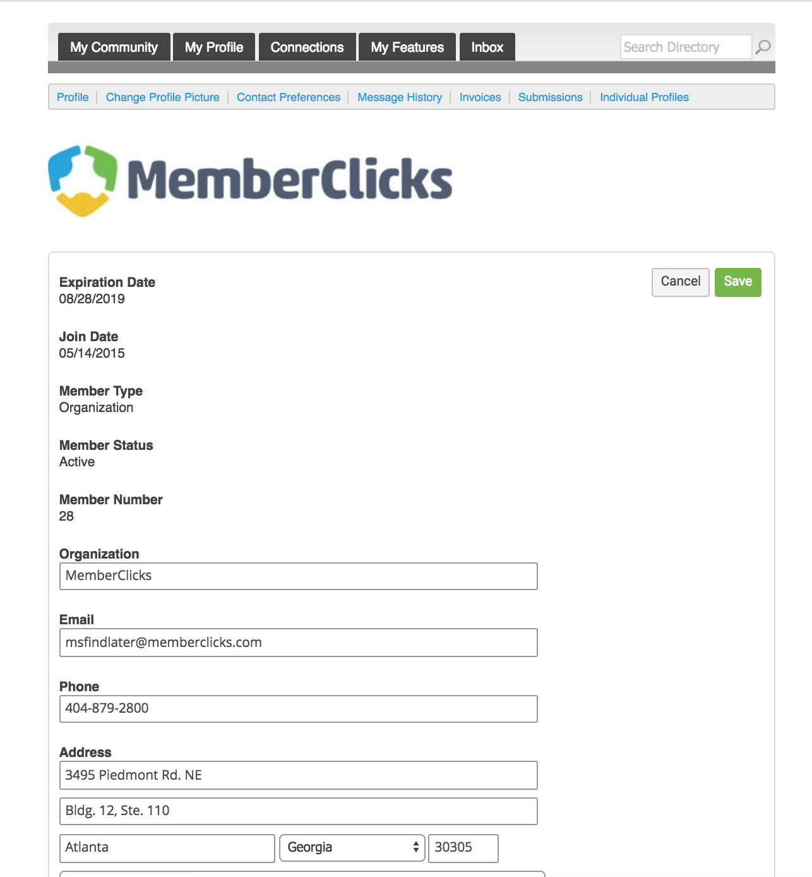
Key Contacts
Information here can be used on your Directory listings or for communications we send.
These fields show you what information we have now. Please fill in any blanks.
Note: the email field is the email address we will send your renewal notice to.
Make sure to click Save at the end of the process

Slide 16
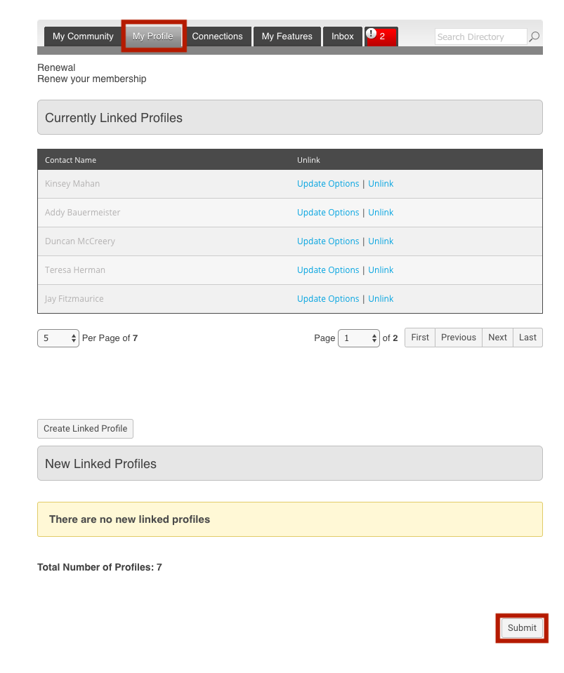
Key Contacts
Key contacts can pay dues on behalf of the organization
Log in to your profile> click ‘Renew’
This will take you to a page to review, add, and unlink any current linked profiles.
Once you are finished reviewing/ making changes to this area, click ‘Submit’ at the bottom.
You will now be taken to your renewal invoice to pay or download.

Slide 17
COMING SOON
These Features will be available soon!
Notes:
At some point in a world long long ago the dream of AMS was that it could help you realize this imagined world….. But it isn’t working

Slide 18
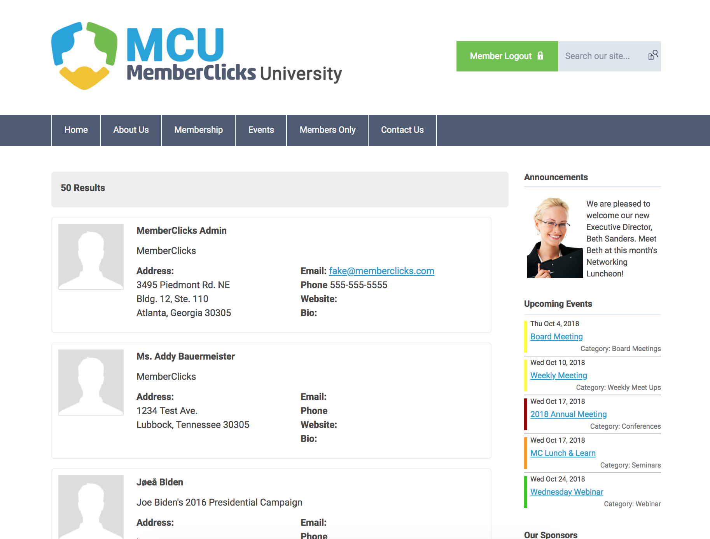
Member Directory
Our Member Directory can be valuable in connecting you with other members. To update what displays for your profile in the directory listing, please edit your profile that was provided in the earlier steps.

Slide 19
Connections
This area provides the opportunity to connect and build relationships with other members. You can;
See all your connections with other members
Browse the directory
Search for members
View your connection requests to other members.
See requests from other members to connect with you.

Slide 20
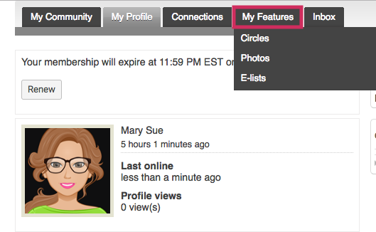
My Features
Your member profile is now a gateway to connect and engage with other members of our community.
Some of the new features of our website include:
Similar to Facebook™ friends or LinkedIn™ connections, you can now form connections with your friends and colleagues.
Create albums and upload photos to your profile to share with other members.
Status messages give you a way to share what you’re working on with other members.
Profiles have a “wall” where connections can leave messages for each other.
Join user driven circles for special interest and discussion groups. You can create photo albums within Circles too!

Slide 21
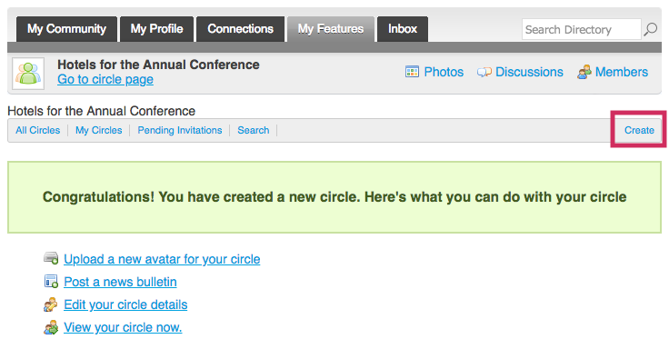
Circles
User driven area for discussions and networking. Circles allow members to create and manage special interest groups within the social community area of their profile. Circle participation allows members to share photo albums, announcements and private discussion forums.

Slide 22
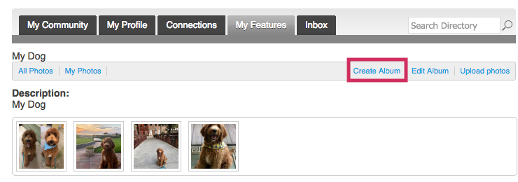
Photos
Members can add photo albums to their profiles or they can share photos within their circles

Slide 23
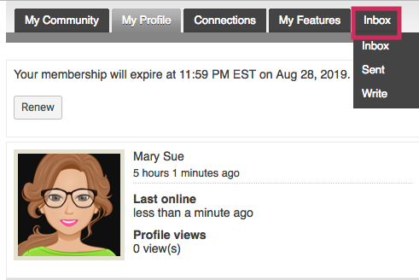
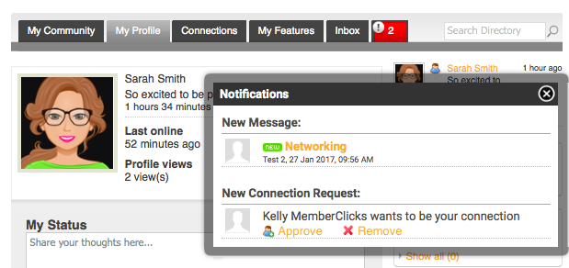
Inbox
Your Inbox will show you messages between you and other members. These are private direct messages between you and one other member.

Slide 24
Questions?
ELK Management Group Executive Team for ITEA Phone: 703-631-6220 www.itea.org | info@itea.org
Notes:
At some point in a world long long ago the dream of AMS was that it could help you realize this imagined world….. But it isn’t working

