Slide 1
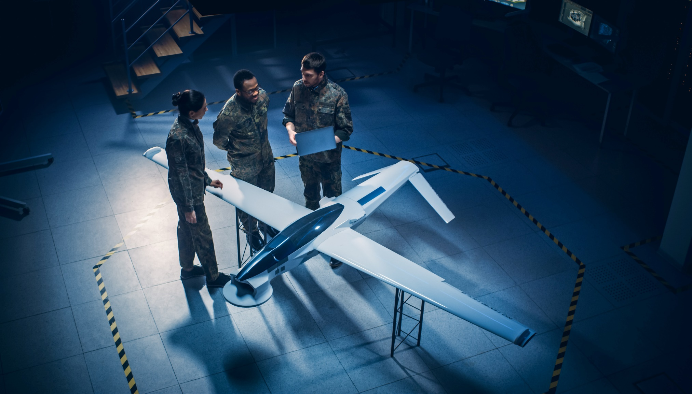

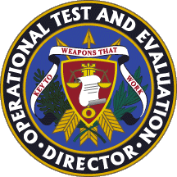
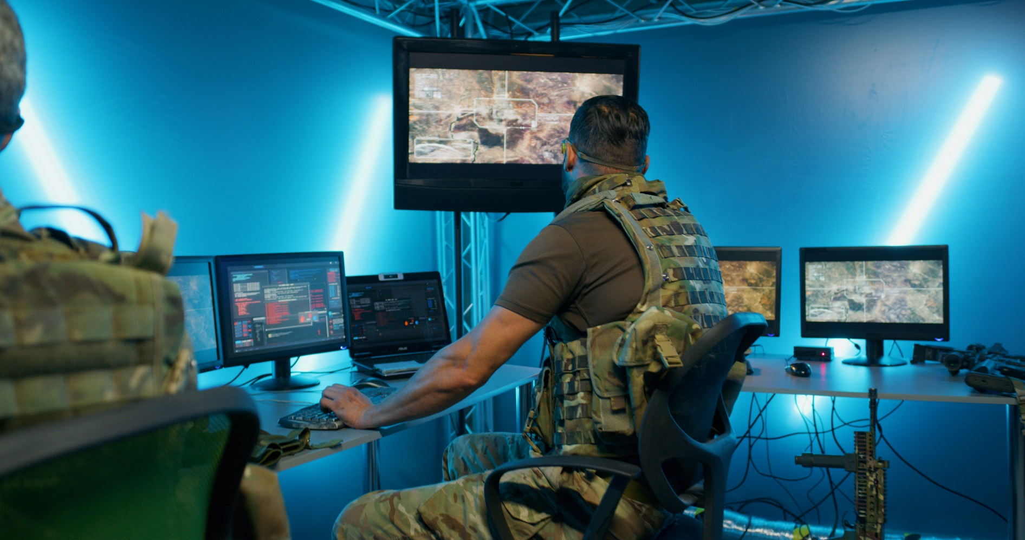

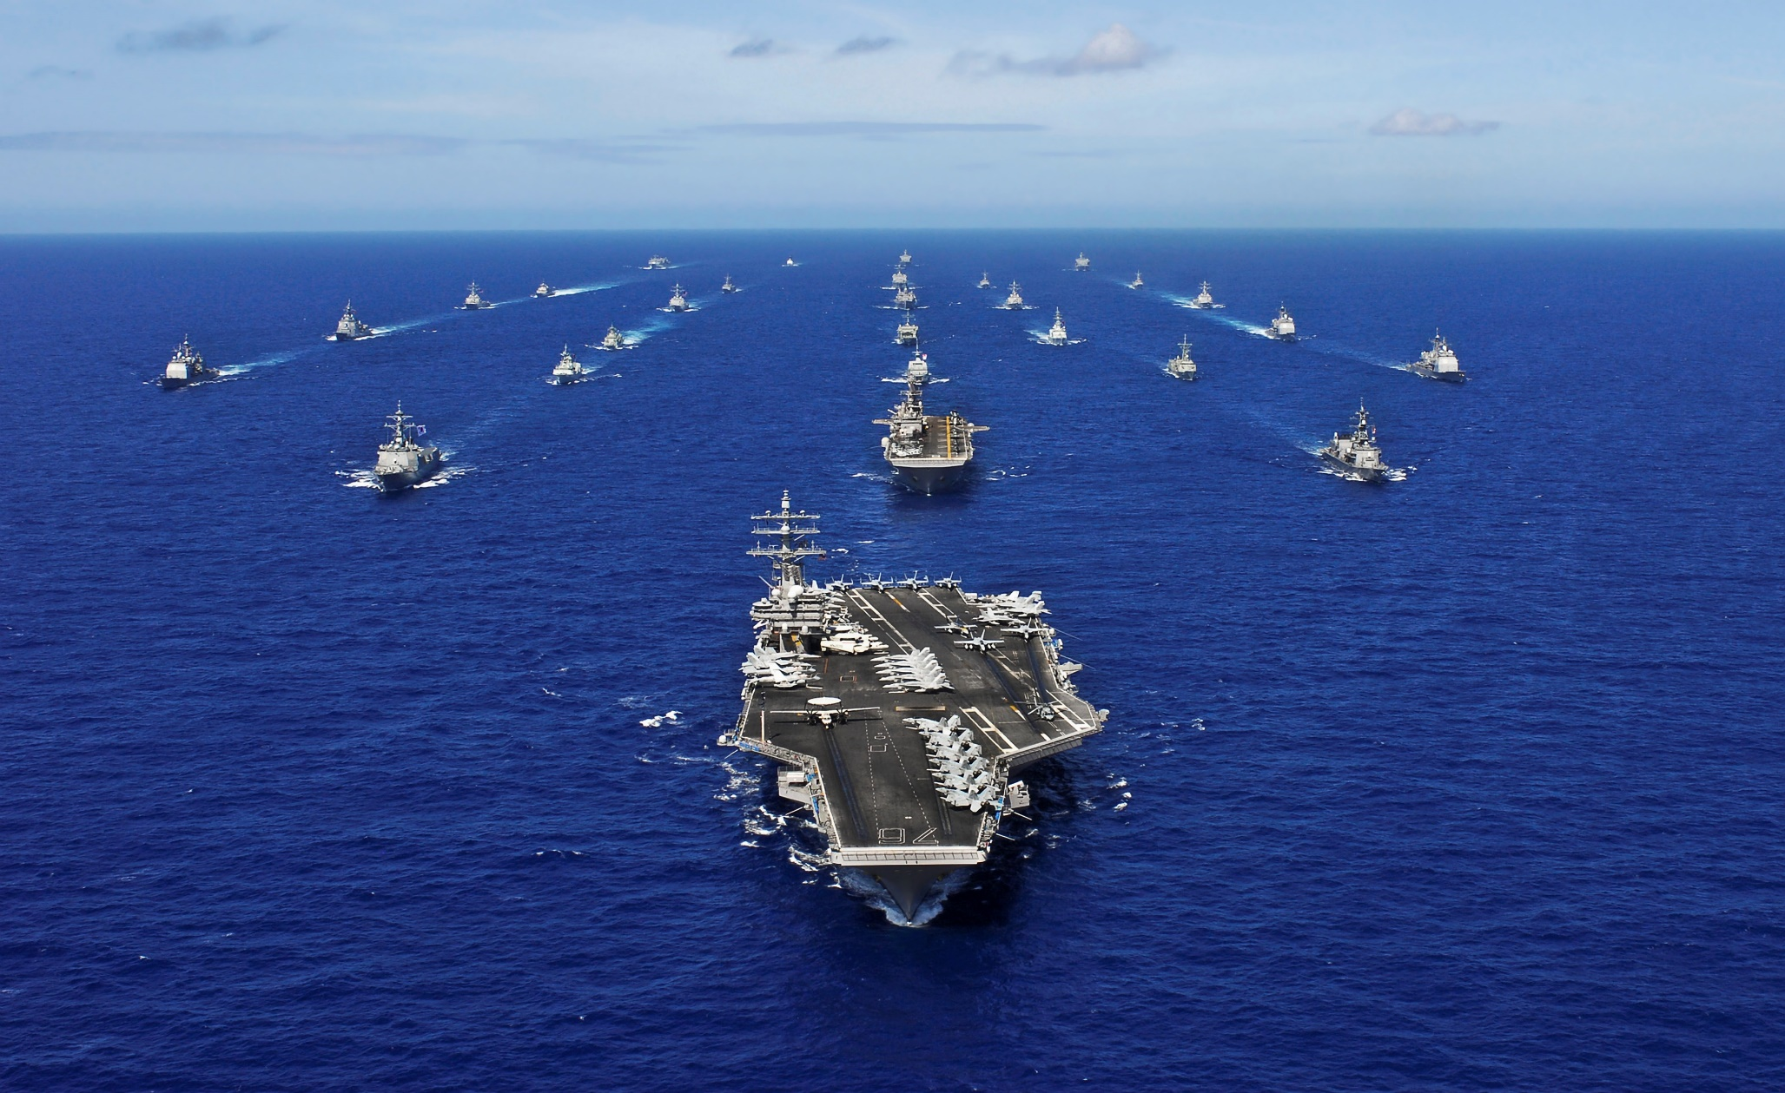
DOT&E Strategy Update 2022
20 July, 2022
Dr. Raymond O’Toole, Jr.
Principal Deputy Director, Operational Test and Evaluation
Notes:
Proposed cover slide

Slide 2
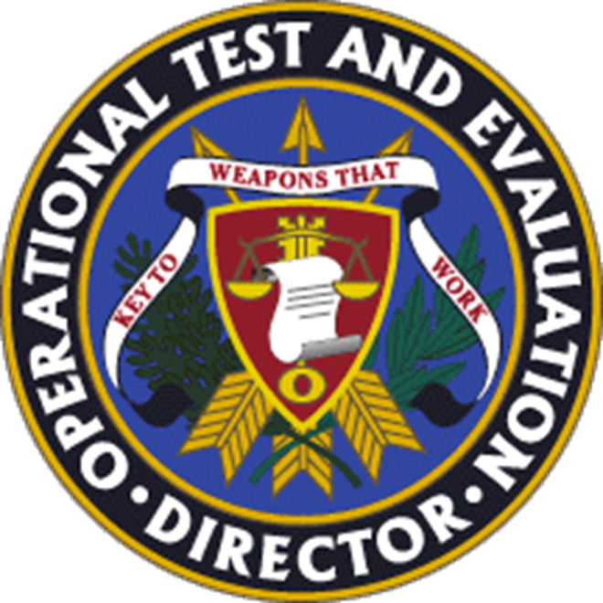
Our Statement of Intent
We will transform test and evaluation to ensure the delivery of the world’s most capable warfighting systems at the speed of need.

Slide 3
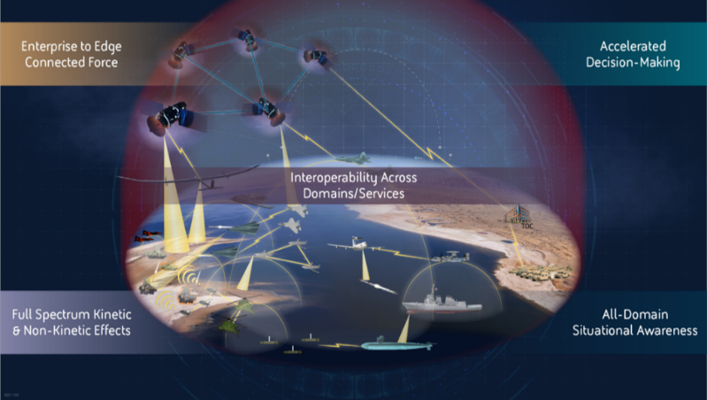
Our role in the 2022 National Defense Strategy
Engineering of Software-Reliant Systems
AI/ML
Joint All-Domain Operations
Data
Speed to Field
Culture
Talent Management

Slide 4
Think and Act like an Enterprise
Artificial Intelligence Autonomous Systems Joint All-Domain Command and Control Solutions Space System Cyber Defense and Offense | Electromagnetic Spectrum Operations Hypersonic Platforms Directed Energy Weapons Interoperability Quantum-Enabled Systems

Slide 5

Strategic Pillars - Our refocused strategy defines five strategic pillars to deliver our intent
Architect T&E around validated mission threads and demonstrate the operational performance of the Joint Force in multi-domain operations.
Standardize a scalable and adaptive representation of the multi-domain operating environment.
Implement measures, tools, and processes to efficiently evaluate kill webs and system-of-systems performance.
Test the way we fight
1
Develop and implement an enterprise-level T&E data management solution.
Integrate T&E in model-based system engineering to operationalize and optimize the shift-left approach
2
Accelerate the delivery of weapons that work
Embrace digital technologies to deliver high-quality systems at more dynamic rates.
Identify, assess and act on cyber, electromagnetic spectrum, space, and other risks to DOD mission – at scale and speed.
Standardize and automate mission-based risk assessments.
Emphasize cyber and electromagnetic spectrum survivability.
Evaluate operational performance in a contested space environment.
3
Improve survivability in a non-permissive environment
Implement fluid and iterative T&E across the entire system lifecycle to help assure continued combat credibility as the system evolves to meet warfighter needs.
Increase the use of credible digital twins in T&E.
Evaluate operational and ethical performance of AI-based systems.
Advance the evaluation of the operational performance of software-reliant systems.
Pioneer T&E of weapon systems built to change over time
4
Centralize and leverage efforts to access, curate, and engage T&E talent to quicken the pace of innovation across the T&E enterprise.
Identify and track T&E workforce capabilities.
Establish core T&E competencies and supply cutting-edge training and education resources.
5
Foster an agile and enduring T&E enterprise workforce

Slide 6

Mobilizing to Action
Governance Structure
Community Engagement
Communications and Change Management
Resource and Timeline

Slide 7
In summary: joint warfighting concepts grounded on seamless integration of multiple platforms and systems using software and data reliant technologies that work in concert across multiple domains are stretching our core T&E capabilities. For us this means new opportunities to support the lethality, sustainability, survivability, agility and the responsiveness of the joint force.
Our refocused strategy calls for cultural and technical changes that do not happen overnight. T&E transformation is an integral part of the DOD mission and the acquisition process: it will be an ongoing process to which we are asking all of our colleagues to contribute. We are committed to building a culture of cooperation and innovation founded on constant learning and agility. With your support we will develop and execute a research plan and a communication strategy aligned with our refocused strategy to facilitate the success of the T&E enterprise in the future.

Slide 8
DOT&E Strategy Update 2022
Dr. Raymond O’Toole, Jr.
raymond.d.otoole1.civ@mail.mil

