Slide 1


DevOps to DevSecOps:
Making Security Part of Your Development Operations

Slide 2

Agenda
AGENDA
ACQUIRED DATA SOLUTIONS
Application Security Challenges
DevOps to DevSecOps Road Map
Where Do I Start?
Case Study
Solution, Implementation, Outcome
Q&A

Slide 3
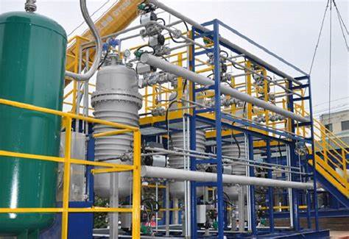
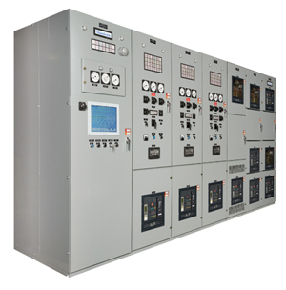
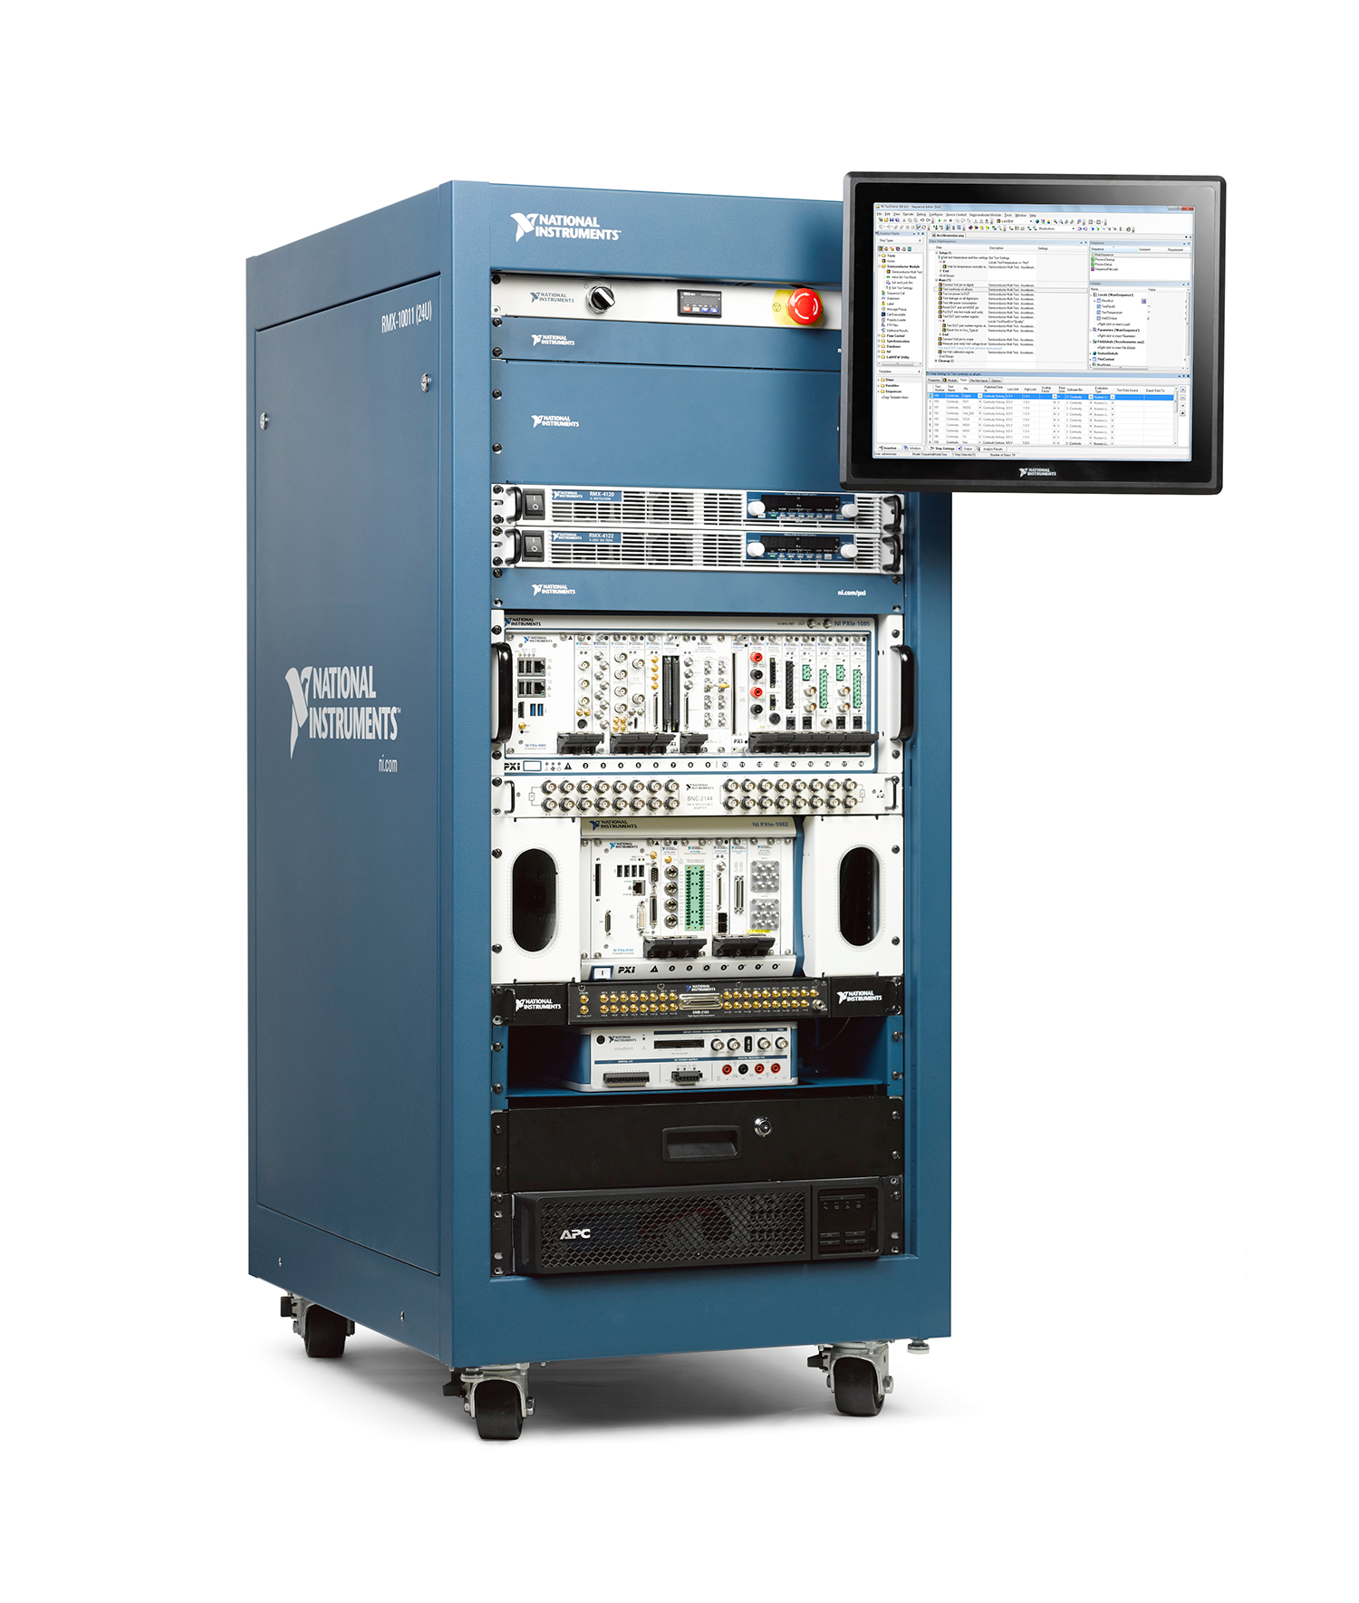

Operational Technology (OT) Overview
TEST SYSTEM OVERVIEW
WHAT IS OPERATIONAL TECHNOLOGY (OT)?
EXAMPLES OF OT
HOW DOES OT RELATE TO IOT?
Supervisory Control & Data Acquisition Systems (SCADA)
Programmable Logic Controllers (PLC)
Human Machine Interface (HMI)
Distributed Control Systems (DCS)
OT is “the hardware & software dedicated to detecting or causing changes in physical processes through direct monitoring and/or control of physical devices.”
OT is “used primarily in industrial control systems for manufacturing, transportation & utilities – and unlike information technology (IT), the technology that controlled operations in those industries was not typically networked.”
With emergence of Internet of Things (IOT), Operational Technologies are now being “IP-Enabled / Networked” which establishes a need for:
Security Boundaries
Assessments
Countermeasures to ensure operations are not being impaired by Threats.
Chemical Filtration Systems
Power Control System
Automated Test Equipment
Manufacturing Equipment

Slide 4
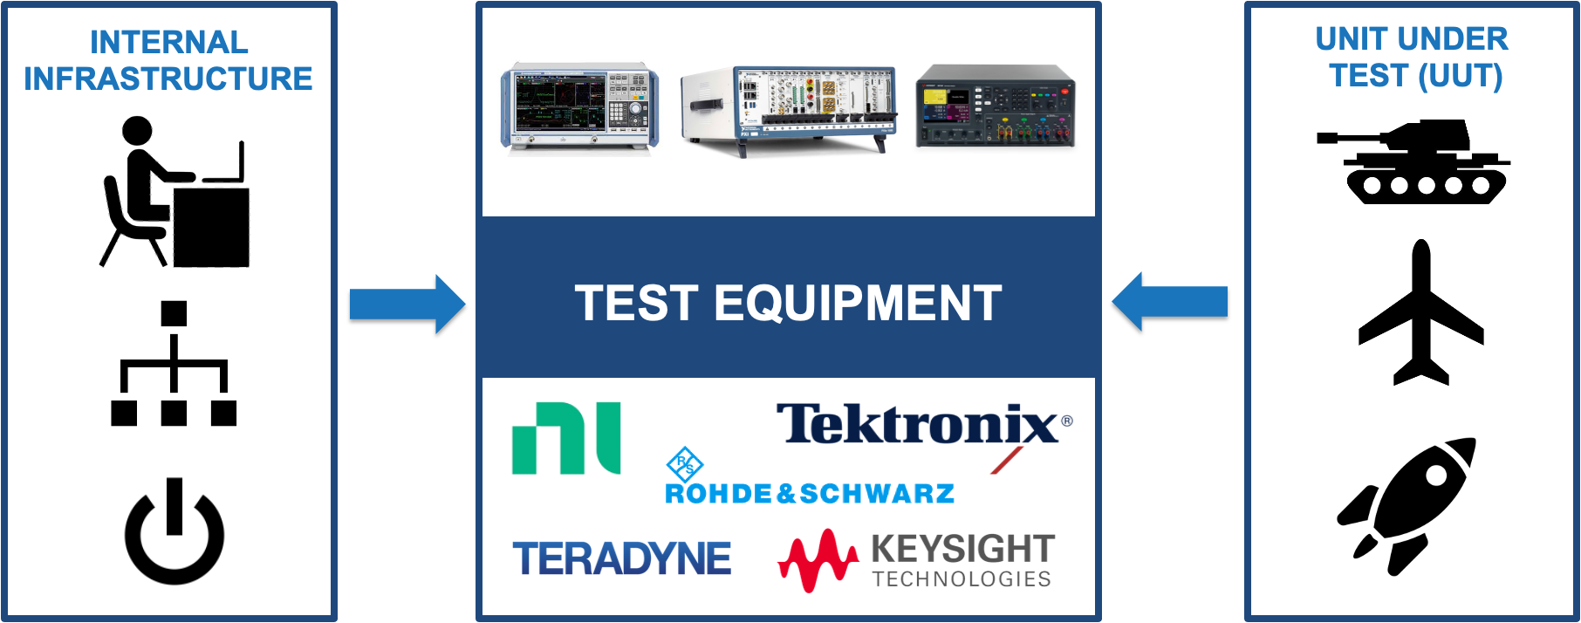
Test System Network
TEST SYSTEM OVERVIEW

Slide 5
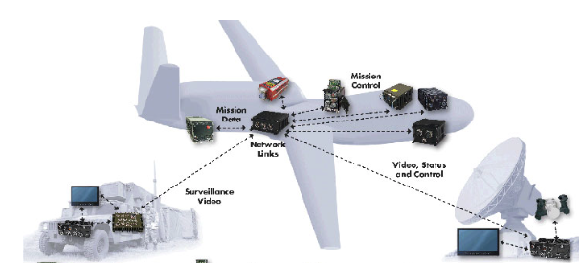
Aerospace Example
TEST SYSTEM OVERVIEW
AIRCRAFT SYSTEM INVOLVES MULTIPLE SEGMENTS:
On-board Avionics
Mission Computing
Ground Communication
Maintenance Equipment
Test Equipment
Focus on confidentiality; information protection
Focus on integrity and availability; mission protection

Slide 6


Problem #1 – Test Application Proliferation
APPLICATION SECURITY CHALLENGES
WEB PAGES
EMBEDDED SYSTEMS
Manual Testing = Slow
Outsourced Pen Tests = Expensive
SaaS Scans = After Production Deploy
Desktop Tools = Not CI/CD Friendly, Don’t Scale Well
OT Security Tools = Immature/undeveloped
IOT
APIs
Notes:
Penetration Test is manual
pay consultants to do penetration tests
Manual Tools - burp suite, zap attack proxy
Typically security testing is not automated.
Code changes daily. You invalidate the testing that day.
If an application becomes out of date, you have to manually test again because it may not be secure.
Manual testing via proxy capture (slow)
Outsourced pen tests (expensive)
Paid SaaS scans (only test public-facing app instances)
Desktop tools
Do not scale well
Not CI/CD friendly out of the box
Automation use cases are an after thought
Complete failure as scaled, repeatable practices

Slide 7
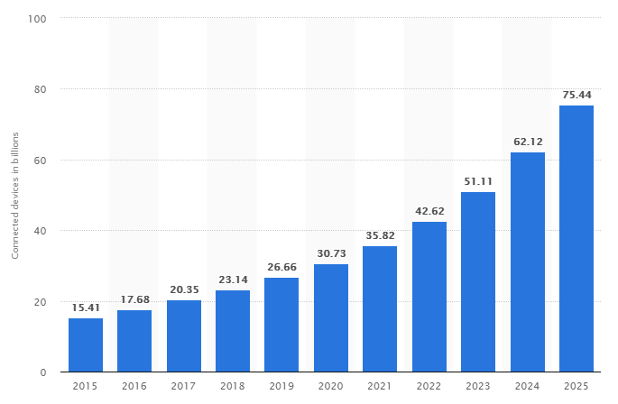






Problem #1 – Test Application Proliferation
APPLICATION SECURITY CHALLENGES
IOT Endpoint Explosion
IOT EXPLOSION
https://www.statista.com/statistics/471264/iot-number-of-connected-devices-worldwide/
Notes:
HTTP is the language of the web and it reaches into all sections of government, industry, academia and our personal lives
Websites with human-readable pages are already a huge footprint
API endpoints are also a large footprint and the number is growing even faster than traditional sites
Microcontroller-based endpoints: IOT/IIOT/OT is bigger still by an order of magnitude (tens of billions)

Slide 8

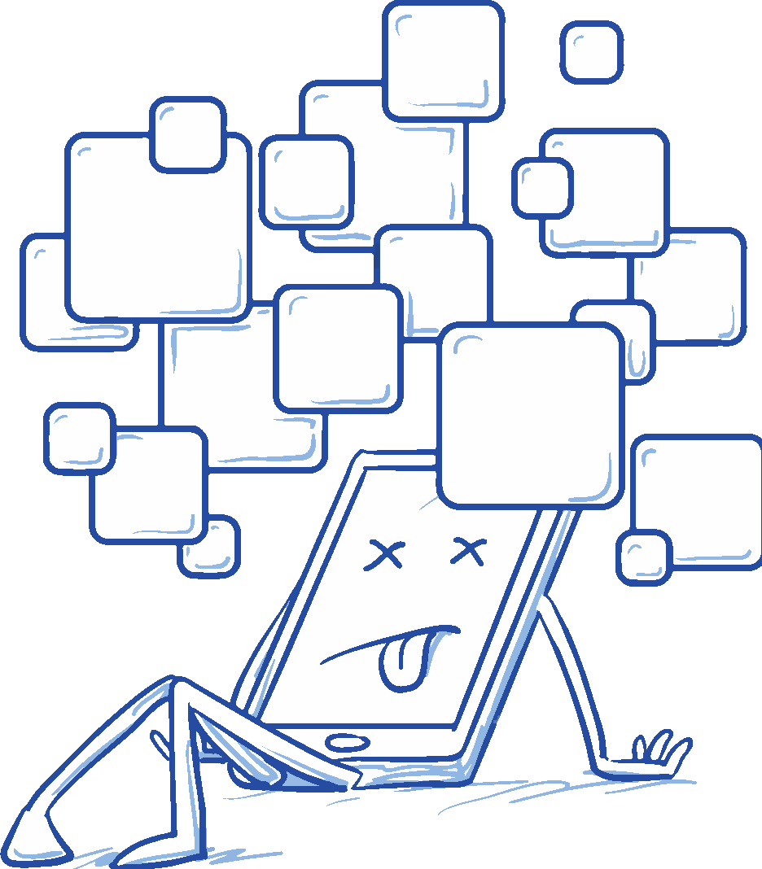


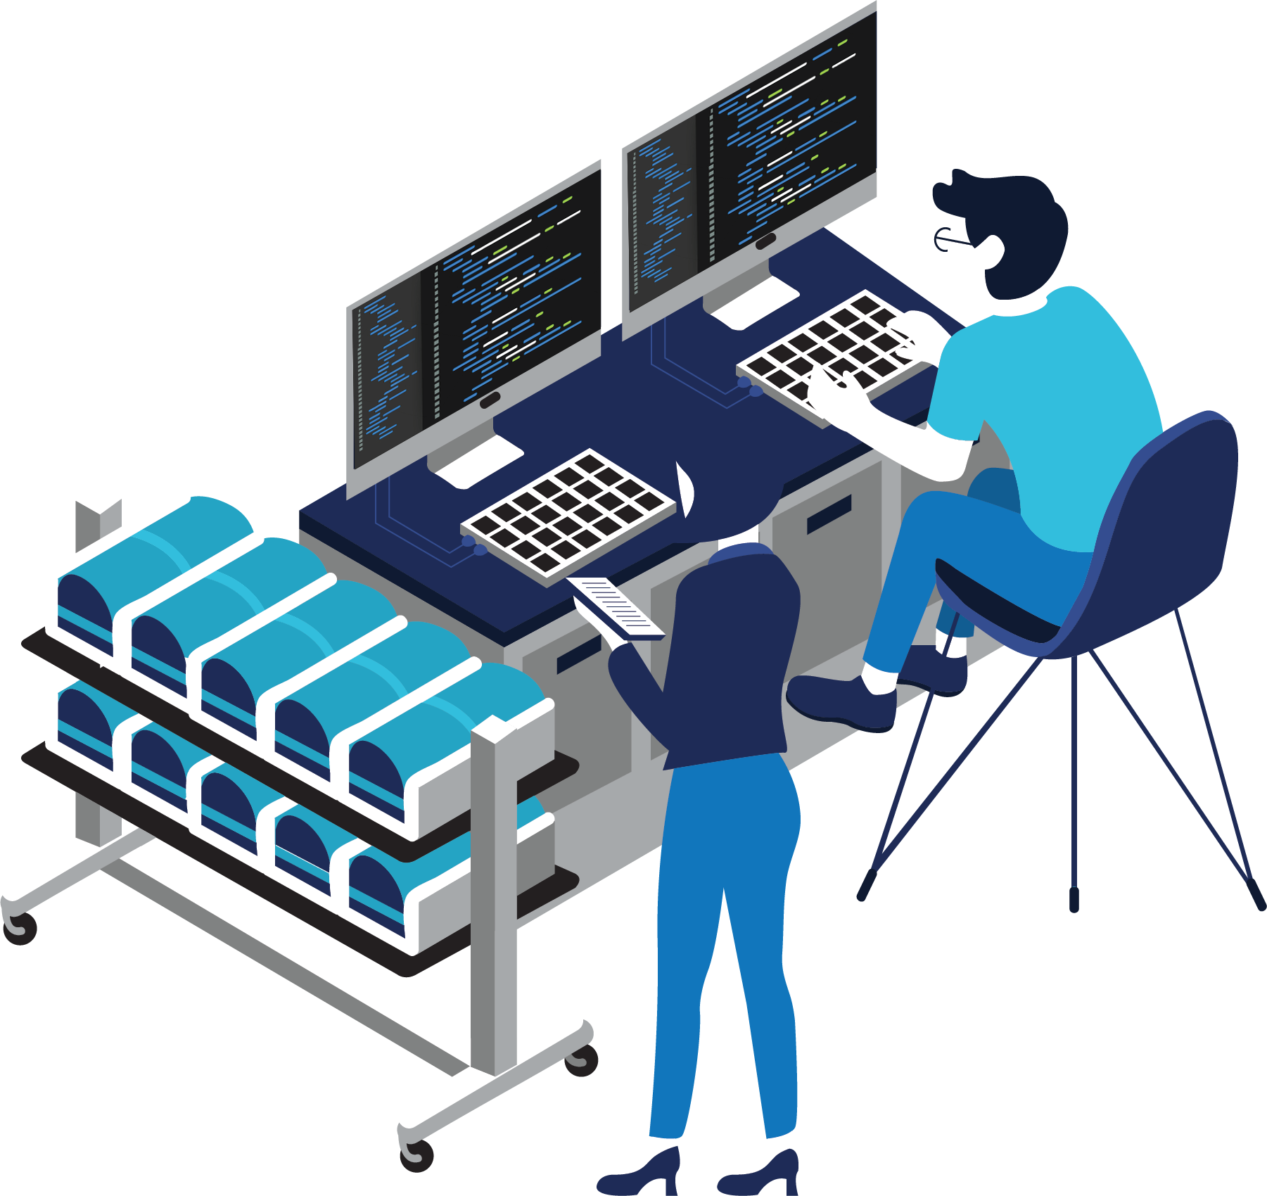


Problem #2 – Code Size & Complexity
APPLICATION SECURITY CHALLENGES
Security Testing is generally an after thought.
COMP
APP
LANG
LANG
COMP
MOD.
BAND-AID
APPROACH
MOD.
APP
Typical approach is to target a subset of applications for manual security testing.
Applications Change. They are not tested continuously.
Size & Complexity of Codebases only
increases over time.
Notes:
Test Applications as well.
Automation is going to have to come in somewhere.
The size of codebases only increases over time
Typical web application code is composed of MANY components (client side JavaScript libraries, server application modules, Multiple API endpoint services). The application inherits vulnerabilities present in these components
Software testing is difficult already but testing web applications is even harder because of the complexity of interconnected parts (browser, server, APIs)
Security testing is generally an afterthought and done once ‘at the end’ of the project
Code tends to live forever. There is no such thing as ‘the end’ of the project
A single code check in for a new feature can open up security holes. This makes CONTINUOUS security analysis a must in a world of rapid, frequent releases
SBOM: software bill of materials (all the parts that make the software)
Inventory of all the codes and where they are coming from.
Open Source = Git Hub Logo (you want to know the origin)
DAST
SCA - software composition analysis (product category for new security tools)

Slide 9
Teams are Overwhelmed by Scale of Testing
APPLICATION SECURITY CHALLENGES
Too many applications to test them all.
Application code changes daily, so they are not tested continuously.
Functional testing is automated, but security testing is not automated (if it is implemented at all).
Typical approach is to target a subset of applications for manual security testing.
Lack of collaboration between the IT Team and the OT System Engineering Team.
Notes:
This is where we are today
Band aid approach
DevOps

Slide 10




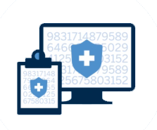


Industries
DEVOPS TO DEVSECOPS ROAD MAP
BANKING
(FinTech)
SERVICE PLATFORM
NON
PROFIT
CRYPTO EXCHANGE
RETAIL
MEDICAL
GOVCON
SCHOOLS
Notes:
Early adopters some of their best practices.
Add: Retail, GovCon, Medical, Schools
Solar Winds

Slide 11
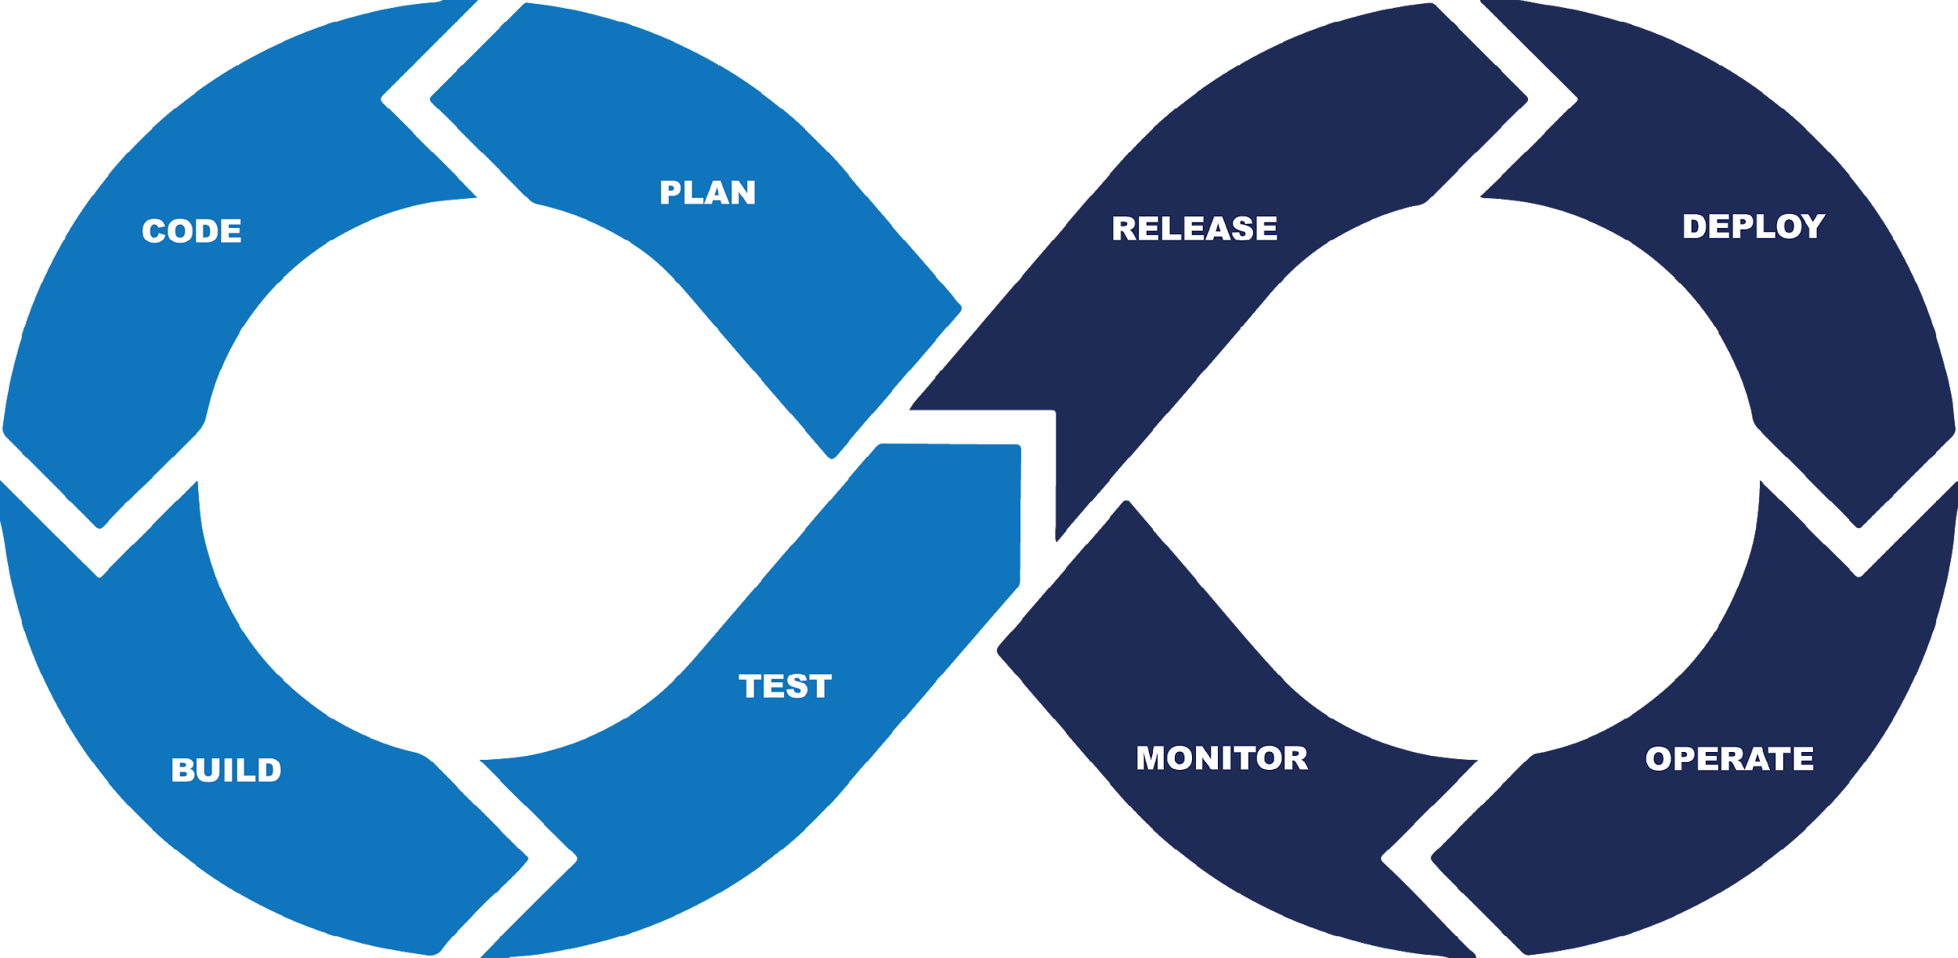
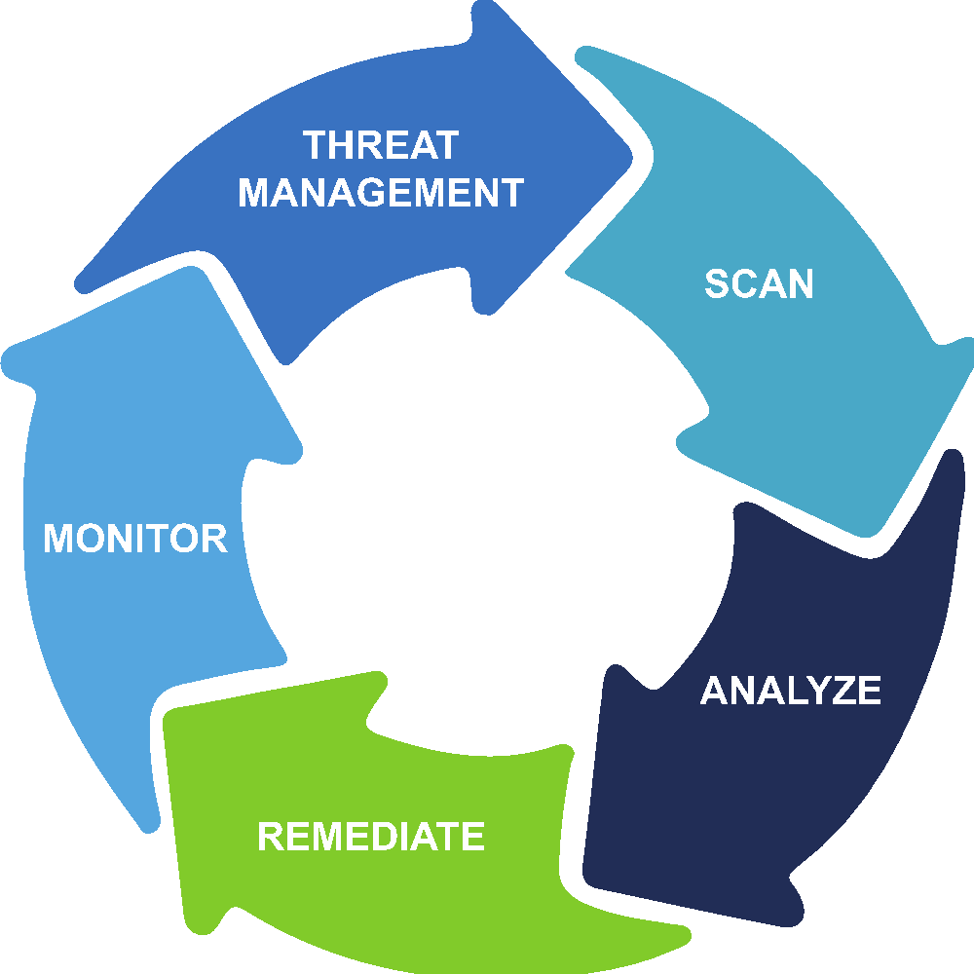
From DevOps to DevSecOps
DEVOPS TO DEVSECOPS ROAD MAP
DEV
OPS
DEV
SEC
OPS
Notes:
Road Map = Where we are now to where we are going.
Agile development and DevOps are mature practices but often lack security testing
DevSecOps for web code requires dynamic integration testing of deployed system. Static analysis is not enough
Putting the ‘Sec’ in DevSecOps can be incremental. Development projects need a concrete starting point.
Requires test tools that expose API control points (must be controllable)

Slide 12


Special Security Considerations for Code
DEVOPS TO DEVSECOPS ROAD MAP
Static Analysis is inadequate.
DAST Dynamic Application Security Testing
(provides attacker’s view).
DAST fits into the Integration Testing Phase.
Notes:
1. Static Analysis is inadequate. Program flow is across multiple servers and code structures. JavaScript code running in browser, Application code running on web server, Dynamic network calls to backend APIs and external assets (ads, tracking, monitoring)
2. Dynamic Application Security Testing (DAST) gives hacker’s full “outside looking in” perspective of attack surface and vulnerabilities of running application with all associated complexity.
3. DAST fits perfectly into the deploy and monitor phases of the DOD DevSecOps loop (Integration Testing Phase).

Slide 13







Adding DAST to Existing Pipeline
DEVOPS TO DEVSECOPS ROAD MAP
CHECKOUT
BUILD
FUNCTIONAL TEST
STAGING
PRODUCTION
Notes:
Jenkins orchestration – controls the build pipeline

Slide 14
Adding DAST to Existing Pipeline
DEVOPS TO DEVSECOPS ROAD MAP
SEC
CHECKOUT
BUILD
FUNCTIONAL TEST
STAGING
SECURITY TEST (DAST)
PRODUCTION

Slide 15

Starting Point
WHERE DO I START?
1
DoD Enterprise DevSecOps Reference*
2
Software Factory Model
3
Containers for Applications and Test Tools
4
Off-the-Shelf Orchestrator
5
Automated DAST Tools for Security Testing
* https://dodcio.defense.gov/Portals/0/Documents/DoD%20Enterprise%20DevSecOps%20Reference%20Design%20v1.0_Public%20Release.pdf
Notes:
- DOD Enterprise DevSecOps Reference Design is a good framework for thinking about distributed security test automation for web applications
Software Factory Model is the goal
- Use containers for both the applications under test and the test infrastructure
- Use an off-the-shelf orchestrator (Jenkins, for example) to run build/test/monitor pipelines
- Use modern DAST tools that are fully controllable via API calls

Slide 16
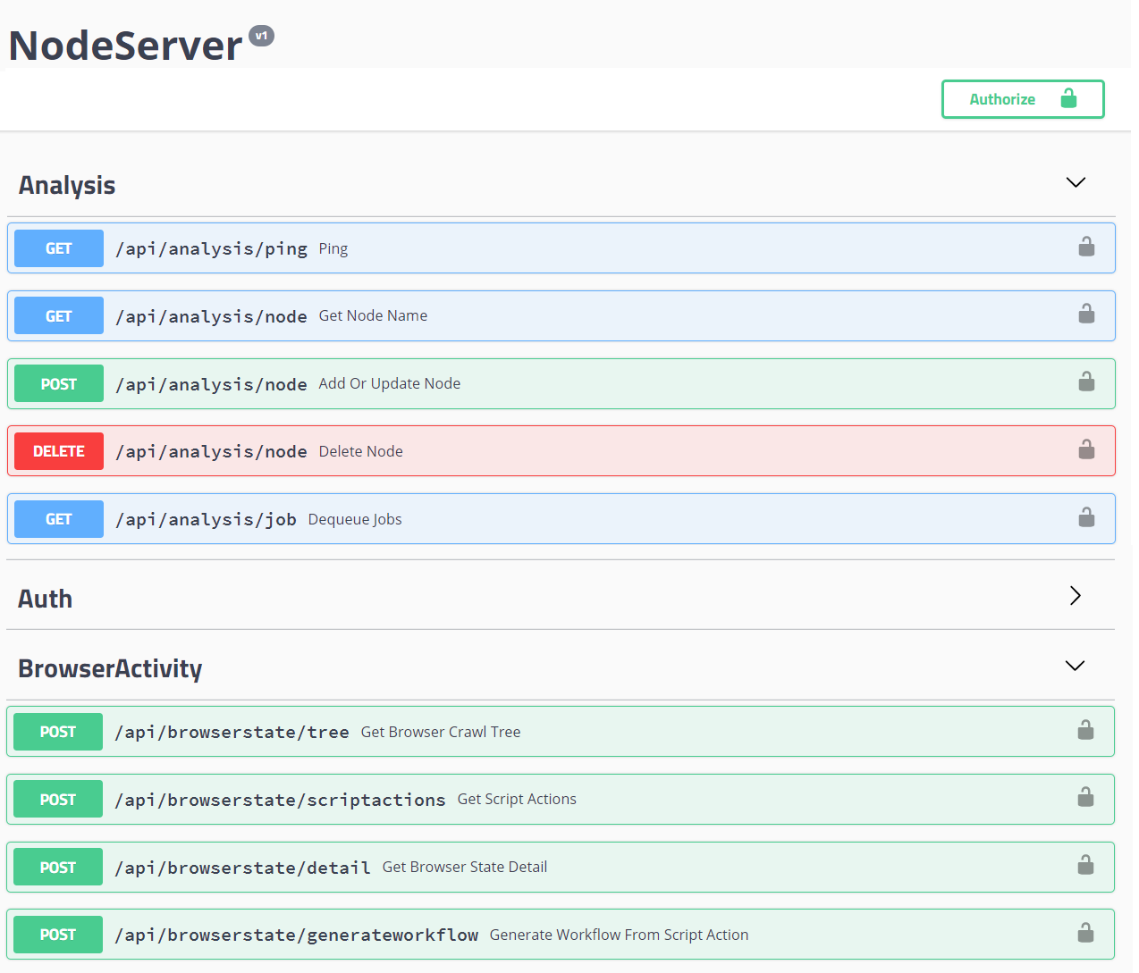
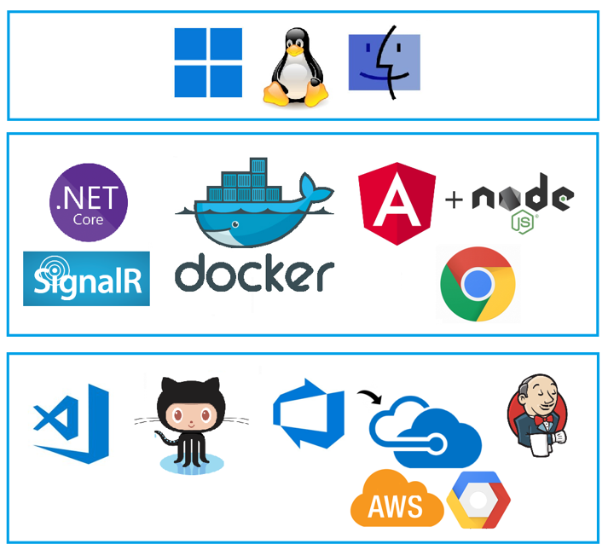

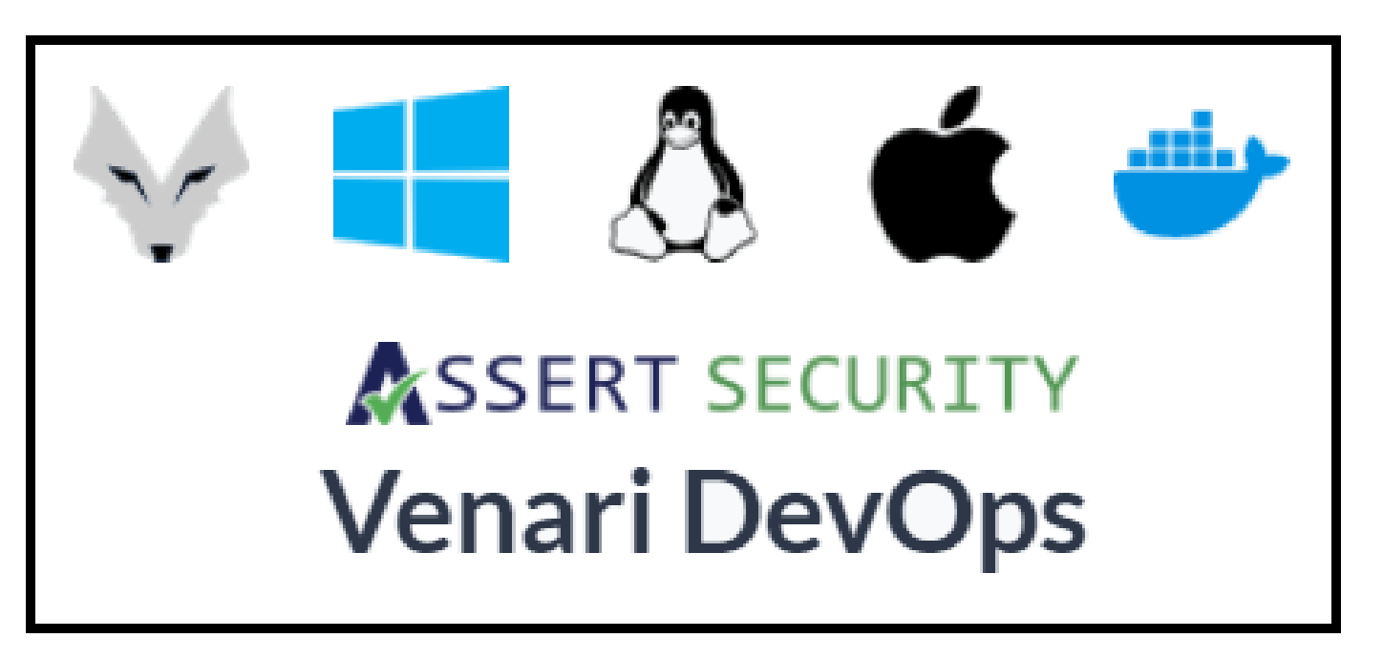
DAST Automation Case Study – Venari DevOps
CASE STUDY
Automate Everything
Cross-Platform
Elastically Scale up & out

Slide 17

DevSecOps DAST Example
SOLUTIONS
CHECKOUT
BUILD
FUNCTIONAL TEST
DEPLOY TO QA
SECURITY TEST (DAST) VENARI
DEPLOY TO STAGING
Notes:
Source Code Repository
Web Application Builder
Venari for Security Testing
Building the code
Deploying the code
Scanning the code (security)

Slide 18
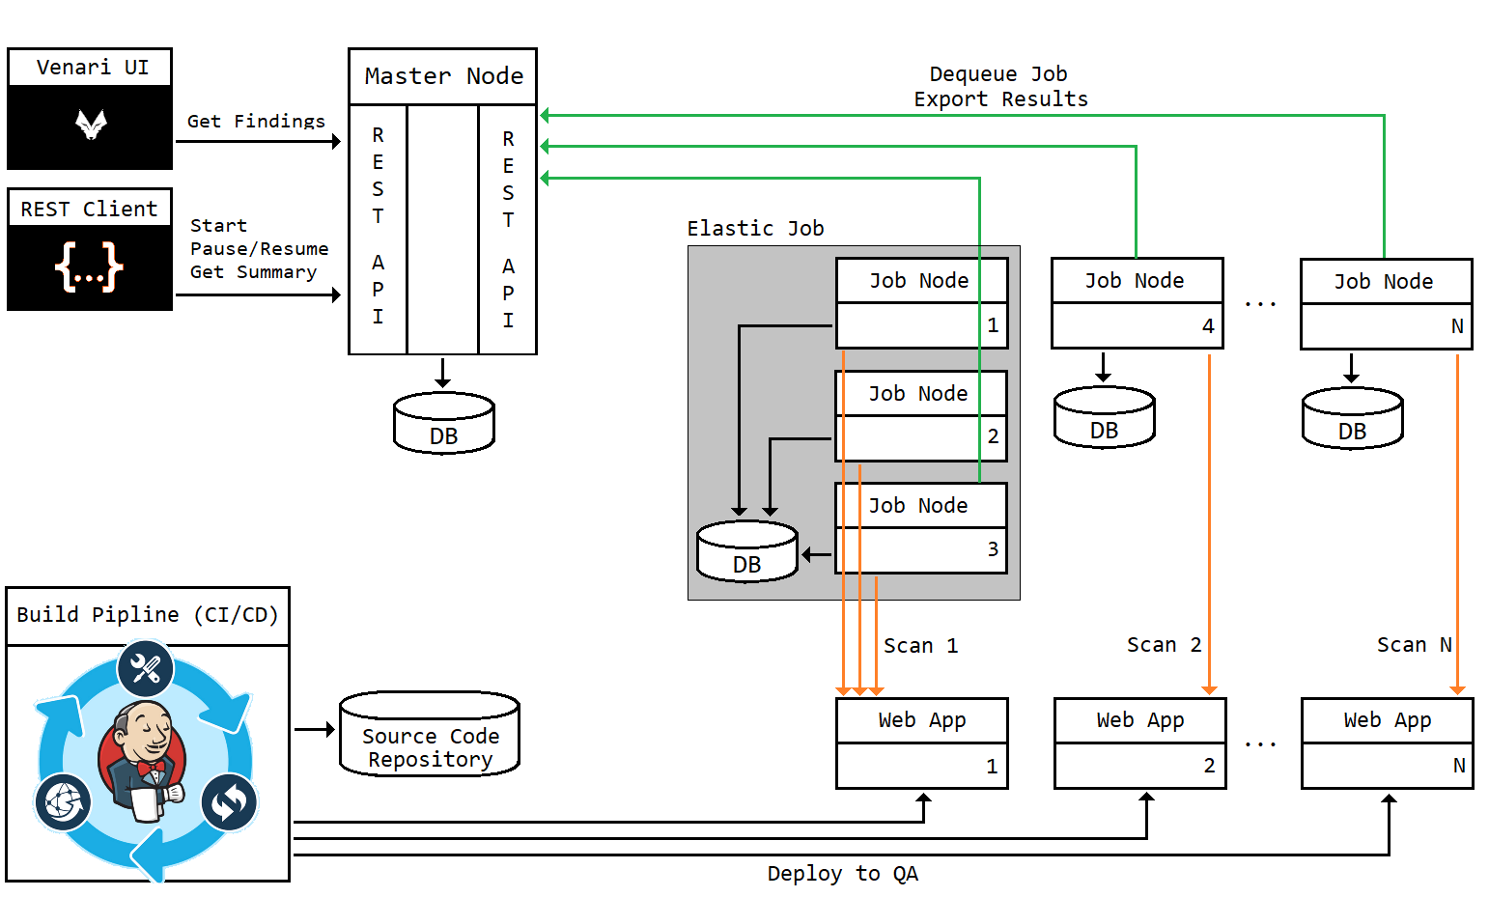
DevSecOps Dynamic Testing Example
SOLUTIONS
Notes:
Step 1: Jenkins pulls source code and builds and deploys the live web applications to containers in the test environment
Step2: Jenkins calls APIs on the Venari master node to create multiple security scanners in containers.
Step3: Venari scans the web applications using modern DAST algorithms to provide security and compliance insights (findings)
Step4: Jenkins pulls security findings data from the Venari master node and stores the data in various defect ticketing systems and/or vulnerability repositories (Code DX, for example)
Step5: Jenkins spins down the Venari containers and proceeds to next steps in DevSecOps loop

Slide 19
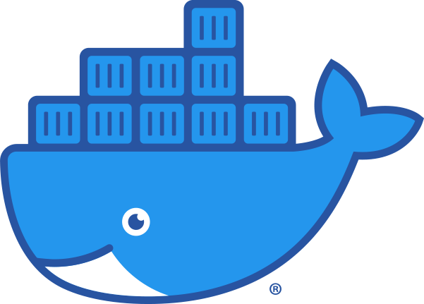

Software Factory Test Architecture
IMPLEMENTATION
Pipeline orchestrator deploys containers and runs tests.
Deploy Venari DAST scanner containers that expose APIs called by orchestrator.
Deploy containerized replica of production web application.
Deploy extra Venari scanners to enable distributed analysis of large applications.
Notes:
Build & Test Pipeline

Slide 20

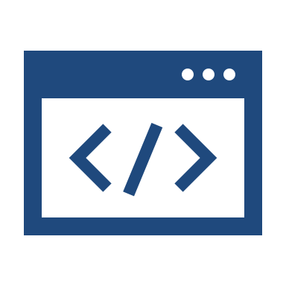



Retrofit Existing Pipelines
IMPLEMENTATION
Existing DevOps pipelines have automated functional tests but lack security tests.
Re-use functional tests by importing them into Venari
(examples: Selenium or POSTMAN).
1
2
3
4
Get started. Configure a small number of web applications for automated security scanning.
Onboard new applications as the team gains expertise.
Notes:
Augment functional tests by importing them into the DAST automation tool. Examples:
Import POSTMAN API tests into Venari and scan APIs for vulnerabilities
Import Selenium web page tests into Venari and scan applications for vulnerabilities
Import HTTP Traffic Captures into Venari and scan applications for vulnerabilities

Slide 21




New Project Pipeline
IMPLEMENTATION
Design the build process to use containers to replicate production deployment with realistic seed data.
Establish requirements using Software Factory Model as basic structure.
Use elastic DAST scan deployments for large applications.
1
2
3
4
5
For contracted projects, make testability & continuous DAST monitoring into formal requirements/deliverables.
Configure the orchestrator to invoke DAST scanning during integration testing.

Slide 22
Automate Compliance Measurement for Security ATO
OUTCOME
Automate the export of security and compliance data for DAST scans.
Automate the mapping of security-relevant findings to corresponding RMF controls.
Automate data artifact collection from coverage and compliance reports to provide evidence for ATO assessments.
Notes:
SA-9, SA-12
SI-10 – Cross; Eyed Script

Slide 23
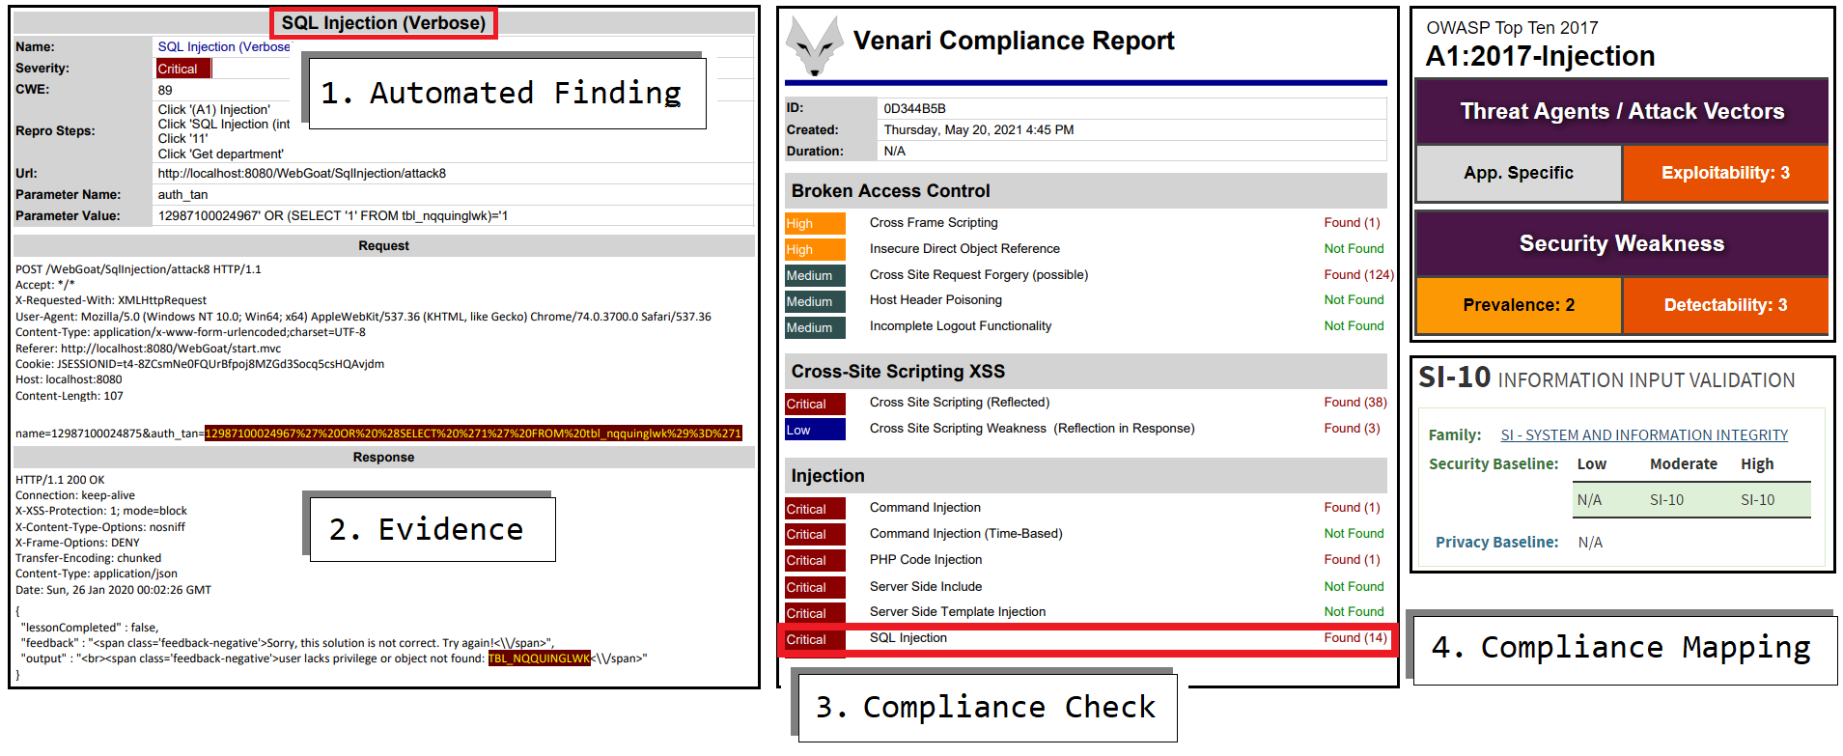
Compliance Mapping Example
OUTCOME
Notes:
ICD 503

Slide 24
Q&A
24

Slide 25
CONTACT US
THANK YOU
STEVE SEIDEN
PRESIDENT
Acquired Data Solutions
steve.seiden@acquiredata.com
www.acquiredata.com
25

